Slide 1
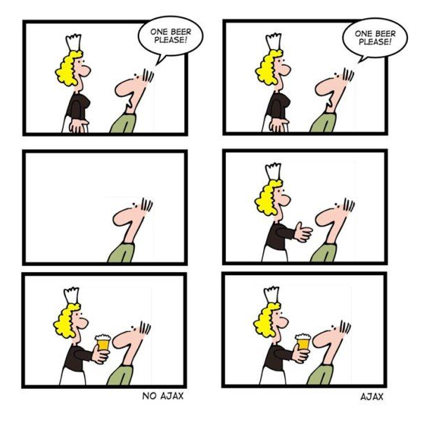
CSE 154
Lecture 11: AJAx

Slide 2
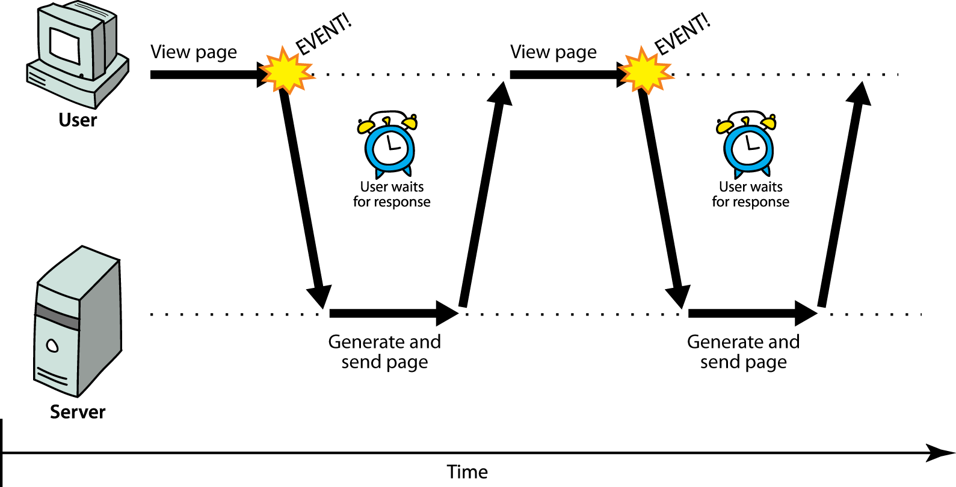
Synchronous web communication
synchronous: user must wait while new pages load
the typical communication pattern used in web pages (click, wait, refresh)

Slide 3
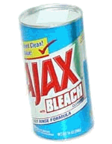
Web applications and Ajax
web application: a dynamic web site that mimics the feel of a desktop app
presents a continuous user experience rather than disjoint pages
examples: Gmail, Google Maps, Google Docs and Spreadsheets, Flickr, A9
Ajax: Asynchronous JavaScript and XML
not a programming language; a particular way of using JavaScript
downloads data from a server in the background
allows dynamically updating a page without making the user wait
avoids the "click-wait-refresh" pattern
examples: UW's CSE 14x Diff Tool, Practice-It; Google Suggest

Slide 4
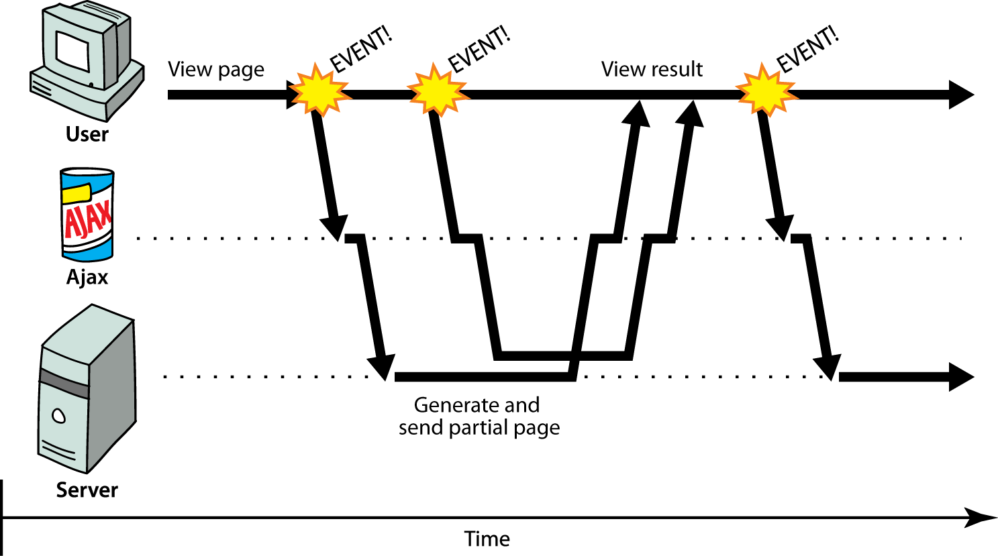
Asynchronous web communication
asynchronous: user can keep interacting with page while data loads

Slide 5
The XMLHttpRequest object
JavaScript includes an XMLHttpRequest object that can fetch files from a web server
supported in IE7+, Safari, Firefox, Opera, Chrome, etc. (all major browsers)
IE5/6 don't have it, but we will ignore this
(technically, MS/IE invented XMLHttpRequest and Ajax for use in an online version of MS Outlook (credit where it's due!)
it can do this asynchronously (in the background, transparent to user)
the contents of the fetched file can be put into current web page using the DOM

Slide 6
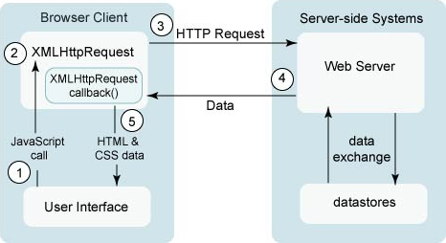
A typical Ajax request
1. user clicks, invoking an event handler
2. handler's code creates an XMLHttpRequest object
3. XMLHttpRequest object requests page from server
4. server retrieves appropriate data, sends it back
5. XMLHttpRequest fires an event when data arrives
this is often called a callback
you can attach a handler function to this event
6. your callback event handler processes the data and displays it

Slide 7
Levels of using XMLHttpRequest
synchronized, text/HTML-only (SJAT?)
asynchronous, text/HTML-only (AJAT?)
asynchronous w/ XML data (Ajax ... seen next lecture)

Slide 8
XMLHttpRequest methods
the core JavaScript object that makes Ajax possible
Method | Description
open(method, url, async) | specifies the URL and HTTP request method
send() send(postData) | sends the HTTP request to the server, with optional POST parameters
abort() | stops the request
getAllResponseHeaders(), getResponseHeader(name), setRequestHeader(name,value) | for getting/setting raw HTTP headers

Slide 9
XMLHttpRequest properties
Property | Description
responseText | the entire text of the fetched page, as a string
responseXML | the entire contents of the fetched page, as an XML document tree (seen later)
status | the request's HTTP status code (200 = OK, etc.)
statusText | HTTP status code text (e.g. "Bad Request" for 400)
timeout | how many MS to wait before giving up and aborting the request (default 0 = wait forever)
readyState | request's current state (0 = not initialized, 1 = set up, 2 = sent, 3 = in progress, 4 = complete)

Slide 10
1. Synchronized requests (bad)
// this code is in some control's event handler
var ajax = new XMLHttpRequest();
ajax.open("GET", url, false);
ajax.send();
do something with ajax.responseText; JS
create the request object, open a connection, send the request
when send returns, the fetched text will be stored in request's responseText property

Slide 11
Why synchronized requests suck
your code waits for the request to completely finish before proceeding
easier for you to program, but ...
the user's entire browser LOCKS UP until the download is completed
a terrible user experience (especially if the page is very large or slow to transfer)
better solution: use an asynchronous request that notifies you when it is complete
this is accomplished by learning about the event properties of XMLHttpRequest

Slide 12
XMLHttpRequest events
Event | Description
load | occurs when the request is completed
error | occurs when the request fails
timeout | occurs when the request times out
abort | occurs when the request is aborted by calling abort()
loadstart, loadend, progress, readystatechange | progress events to track a request in progress

Slide 13
2. Asynchronous requests, basic idea
var ajax = new XMLHttpRequest();
ajax.onload = functionName;
ajax.open("GET", url, true);
ajax.send();
...
function functionName() {
do something with this.responseText;
} JS
attach an event handler to the load event
handler will be called when request state changes, e.g. finishes
function contains code to run when request is complete
inside your handler function, this will refer to the ajax object
you can access its responseText and other properties

Slide 14
What if the request fails?
var ajax = new XMLHttpRequest();
ajax.onload = functionName;
ajax.open("GET", "url", true);
ajax.send();
...
function functionName() {
if (this.status == 200) { // 200 means request succeeded
do something with this.responseText;
} else {
code to handle the error;
}
} JS
web servers return status codes for requests (200 means Success)
you may wish to display a message or take action on a failed request

Slide 15
Handling the error event
var ajax = new XMLHttpRequest();
ajax.onload = functionName;
ajax.onerror = errorFunctionName;
ajax.open("GET", "url", true);
ajax.send();
...
function functionName(e) {
do something with e, this.status, this.statusText, ...
} JS
the graceful way to handle errors is to listen for the error event
the handler is passed the error/exception as a parameter
you can examine the error, as well as the request status, to determine what went wrong

Slide 16
Example Ajax error handler
var ajax = new XMLHttpRequest();
...
ajax.onerror = ajaxFailure;
...
function ajaxFailure(exception) {
alert("Error making Ajax request:" +
"\n\nServer status:\n" + this.status + " " + this.statusText +
"\n\nServer response text:\n" + this.responseText);
if (exception) {
throw exception;
}
} JS
for user's (and developer's) benefit, show an error message if a request fails

Slide 17
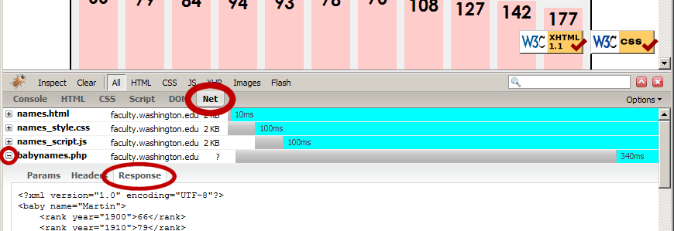
Debugging Ajax code
Firebug Net tab (or Chrome's Network tab) shows each request, parameters, response, errors
expand a request with + and look at Response tab to see Ajax result
check Console tab for any errors that are thrown by requests

Slide 18
Passing query parameters to a request
var ajax = new XMLHttpRequest();
ajax.onload = functionName;
ajax.open("GET", "url?name1=value1&name2=value2&...", true);
ajax.send(); JS
to pass parameters, concatenate them to the URL yourself
you may need to URL-encode the parameters by calling the JS encodeURIComponent(string) function on them
won't work for POST requests (see next slide)

Slide 19
Creating a POST request
var params = new FormData();
params.append("name", value);
params.append("name", value);
var ajax = new XMLHttpRequest();
ajax.onload = functionName;
ajax.open("POST", "url", true);
ajax.send(params); JS
use a FormData object to gather your POST query parameters
pass the FormData to the request's send method
method passed to open should be changed to "POST"

Slide 20
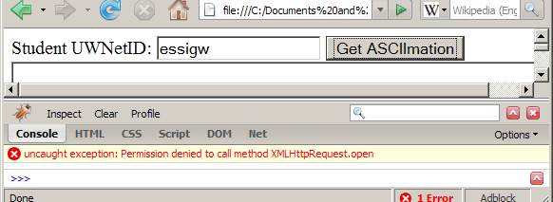
XMLHttpRequest security restrictions
Ajax must be run on a web page stored on a web server
(cannot be run from a web page stored on your hard drive)
Ajax can only fetch files from the same server that the page is on
http://www.foo.com/a/b/c.html can only fetch from http://www.foo.com

