Slide 1
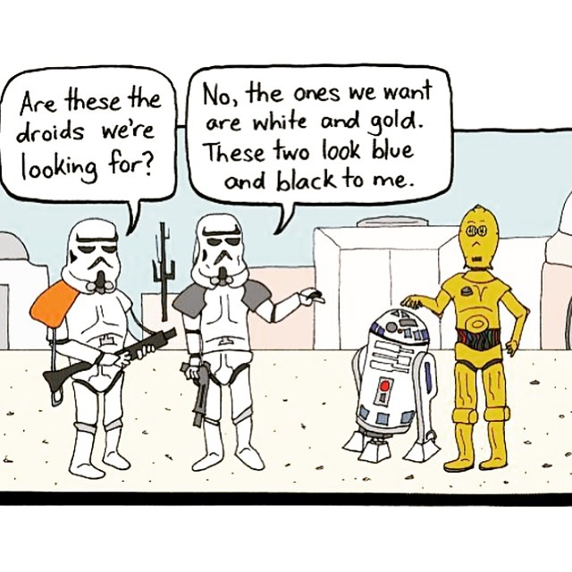
CSE 154
Lecture 7: The Document Object Model (DOM); Unobtrusive JavaScript

Slide 2
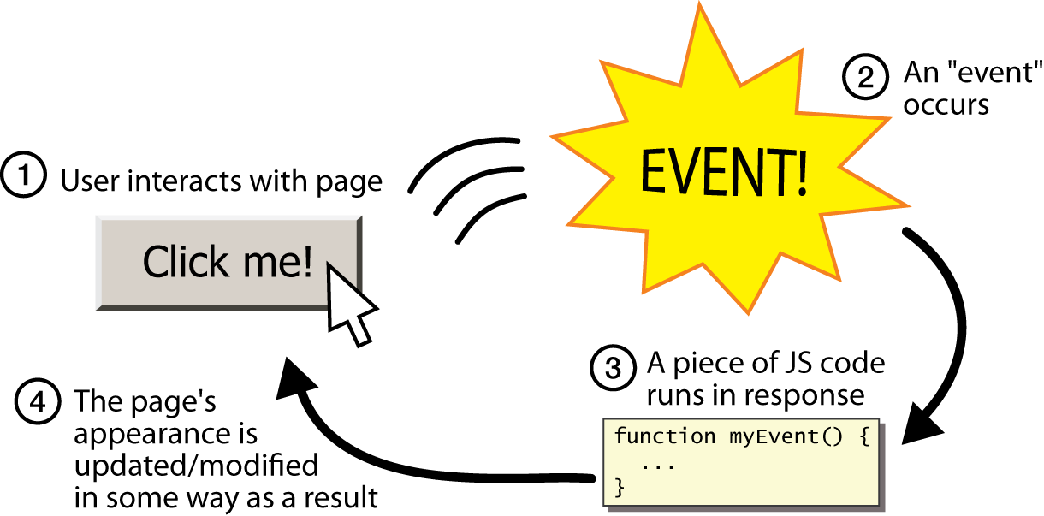
Event-driven programming
JS programs have no main; they respond to user actions called events
event-driven programming: writing programs driven by user events

Slide 3
Event handlers
<element attributes onclick="function();">... HTML
<div onclick="myFunction();">Click me!</div> HTML
Click me! HTML
JavaScript functions can be set as event handlers
when you interact with the element, the function will execute
onclick is just one of many event HTML attributes we'll use

Slide 4
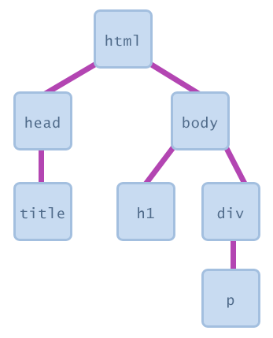
Document Object Model (DOM)
a set of JavaScript objects that represent each element on the page
each tag in a page corresponds to a JavaScript DOM object
JS code can talk to these objects to examine elements' state
e.g. see whether a box is checked
we can change state
e.g. insert some new text into a div
we can change styles
e.g. make a paragraph red

Slide 5
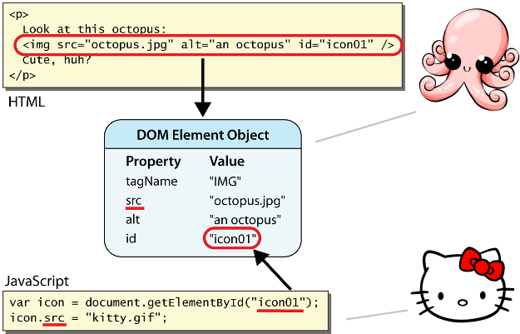
DOM element objects
access/modify the attributes of a DOM object with objectName.attributeName
most DOM object attributes have the same names as the corresponding HTML attribute
img tag's src property
a tag's href property

Slide 6
DOM object properties
<div id="main" class="foo bar">
<p>See our <a href="sale.html" id="saleslink">Sales</a> today!</p>
<img id="icon" src="images/borat.jpg" alt="Borat" />
</div> HTML
var mainDiv = document.getElementById("main");
var icon = document.getElementById("icon");
var theLink = document.getElementById("saleslink"); JS
Property | Description | Example
tagName | element's HTML tag | mainDiv.tagName is "DIV"
className | CSS classes of element | mainDiv.className is "foo bar"
innerHTML | content in element | mainDiv.innerHTML is "\n <p>See our <a hr...
src | URL target of an image | icon.src is "images/borat.jpg"
href | URL target of a link | theLink.href is "sale.html"

Slide 7
Text fields: <input>
<input type="text" size="10" maxlength="8" /> NetID <br />
<input type="password" size="16" /> Password HTML
output
input attributes: disabled, maxlength, readonly, size, value
size attribute controls onscreen width of text field
maxlength limits how many characters user is able to type into field

Slide 8
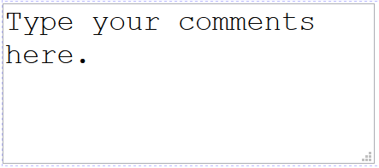
Text boxes: <textarea>
a multi-line text input area (inline)
<textarea rows="4" cols="20">
Type your comments here.
</textarea> HTML
output
initial text is placed inside textarea tag (optional)
required rows and cols attributes specify height/width in characters
optional readonly attribute means text cannot be modified

Slide 9
DOM properties for form controls
<input id="sid" type="text" size="7" maxlength="7" />
<input id="frosh" type="checkbox" checked="checked" /> Freshman?
HTML
var sid = document.getElementById("sid");
var frosh = document.getElementById("frosh"); JS
output
Property | Description | Example
value | the text/value chosen by the user | sid.value could be "1234567"
checked | whether a box is checked | frosh.checked is true
disabled | whether a control is disabled (boolean) | frosh.disabled is false
readOnly | whether a text box is read-only | sid.readOnly is false

Slide 10
Adjusting styles with the DOM
objectName.style.propertyName = "value"; JS
<button onclick="colorIt();">Click me!</button>
<span id="fancytext">Don't forget your homework!</span> HTML
function colorIt() {
var text = document.getElementById("fancytext");
text.style.color = "#ff5500";
text.style.fontSize = "40pt";
} JS
output
Property | Description
style | lets you set any CSS style property for an element
same properties as in CSS, but with camelCasedNames, not names-with-underscores
examples: backgroundColor, borderLeftWidth, fontFamily

Slide 11
Common DOM styling errors
many students forget to write .style when setting styles
var clickMe = document.getElementById("clickme");
clickMe.color = "red";
clickMe.style.color = "red"; JS
style properties are capitalized likeThis, not like-this
clickMe.style.font-size = "14pt";
clickMe.style.fontSize = "14pt"; JS
style properties must be set as strings, often with units at the end
clickMe.style.width = 200;
clickMe.style.width = "200px";
clickMe.style.padding = "0.5em"; JS
write exactly the value you would have written in the CSS, but in quotes

Slide 12
Unobtrusive JavaScript
JavaScript event code seen previously was obtrusive, in the HTML; this is bad style
now we'll see how to write unobtrusive JavaScript code
HTML with no JavaScript code inside the tags
uses the JS DOM to attach and execute all JavaScript event handlers
allows separation of web site into 3 major categories:
content (HTML) - what is it?
presentation (CSS) - how does it look?
behavior (JavaScript) - how does it respond to user interaction?

Slide 13
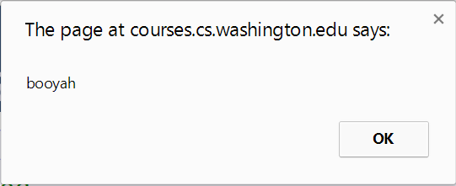
Obtrusive event handlers (bad)
<button onclick="okayClick();">OK</button> HTML
// called when OK button is clicked
function okayClick() {
alert("booyah");
} JS
output
this is bad style (HTML is cluttered with JS code)
goal: remove all JavaScript code from the HTML body

Slide 14
Attaching an event handler in JavaScript code
objectName.onevent = function; JS
<button id="ok">OK</button> HTML
var okButton = document.getElementById("ok");
okButton.onclick = okayClick; JS
it is legal to attach event handlers to elements' DOM objects in your JavaScript code
notice that you do not put parentheses after the function's name
this is better style than attaching them in the HTML

Slide 15
When does my code run?
<html>
<head>
<script src="myfile.js" type="text/javascript"></script>
</head>
<body> ... </body> </html> HTML
var x = 3;
function f(n) { return n + 1; }
function g(n) { return n - 1; }
x = f(x); JS
your file's JS code runs the moment the browser loads the script tag
any variables are declared immediately
any functions are declared but not called, unless your global code explicitly calls them
at this point in time, the browser has not yet read your page's body
none of the DOM objects for tags on the page have been created yet

Slide 16
A failed attempt at being unobtrusive
<html>
<head>
<script src="myfile.js" type="text/javascript"></script>
</head>
<body>
<div><button id="ok">OK</button></div> HTML
var ok = document.getElementById("ok");
ok.onclick = okayClick; // error: null JS
problem: global JS code runs the moment the script is loaded
script in head is processed before page's body has loaded
no elements are available yet or can be accessed yet via the DOM
we need a way to attach the handler after the page has loaded...

Slide 17
The window.onload event
function functionName() {
// code to initialize the page
...
}
// run this function once the page has finished loading
window.onload = functionName;
there is a global event called window.onload event that occurs at the moment the page body is done being loaded
if you attach a function as a handler for window.onload, it will run at that time

Slide 18
An unobtrusive event handler
<button id="ok">OK</button> <!-- (1) --> HTML
// called when page loads; sets up event handlers
function pageLoad() {
var ok = document.getElementById("ok"); // (3)
ok.onclick = okayClick;
}
function okayClick() {
alert("booyah"); // (4)
}
window.onload = pageLoad; // (2) JS
output

Slide 19
Common unobtrusive JS errors
event names are all lowercase, not capitalized like most variables
window.onLoad = pageLoad;
window.onload = pageLoad;
you shouldn't write () when attaching the handler (if you do, it calls the function immediately, rather than setting it up to be called later)
ok.onclick = okayClick();
ok.onclick = okayClick;
our JSLint checker will catch this mistake
related: can't directly call functions like alert; must enclose in your own function
ok.onclick = alert("booyah");
ok.onclick = okayClick;
function okayClick() { alert("booyah"); }

Slide 20
Anonymous functions
function(parameters) {
statements;
} JS
JavaScript allows you to declare anonymous functions
quickly creates a function without giving it a name
can be stored as a variable, attached as an event handler, etc.

Slide 21
Anonymous function example
window.onload = function() {
var ok = document.getElementById("ok");
ok.onclick = okayClick;
};
function okayClick() {
alert("booyah");
} JS
output
or the following is also legal (though harder to read and bad style):
window.onload = function() {
document.getElementById("ok").onclick = function() {
alert("booyah");
};
};

Slide 22
Unobtrusive styling
function okayClick() {
this.style.color = "red";
this.className = "highlighted";
} JS
.highlighted { color: red; } CSS
well-written JavaScript code should contain as little CSS as possible
use JS to set CSS classes/IDs on elements
define the styles of those classes/IDs in your CSS file

Slide 23
The danger of global variables
var count = 0;
function incr(n) {
count += n;
}
function reset() {
count = 0;
}
incr(4);
incr(2);
console.log(count);
JS
globals can be bad; other code and other JS files can see and modify them
How many global symbols are introduced by the above code?
3 global symbols: count, incr, and reset

Slide 24
Enclosing code in a function
function everything() {
var count = 0;
function incr(n) {
count += n;
}
function reset() {
count = 0;
}
incr(4);
incr(2);
console.log(count);
}
everything();
// call the function to run the code
the above example moves all the code into a function; variables and functions declared inside another function are local to it, not global
How many global symbols are introduced by the above code?
1 global symbol: everything (can we get it down to 0?)

Slide 25
The "module pattern"
(function() {
statements;
})(); JS
wraps all of your file's code in an anonymous function that is declared and immediately called
0 global symbols will be introduced!
the variables and functions defined by your code cannot be messed with externally

Slide 26
Module pattern example
(function() {
var count = 0;
function incr(n) {
count += n;
}
function reset() {
count = 0;
}
incr(4);
incr(2);
console.log(count);
})();
JS
How many global symbols are introduced by the above code?
0 global symbols

Slide 27
JavaScript "strict" mode
"use strict";
your code...
writing "use strict"; at the very top of your JS file turns on strict syntax checking:
shows an error if you try to assign to an undeclared variable
stops you from overwriting key JS system libraries
forbids some unsafe or error-prone language features
You should always turn on strict mode for your code in this class!

Slide 28
Checkboxes: <input>
yes/no choices that can be checked and unchecked (inline)
<input type="checkbox" name="lettuce" /> Lettuce
<input type="checkbox" name="tomato" checked="checked" /> Tomato
<input type="checkbox" name="pickles" checked="checked" /> Pickles HTML
output
none, 1, or many checkboxes can be checked at same time
when sent to server, any checked boxes will be sent with value on:
http://webster.cs.washington.edu/params.php?tomato=on&pickles=on
use checked="checked" attribute in HTML to initially check the box

Slide 29
Radio buttons: <input>
sets of mutually exclusive choices (inline)
<input type="radio" name="cc" value="visa" checked="checked" /> Visa
<input type="radio" name="cc" value="mastercard" /> MasterCard
<input type="radio" name="cc" value="amex" /> American Express HTML
output
grouped by name attribute (only one can be checked at a time)
must specify a value for each one or else it will be sent as value on

Slide 30
Text labels: <label>
<label><input type="radio" name="cc" value="visa" checked="checked" /> Visa</label>
<label><input type="radio" name="cc" value="mastercard" /> MasterCard</label>
<label><input type="radio" name="cc" value="amex" /> American Express</label> HTML
output
associates nearby text with control, so you can click text to activate control
can be used with checkboxes or radio buttons
label element can be targeted by CSS style rules

Slide 31
Drop-down list: <select>, <option>
menus of choices that collapse and expand (inline)
<select name="favoritecharacter">
<option>Jerry</option>
<option>George</option>
<option selected="selected">Kramer</option>
<option>Elaine</option>
</select> HTML
output
option element represents each choice
select optional attributes: disabled, multiple, size
optional selected attribute sets which one is initially chosen

Slide 32
Using <select> for lists
<select name="favoritecharacter[]" size="3" multiple="multiple">
<option>Jerry</option>
<option>George</option>
<option>Kramer</option>
<option>Elaine</option>
<option selected="selected">Newman</option>
</select> HTML
output
optional multiple attribute allows selecting multiple items with shift- or ctrl-click
must declare parameter's name with [] if you allow multiple selections
option tags can be set to be initially selected

Slide 33
Option groups: <optgroup>
<select name="favoritecharacter">
<optgroup label="Major Characters">
<option>Jerry</option>
<option>George</option>
<option>Kramer</option>
<option>Elaine</option>
</optgroup>
<optgroup label="Minor Characters">
<option>Newman</option>
<option>Susan</option>
</optgroup>
</select> HTML
output
What should we do if we don't like the bold appearance of the optgroups?

Slide 34
Grouping input: <fieldset>, <legend>
groups of input fields with optional caption (block)
<fieldset>
<legend>Credit cards:</legend>
<input type="radio" name="cc" value="visa" checked="checked" /> Visa
<input type="radio" name="cc" value="mastercard" /> MasterCard
<input type="radio" name="cc" value="amex" /> American Express
</fieldset> HTML
output
fieldset groups related input fields, adds a border; legend supplies a caption

Slide 35
Styling form controls
element[attribute="value"] {
property : value;
property : value;
...
property : value;
} CSS
input[type="text"] {
background-color: yellow;
font-weight: bold;
} CSS
output
attribute selector: matches only elements that have a particular attribute value
useful for controls because many share the same element (input)

Slide 36
More about form controls
<select id="captain">
<option value="kirk">James T. Kirk</option>
<option value="picard">Jean-Luc Picard</option>
<option value="cisco">Benjamin Cisco</option>
</select>
<label> <input id="trekkie" type="checkbox" /> I'm a Trekkie </label> HTML
output
when talking to a text box or select, you usually want its value
when talking to a checkbox or radio button, you probably want to know if it's checked (true/false)

Slide 37
The innerHTML property
<button onclick="addText();">Click me!</button>
<span id="output">Hello </span> HTML
function addText() {
var span = document.getElementById("output");
span.innerHTML += " bro";
} JS
output
can change the text inside most elements by setting the innerHTML property

Slide 38
Abuse of innerHTML
// bad style!
var paragraph = document.getElementById("welcome");
paragraph.innerHTML =
"<p>text and <a href=\"page.html\">link</a>";
JS
innerHTML can inject arbitrary HTML content into the page
however, this is prone to bugs and errors and is considered poor style
we forbid using innerHTML to inject HTML tags; inject plain text only
(later, we'll see a better way to inject content with HTML tags in it)

