Slide 1
CSE 154
Lecture 19: Forms and uploading files

Slide 2
Exercise: Baby name web service JSON
Modify our babynames.php service to produce its output as JSON. For the data:
Morgan m 375 410 392 478 579 507 636 499 446 291 278 332 518
The service should output the following JSON:
{
"name": "Morgan",
"gender": "m",
"rankings": [375, 410, 392, 478, 579, 507, 636, 499, 446, 291, 278, 332, 518]
} JSON

Slide 3
Emitting JSON data manually
...
header("Content-type: application/json");
print "{\n";
print " \"books\": [\n";
foreach ($books as $book) {
print " {\"author\": \"{$book['author']}\", \"title\": \"{$book['title']}\"}\n";
}
print "\n";
specify a content type of application/json
messy, just like when manually printing XML (not recommended)

Slide 4
PHP's JSON functions
PHP includes the following global functions for interacting with JSON data:
json_decode(string) | parses the given JSON data string and returns an equivalent associative array object (like JSON.parse in JavaScript)
json_encode(object) | returns JSON equivalent for the given object or array or value (like JSON.stringify in JavaScript)
json_encode will output associative arrays as objects and normal arrays as arrays

Slide 5
PHP JSON example
<?php
$data = array(
"library" => "Odegaard",
"category" => "fantasy",
"year" => 2012,
"books" => array(
array("title" => "Harry Potter", "author" => "J.K. Rowling"),
array("title" => "The Hobbit", "author" => "J.R.R. Tolkien"),
array("title" => "Game of Thrones", "author" => "George R. R. Martin"),
array("title" => "Dragons of Krynn", "author" => "Margaret Weis"),
)
);
header("Content-type: application/json");
print json_encode($data);
?> PHP

Slide 6
PHP JSON example - output
{
"library": "Odegaard",
"category": "fantasy",
"year": 2012,
"books": [
{"title": "Harry Potter", "author": "J.K. Rowling"},
{"title": "The Hobbit", "author": "J.R.R. Tolkien"},
{"title": "Game of Thrones", "author": "George R. R. Martin"},
{"title": "Dragons of Krynn", "author": "Margaret Weis"},
]
} JSON

Slide 7
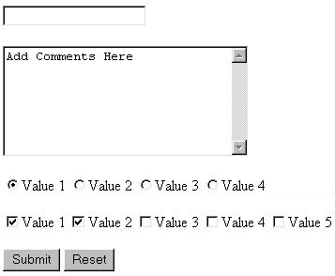
HTML forms
form: a group of UI controls that accepts information from the user and sends the information to a web server
the information is sent to the server as a query string
JavaScript can be used to create interactive controls (seen later)

Slide 8
HTML form: <form>
<form action="destination URL">
form controls
</form> HTML
required action attribute gives the URL of the page that will process this form's data
when form has been filled out and submitted, its data will be sent to the action's URL
one page may contain many forms if so desired

Slide 9
Form example
<form action="http://www.google.com/search">
<div>
Let's search Google:
<input name="q" />
<input type="submit" />
</div>
</form> HTML
Let's search Google: output
must wrap the form's controls in a block element such as div

Slide 10
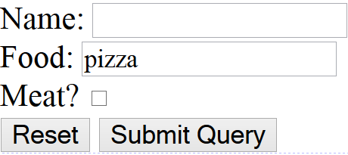
Reset buttons
Name: <input type="text" name="name" /> <br />
Food: <input type="text" name="meal" value="pizza" /> <br />
<label>Meat? <input type="checkbox" name="meat" /></label> <br />
<input type="reset" /> HTML
output
when clicked, returns all form controls to their initial values
specify custom text on the button by setting its value attribute

Slide 11
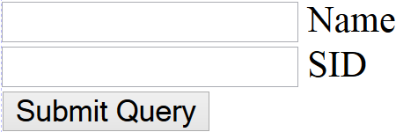
Hidden input parameters
<input type="text" name="username" /> Name <br />
<input type="text" name="sid" /> SID <br />
<input type="hidden" name="school" value="UW" />
<input type="hidden" name="year" value="2048" /> HTML
output
an invisible parameter that is still passed to the server when form is submitted
useful for passing on additional state that isn't modified by the user

Slide 12
HTTP GET vs. POST requests
GET : asks a server for a page or data
if the request has parameters, they are sent in the URL as a query string
POST : submits data to a web server and retrieves the server's response
if the request has parameters, they are embedded in the request's HTTP packet, not the URL
For submitting data to be saved, POST is more appropriate than GET
GET requests embed their parameters in their URLs
URLs are limited in length (~ 1024 characters)
URLs cannot contain special characters without encoding
private data in a URL can be seen or modified by users

Slide 13
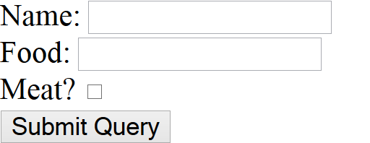
Form POST example
<form action="http://foo.com/app.php" method="post">
<div>
Name: <input type="text" name="name" /> <br />
Food: <input type="text" name="meal" /> <br />
<label>Meat? <input type="checkbox" name="meat" /></label> <br />
<input type="submit" />
<div>
</form> HTML
output

Slide 14
The htmlspecialchars function
htmlspecialchars | returns an HTML-escaped version of a string
text from files / user input / query params might contain <, >, &, etc.
we could manually write code to strip out these characters
better idea: allow them, but escape them
$text = "<p>hi 2 u & me</p>";
$text = htmlspecialchars($text); # "&lt;p&gt;hi 2 u &amp; me&lt;/p&gt;"

Slide 15
GET or POST?
if ($_SERVER["REQUEST_METHOD"] == "GET") {
# process a GET request
...
} elseif ($_SERVER["REQUEST_METHOD"] == "POST") {
# process a POST request
...
} PHP
some PHP pages process both GET and POST requests
to find out which kind of request we are currently processing,
look at the global $_SERVER array's "REQUEST_METHOD" element

Slide 16
A form that submits to itself
<form action="" method="post">
...
</form> HTML
a form can submit its data back to itself by setting the action to be blank (or to the page's own URL)
benefits
fewer pages/files (don't need a separate file for the code to process the form data)
can more easily re-display the form if there are any errors

Slide 17
Processing a self-submitted form
if ($_SERVER["REQUEST_METHOD"] == "GET") {
# normal GET request; display self-submitting form
?>
<form action="" method="post">...</form>
<?php
} elseif ($_SERVER["REQUEST_METHOD"] == "POST") {
# POST request; user is submitting form back to here; process it
$var1 = $_POST["param1"];
...
} PHP
a page with a self-submitting form can process both GET and POST requests
look at the global $_SERVER array to see which request you're handling
handle a GET by showing the form; handle a POST by processing the submitted form data

Slide 18
Uploading files
<form action="http://webster.cs.washington.edu/params.php"
method="post" enctype="multipart/form-data">
Upload an image as your avatar:
<input type="file" name="avatar" />
<input type="submit" />
</form> HTML
output
add a file upload to your form as an input tag with type of file
must also set the enctype attribute of the form

Slide 19
Processing an uploaded file in PHP
uploaded files are placed into global array $_FILES, not $_POST
each element of $_FILES is itself an associative array, containing:
name : the local filename that the user uploaded
type : the MIME type of data that was uploaded, such as image/jpeg
size : file's size in bytes
tmp_name : a filename where PHP has temporarily saved the uploaded file
to permanently store the file, move it from this location into some other file

Slide 20
Uploading details
<input type="file" name="avatar" /> HTML
output
example: if you upload borat.jpg as a parameter named avatar,
$_FILES["avatar"]["name"] will be "borat.jpg"
$_FILES["avatar"]["type"] will be "image/jpeg"
$_FILES["avatar"]["tmp_name"] will be something like "/var/tmp/phpZtR4TI"

Slide 21
Processing uploaded file, example
$username = $_POST["username"];
if (is_uploaded_file($_FILES["avatar"]["tmp_name"])) {
move_uploaded_file($_FILES["avatar"]["tmp_name"], "$username/avatar.jpg");
print "Saved uploaded file as $username/avatar.jpg\n";
} else {
print "Error: required file not uploaded";
} PHP
functions for dealing with uploaded files:
is_uploaded_file(filename)
returns TRUE if the given filename was uploaded by the user
move_uploaded_file(from, to)
moves from a temporary file location to a more permanent file
proper idiom: check is_uploaded_file, then do move_uploaded_file

