Slide 1
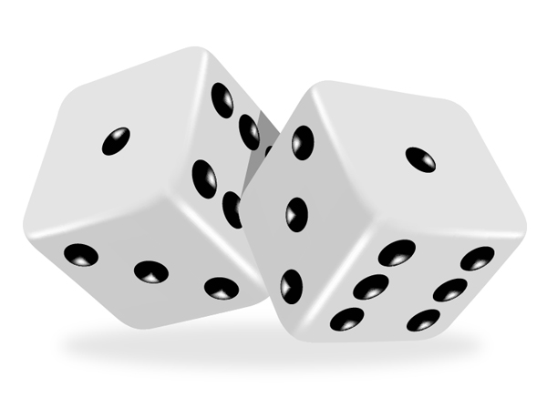
Exercise: Dice roll sum
Write a method diceSum similar to diceRoll, but it also accepts a desired sum and prints only arrangements that add up to exactly that sum.
diceSum(2, 7); diceSum(3, 7);
[1, 6]
[2, 5]
[3, 4]
[4, 3]
[5, 2]
[6, 1]
[1, 1, 5]
[1, 2, 4]
[1, 3, 3]
[1, 4, 2]
[1, 5, 1]
[2, 1, 4]
[2, 2, 3]
[2, 3, 2]
[2, 4, 1]
[3, 1, 3]
[3, 2, 2]
[3, 3, 1]
[4, 1, 2]
[4, 2, 1]
[5, 1, 1]

Slide 2
Consider all paths?
chosen | available | desired sum
- | 3 dice | 5
1 | 2 dice
2 | 2 dice
3 | 2 dice
4 | 2 dice
5 | 2 dice
6 | 2 dice
1, 1 | 1 die
1, 2 | 1 die
1, 3 | 1 die
1, 4 | 1 die
1, 5 | 1 die
1, 6 | 1 die
1, 1, 1
1, 1, 2
1, 1, 3
1, 1, 4
1, 1, 5
1, 1, 6
1, 6, 1
1, 6, 2
...

Slide 3
Optimizations
We need not visit every branch of the decision tree.
Some branches are clearly not going to lead to success.
We can preemptively stop, or prune, these branches.
Inefficiencies in our dice sum algorithm:
Sometimes the current goal is too low.
(Even rolling 1 for all remaining dice would exceed the sum.)
Sometimes the current goal is too high.
(Even rolling 6 for all remaining dice would not reach the sum.)

Slide 4
New decision tree
chosen | available | desired sum
- | 3 dice | 5
1 | 2 dice
2 | 2 dice
3 | 2 dice
4 | 2 dice
5 | 2 dice
6 | 2 dice
1, 1 | 1 die
1, 2 | 1 die
1, 3 | 1 die
1, 4 | 1 die
1, 5 | 1 die
1, 6 | 1 die
1, 1, 1
1, 1, 2
1, 1, 3
1, 1, 4
1, 1, 5
1, 1, 6
1, 6, 1
1, 6, 2
...

Slide 5
The "8 Queens" problem
Consider the problem of trying to place 8 queens on a chess board such that no queen can attack another queen.
What are the "choices"?
How do we "make" or "un-make" a choice?
How do we know when to stop?
Q
 |  |  |  |  | Q
 |  |  |  |  |  |  | Q
 |  | Q
 |  |  |  |  |  | Q
 |  |  | Q
 | Q
 |  |  |  | Q

Slide 6
Naive algorithm
for (each square on board):
Place a queen there.
Try to place the rest of the queens.
Un-place the queen.
How large is the solution space for this algorithm?
64 * 63 * 62 * 61 *
60 * 59 * 58 * 57
 | 1 | 2 | 3 | 4 | 5 | 6 | 7 | 8
1 | Q | ... | ... | ... | ... | ... | ... | ...
2 | ... | ... | ... | ... | ... | ... | ... | ...
3 | ...
4
5
6
7
8

Slide 7
Better algorithm idea
Observation: In a working solution, exactly 1 queen must appear in each row and in each column.
Redefine a "choice" to be valid placement of a queen in a particular column.
How large is the solution space now?
8 * 8 * 8 * 8 *
8 * 8 * 8 * 8
 | 1 | 2 | 3 | 4 | 5 | 6 | 7 | 8
1 | Q | ... | ...
2 |  | ... | ...
3 |  | Q | ...
4 |  |  | ...
5 |  |  | Q
6
7
8

Slide 8
Exercise
Suppose we have a Board class with these methods:
Write a method solve that accepts a Board as a parameter and tries to place 8 queens on it safely.
Your method should find all solutions.
Method/Constructor | Description
public Board(int size) | construct empty board
public int size() | returns the length/width of the board
public boolean safe(int row, int column) | true if queen can be safely placed here
public void place(int row, int column) | place queen here
public void remove(int row, int column) | remove queen from here
public void print() | displays the board

Slide 9
Recall: Backtracking
A general pseudo-code algorithm for backtracking problems:
Explore(choices):
if there are no more choices to make: stop.
else, for each available choice C:
Choose C.
Explore the remaining choices.
Un-choose C, if necessary. (backtrack!)

