Slide 7
CSE 142 vs CSE 143
CSE 142 / AP CS A
CSE 143
You learned how to write programs and decompose large problems with:
Print statements
Methods
Control Structures
loops, if/else
File I/O
Arrays
Objects
Return of the objects
You learned to solve more complex tasks efficiently
Data structures to organize and model data
Algorithms for solving common tasks
More advanced language features
Abstractions are important!

Slide 8
Road Map
CS Concepts
Client/Implementer
Efficiency
Recursion
Regular Expressions
Grammars
Searching / Sorting
Backtracking
Hashing
Huffman Compression
Data Structures
Lists
Stacks
Queues
Sets
Maps
Priority Queues
Java Language
Exceptions
Interfaces
References
Comparable
Generics
Inheritance / Polymorphism
Abstract Classes
Java Collections
Arrays
ArrayList 🛠
LinkedList 🛠
Stack
TreeSet / TreeMap 🛠
HashSet / HashMap 🛠
PriorityQueue

Slide 9
Major themes
Abstraction
Leverage existing components without understanding details
Create components that can be used as black boxes
Problem solving
Decomposing a large problem into smaller ones
Design tradeoffs
Algorithm analysis - scalability and growth
Keeping code easy to read for maintainability
Recursion
Reason about problems in terms of self-similarity
Write very short code to achieve complex behaviors

Slide 10
What project?
Add a GUI to the random sentence generator
Automate chemistry, physics, calculus problems, etc
Maybe even automate writing code with good style?
Find quotes by keyword in books
What are you currently doing that a computer could do?
List of some project ideas

Slide 11
What language?
Expanding your Java knowledge with a project is valuable
Pick a project, see what language is most appropriate
iOS: Swift
Android: Java, Kotlin
Client-side web: Javascript (many frameworks to choose from)
Beautiful visuals: Processing
Data Processing + Machine Learning: Python
Data Management: SQL
Embedded systems: C / C++
Learn a new programming paradigm
Functional languages: Racket, Haskell, Scala, (now, Java 8!)

Slide 12
Leveraging existing code
Processing language
http://nlp.stanford.edu/software/
Building games
http://lwjgl.org/
http://jbox2d.org/ (with physics!)
Processing biological data
http://biojava.org/wiki/Main_Page
Accessing Facebook data
http://restfb.com/
Making music
http://www.jfugue.org/

Slide 13
Courses?
CSE non-majors
CSE 154: Web Programming
CSE 163: Intermediate Data Programming (Python)
CSE 373: Data Structures and Algorithms
CSE 374: Programming Concepts and Tools (C/C++, Linux, ...)
CSE/STAT 416: Machine learning (requires STAT 311 or 390)
CSE 131: Digital Photography
CSE 460: Animation Capstone (open to all majors)
CSE majors
CSE 311: (Mathematical) Foundations of Computing
CSE 332: Data Abstractions (Data Structures and Algorithms)
CSE 331: Software Design and Implementation
CSE 341: Programming Languages
CSE 344: Intro to Data Management (and databases)
CSE 351: Hardware/Software Interface
INFO, AMATH, HCDE, DXARTS, ...

Slide 14
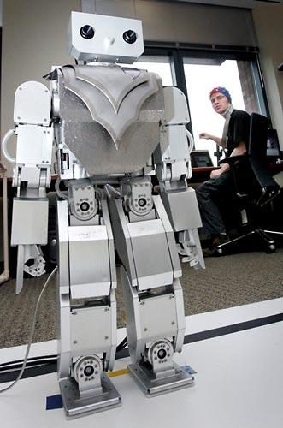
Beyond programming
Mind-controlled robots
http://www.youtube.com/watch?v=TQ7EOpPNQyw
Muscle-controlled interfaces
http://www.youtube.com/watch?v=pktVSTwC8qo
3D models from pictures
http://www.youtube.com/watch?v=25Yifq70elY
Face aging
http://www.youtube.com/watch?v=fLQtssJDMMc
Animation
http://www.youtube.com/watch?v=b4kkPlLdMvI
Security
http://www.pbs.org/wgbh/nova/tech/tadayoshi-kohno.html

Slide 15
Weekly meetings
Change – technologies for low-income regions
http://change.washington.edu/
Dub – human-computer interaction and design
http://dub.washington.edu/

Slide 16
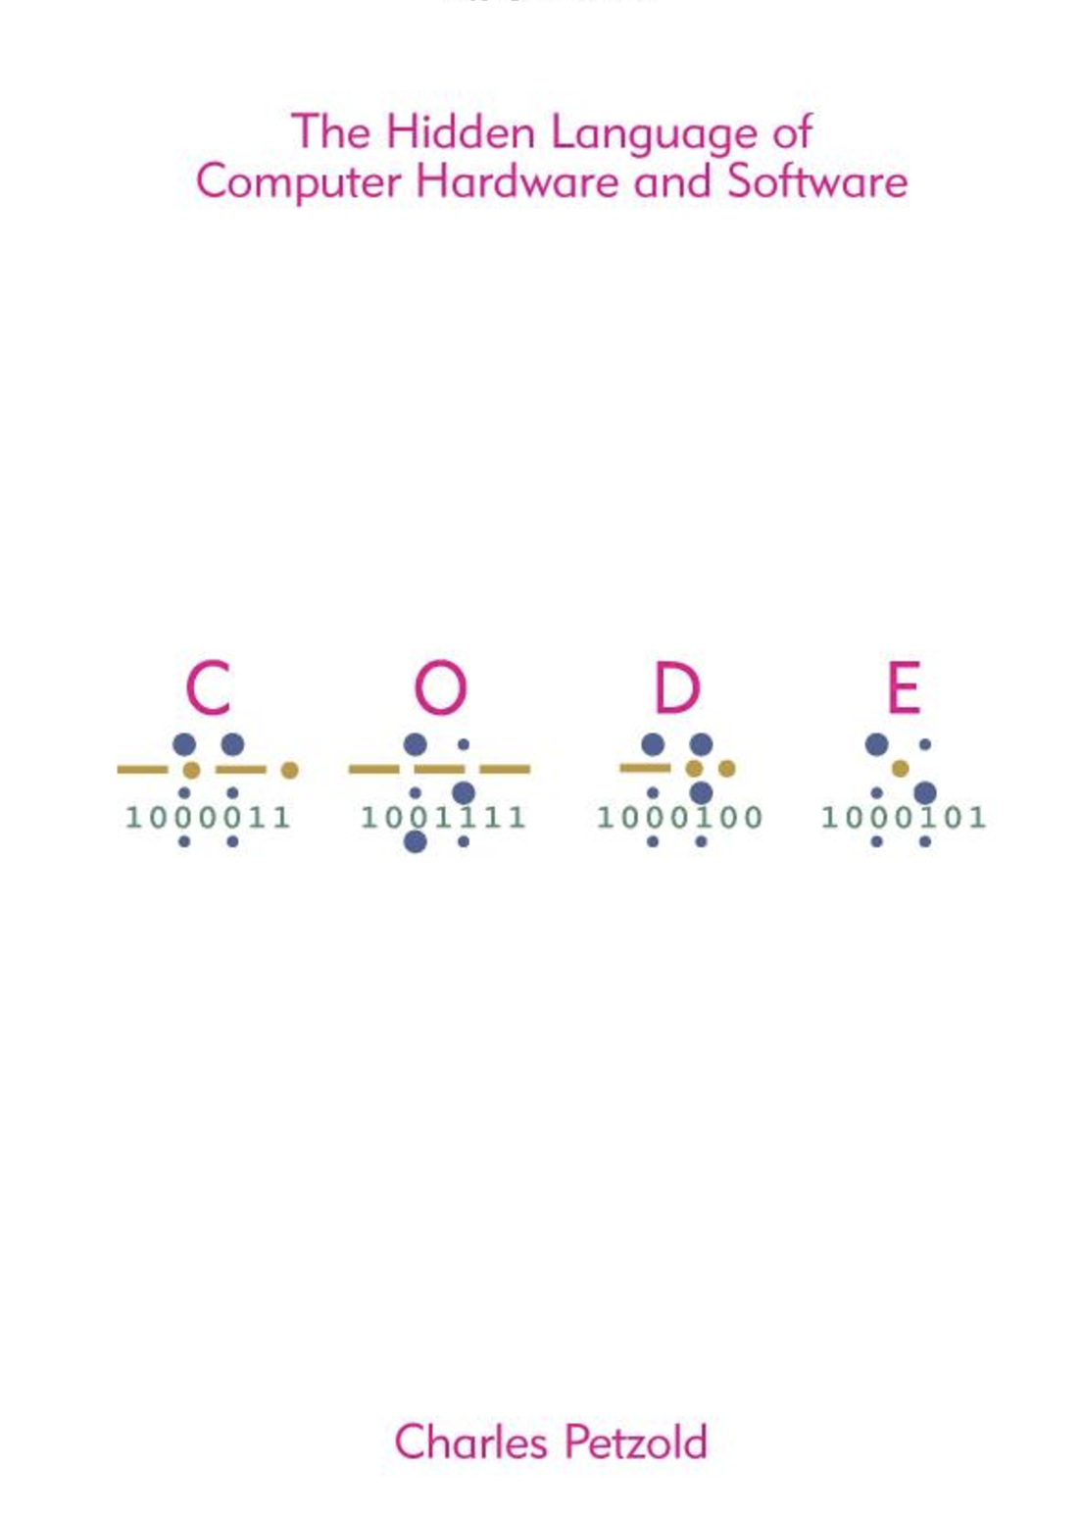
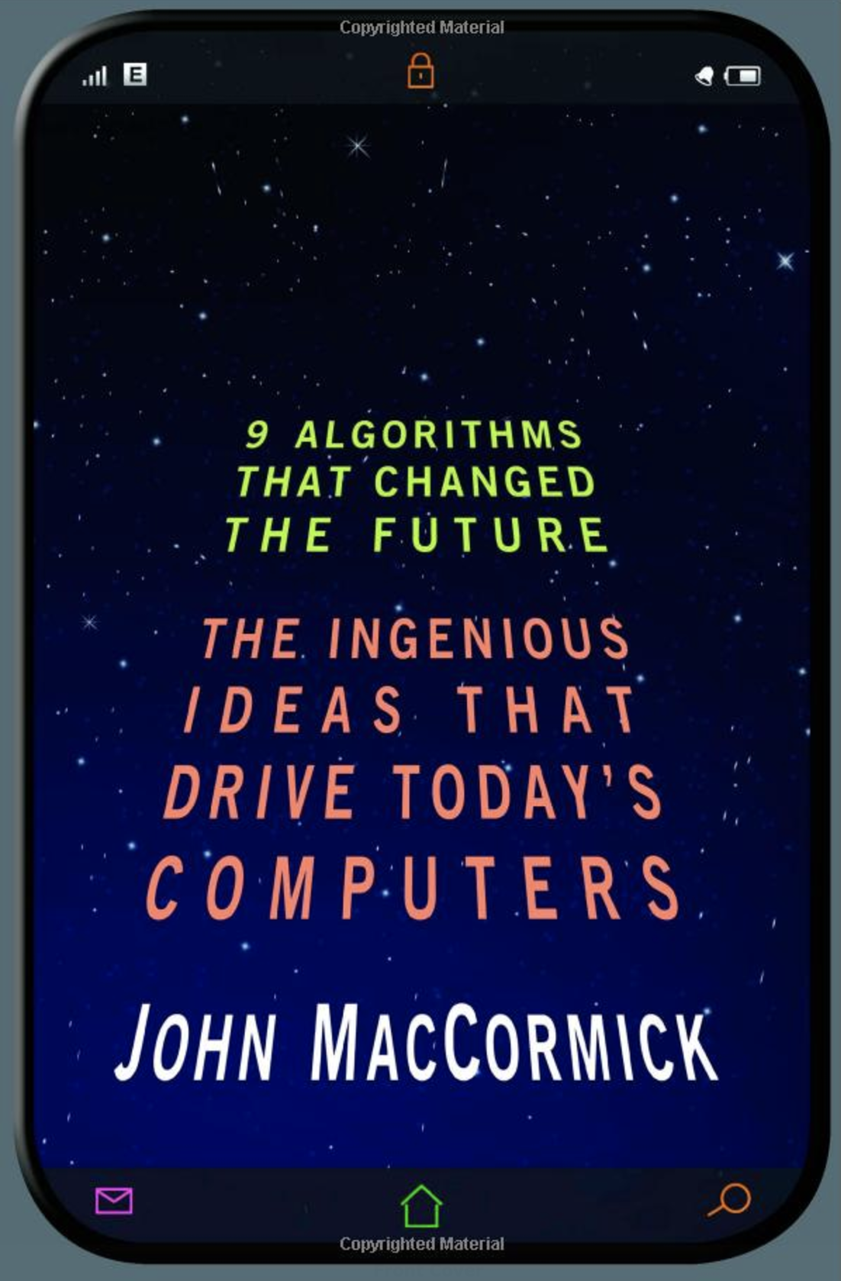
Computer Science Books

Slide 18
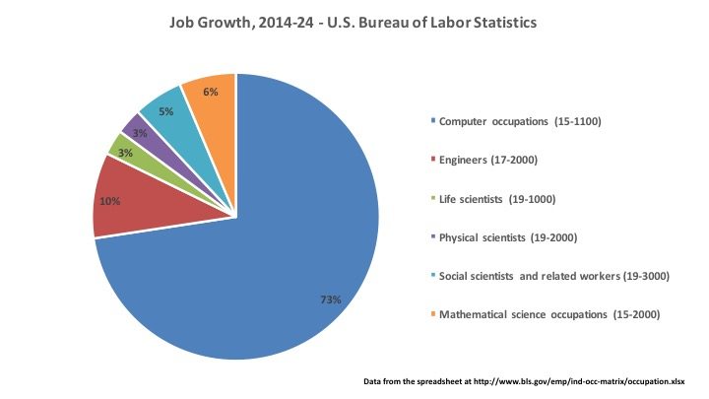
Computing & Jobs

Slide 19
Internships
Various career fairs around campus.
Start looking early!
Cast a broad net and interview lots of places
For those just starting out
Microsoft Explorer Program
Google Engineering Practicum

Slide 20
Roles in Industry
Software Developer/Software Engineer
Builds and designs software
Includes designing and engineering architecture of a software system as well as programming
Product Manager (PM)
Designs and makes decisions regarding the overall product
Works with people across disciplines at the company
Role can be different at different companies
Test/QA
Write and design tests of the product
Site Reliability Engineer (SRE)
Responsible for ensuring that systems and services are available and responsive

Slide 21
Small vs Big Company?
Small Company
Lots of autonomy and impact within the company
Often move quickly
Breadth – get to work on many projects and with many types of people
Large company
Large data sets, impact many users
Lots of support and infrastructure to do your job well
Depth – get to focus on specific areas of a project

Slide 22
What Do I Do?
I’m lecturer in the Paul G Allen Center for Computer Science. My job is to teach and get you all excited about computing!
Topics in CS that interest me:
Data Science
Machine Learning and Data Visualization
Computer Science Education
Introductory programming and introductory data science
Scaling classes to handle increased enrollments

Slide 23
Where Have I worked?
Redfin
Job: Full-stack engineer (worked on frontend and backend)
Languages: Java + Javascript
Socrata (Seattle City Data)
Job: Mostly data science, a little of backend work on search
Machine Learning: Python
Search Backend: Scala + ElasticSearch
Sift Science
Job: Machine learning infrastructure
Language: Java + Python
Libraries: Spark

Slide 24
AMA
(ask me anything)

