Slide 1
The Comparable Interface
reading: 10.2

Slide 2
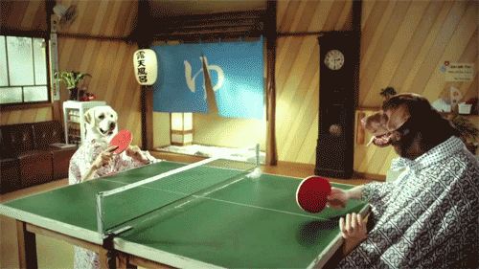

Slide 3
Binary search and objects
Can we binarySearch an array of Strings?
Operators like < and > do not work with String objects.
But we do think of strings as having an alphabetical ordering.
natural ordering: Rules governing the relative placement of all values of a given type.
comparison function: Code that, when given two values A and B of a given type, decides their relative ordering:
A < B, A == B, A > B

Slide 4
Collections class
Method name | Description
binarySearch(list, value) | returns the index of the given value in a sorted list (< 0 if not found)
copy(listTo, listFrom) | copies listFrom's elements to listTo
emptyList(), emptyMap(), emptySet() | returns a read-only collection of the given type that has no elements
fill(list, value) | sets every element in the list to have the given value
max(collection), min(collection) | returns largest/smallest element
replaceAll(list, old, new) | replaces an element value with another
reverse(list) | reverses the order of a list's elements
shuffle(list) | arranges elements into a random order
sort(list) | arranges elements into ascending order

Slide 5
The compareTo method (10.2)
The standard way for a Java class to define a comparison function for its objects is to define a compareTo method.
Example: in the String class, there is a method:
public int compareTo(String other)
A call of A.compareTo(B) will return:
a value < 0 if A comes "before" B in the ordering,
a value > 0 if A comes "after" B in the ordering,
0 if A and B are considered "equal" in the ordering.

Slide 6
Using compareTo
compareTo can be used as a test in an if statement.
String a = "alice";
String b = "bob";
if (a.compareTo(b) < 0) { // true
...
}
Primitives | Objects
if (a < b) { ... | if (a.compareTo(b) < 0) { ...
if (a <= b) { ... | if (a.compareTo(b) <= 0) { ...
if (a == b) { ... | if (a.compareTo(b) == 0) { ...
if (a != b) { ... | if (a.compareTo(b) != 0) { ...
if (a >= b) { ... | if (a.compareTo(b) >= 0) { ...
if (a > b) { ... | if (a.compareTo(b) > 0) { ...

Slide 7
Binary search w/ strings
// Returns the index of an occurrence of target in a,
// or a negative number if the target is not found.
// Precondition: elements of a are in sorted order
public static int binarySearch(String[] a, int target) {
int min = 0;
int max = a.length - 1;
while (min <= max) {
int mid = (min + max) / 2;
if (a[mid].compareTo(target) < 0) {
min = mid + 1;
} else if (a[mid].compareTo(target) > 0) {
max = mid - 1;
} else {
return mid; // target found
}
}
return -(min + 1); // target not found
}

Slide 8
compareTo and collections
You can use an array or list of strings with Java's included binary search method because it calls compareTo internally.
String[] a = {"al", "bob", "cari", "dan", "mike"};
int index = Arrays.binarySearch(a, "dan"); // 3
Java's TreeSet/Map use compareTo internally for ordering.
Set<String> set = new TreeSet<String>();
for (String s : a) {
set.add(s);
}
System.out.println(s);
// [al, bob, cari, dan, mike]

Slide 9
Ordering our own types
We cannot binary search or make a TreeSet/Map of arbitrary types, because Java doesn't know how to order the elements.
The program compiles but crashes when we run it.
Set<HtmlTag> tags = new TreeSet<HtmlTag>();
tags.add(new HtmlTag("body", true));
tags.add(new HtmlTag("b", false));
...
Exception in thread "main" java.lang.ClassCastException
at java.util.TreeSet.add(TreeSet.java:238)

Slide 10
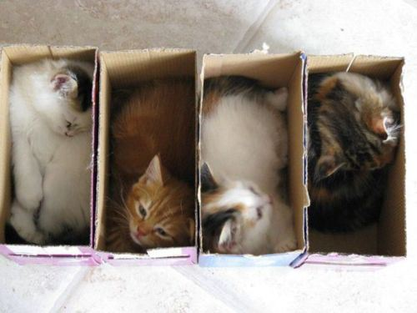

Slide 11
Interfaces (9.5)
interface: A list of methods that a class can promise to implement.
Inheritance gives you an is-a relationship and code sharing.
A Lawyer can be treated as an Employee and inherits its code.
Interfaces give you an is-a relationship without code sharing.
A Rectangle object can be treated as a Shape but inherits no code.
Analogous to non-programming idea of roles or certifications:
"I'm certified as a CPA accountant. This assures you I know how to do taxes, audits, and consulting."
"I'm 'certified' as a Shape, because I implement the Shape interface. This assures you I know how to compute my area and perimeter."

Slide 12
Comparable (10.2)
public interface Comparable<E> {
public int compareTo(E other);
}
A class can implement the Comparable interface to define a natural ordering function for its objects.
A call to your compareTo method should return:
a value < 0 if the this object comes "before" other one,
a value > 0 if the this object comes "after" other one,
0 if the this object is considered "equal" to other.

Slide 13
pollev.com/cse143
Cat cat1 = new Cat("Clawdia", 6, 3.6); Cat cat2 = new Cat("Shakespurr", 2, 1.4); Cat cat3 = new Cat("Grumpy", 6, 3.8);
List<Cat> cats = Arrays.asList(cat1, cat2, cat3);
Collections.sort(cats);
What is the order of the list after we sort?
[cat1, cat2, cat3]
[cat1, cat3, cat2]
[cat2, cat1, cat3]
[cat2, cat3, cat1]
[cat3, cat1, cat2]
[cat3, cat2, cat1]
// first sort on lives in ascending order
// then sort on cuteness in descending order public int compareTo(Cat other) { if (other.lives != this.lives) { return this.lives - other.lives; } else { return (int) (other.cuteness - this.cuteness); }
}

Slide 14
Comparable template
public class name implements Comparable<name> {
...
public int compareTo(name other) {
...
}
}

Slide 15
Comparable example
public class Point implements Comparable<Point> {
private int x;
private int y;
...
// sort by x and break ties by y
public int compareTo(Point other) {
if (x < other.x) {
return -1;
} else if (x > other.x) {
return 1;
} else if (y < other.y) {
return -1; // same x, smaller y
} else if (y > other.y) {
return 1; // same x, larger y
} else {
return 0; // same x and same y
}
}
}

Slide 16
compareTo tricks
subtraction trick - Subtracting related numeric values produces the right result for what you want compareTo to return:
// sort by x and break ties by y
public int compareTo(Point other) {
if (x != other.x) {
return x - other.x; // different x
} else {
return y - other.y; // same x; compare y
}
}
The idea:
if x > other.x, then x - other.x > 0
if x < other.x, then x - other.x < 0
if x == other.x, then x - other.x == 0
NOTE: This trick doesn't work for doubles (but see Math.signum)

Slide 17
compareTo tricks 2
delegation trick - If your object's fields are comparable (such as strings), use their compareTo results to help you:
// sort by employee name, e.g. "Jim" < "Susan"
public int compareTo(Employee other) {
return name.compareTo(other.getName());
}
toString trick - If your object's toString representation is related to the ordering, use that to help you:
// sort by date, e.g. "09/19" > "04/01"
public int compareTo(Date other) {
return toString().compareTo(other.toString());
}

Slide 18
Exercises
Make the HtmlTag class from HTML Validator comparable.
Compare tags by their elements, alphabetically by name.
For the same element, opening tags come before closing tags.
// <body><b></b><i><b></b><br/></i></body>
Set<HtmlTag> tags = new TreeSet<HtmlTag>();
tags.add(new HtmlTag("body", true)); // <body>
tags.add(new HtmlTag("b", true)); // <b>
tags.add(new HtmlTag("b", false)); // </b>
tags.add(new HtmlTag("i", true)); // <i>
tags.add(new HtmlTag("b", true)); // <b>
tags.add(new HtmlTag("b", false)); // </b>
tags.add(new HtmlTag("br")); // <br />
tags.add(new HtmlTag("i", false)); // </i>
tags.add(new HtmlTag("body", false)); // </body>
System.out.println(tags);
// [<b>, </b>, <body>, </body>, <br />, <i>, </i>]

Slide 19
Exercise solution
public class HtmlTag implements Comparable<HtmlTag> {
...
// Compares tags by their element ("body" before "head"),
// breaking ties with opening tags before closing tags.
// Returns < 0 for less, 0 for equal, > 0 for greater.
public int compareTo(HtmlTag other) {
int compare = element.compareTo(other.getElement());
if (compare != 0) {
// different tags; use String's compareTo result
return compare;
} else {
// same tag
if ((isOpenTag == other.isOpenTag()) {
return 0; // exactly the same kind of tag
} else if (other.isOpenTag()) {
return 1; // he=open, I=close; I am after
} else {
return -1; // I=open, he=close; I am before
}
}
}
}

