Slide 1
Building Java Programs
Chapter 9
Inheritance and Polymorphism
reading: 9.1 - 9.2

Slide 2
Before class starts
Interactive Activities
Go to pollev.com/cse143 on your phone
Type in your UW email
Don’t create account / type in password
Click link for single sign-on
Sign in using your UW credentials
Answer the question!

Slide 3
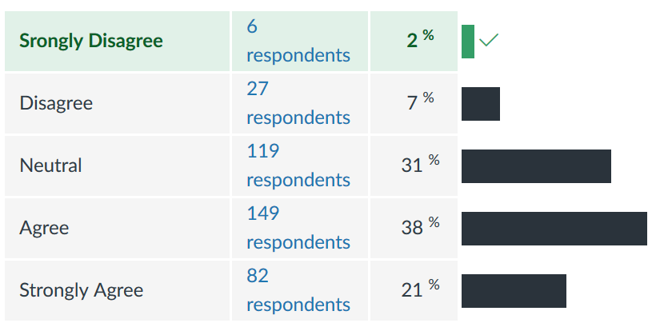
“Being given time to talk to my peers and TAs in lecture helps clarify concepts I might have been confused abotu.”
“In general, I am attentive with what’s going on during lecture.”
“I feel comfortable asking questions in lecture.”

Slide 4
Asking Questions
Asking questions is crucial to your learning
Goal: Make a classroom environment that welcomes (and encourages) asking questions
Sometimes it can be a bit hard to ask questions in a 500 person lecture
Some alternatives
Index cards (once a week)
While TAs are walking around
Have a TA ask a question for you
pollev.com/cse143questions

Slide 5
Recall: Inheritance
inheritance: Forming new classes based on existing ones.
a way to share/reuse code between two or more classes
superclass: Parent class being extended.
subclass: Child class that inherits behavior from superclass.
gets a copy of every field and method from superclass
is-a relationship: Each object of the subclass also "is a(n)" object of the superclass and can be treated as one.
Employee
Yellow Form
Lawyer
Yellow Form
Engineer
Yellow Form
Sales Rep.
Purple Form
Software Eng.
Green Form

Slide 6
Recall: Inheritance
public class A {
public void m1() {
S.o.pln(“A1”);
}
public void m2() {
S.o.pln(“A2”);
}
}
public class B extends A {
public void m2() {
super.method1();
S.o.pln(“B2”);
}
}
A a = new A();
B b = new B();
b.m1();
a.m2();
b.m2();
 | m1 | m2
A
B

Slide 7
public class A {
public void m1() {
S.o.pln(“A1”);
}
public void m2() {
S.o.pln(“A2”);
}
public void m3() {
S.o.pln(“A3”);
}
}
public class B extends A {
public void m2() {
S.o.pln(“B2”);
}
}
public class C extends B {
public void m1() {
S.o.pln(“C1”);
}
public void m3() {
super.m1();
S.o.pln(“C3”);
}
}
C c = new C();
c.m3();
What is the output?
A1 / C3
B1 / C3
C1 / C3
C3
Some kind of error

Slide 8
Why cover this again?
New Topics
Polymorphism when calling other methods
Investigating Java’s type system
What happens when you using casting with objects?
What is and isn’t possible for the compiler to check?
Motivation: We’ve been hand-waving what it means to say
List<Integer> list = new ArrayList<Integer>();
list.add(1);
Why allow different types on the left side vs. right side?
PromiseType variable = new ActualType();
PromiseType can be a superclass that ActualType extends or an interface that ActualType implements
Restricts usage of the instance of ActualType to only PromiseType methods. Why is this useful?

Slide 9
Example: Music Players

Slide 10
MusicPlayer p = new Zune();
((iPhone) p2).record();
What does this line do?
Call record on Zune
Call record on MusicPlayer
Call record on iPhone
Compiler Error
Runtime Error

Slide 11
public class MusicPlayer {
public void m1() {
S.o.pln(“MusicPlayer1”);
}
}
public class TapeDeck
extends MusicPlayer {
public void m3() {
S.o.pln(“TapeDeck3”);
}
}
public class IPod
extends MusicPlayer {
public void m2() {
S.o.pln(“IPod2”);
m1();
}
}
public class IPhone
extends IPod {
public void m1() {
S.o.pln(“IPhone1”);
super.m1();
}
public void m3() {
S.o.pln(“IPhone3”);
}
}
 | m1 | m2 | m3
MusicPlayer
TapeDeck
IPod
IPhone

Slide 12
MusicPlayer var1 = new TapeDeck();
MusicPlayer var2 = new IPod();
MusicPlayer var3 = new IPhone();
IPod var4 = new IPhone();
Object var5 = new IPod();
Object var6 = new MusicPlayer();
var1.m1();
MusicPlayer1
var3.m1();
IPhone1 / MusicPlayer1
var4.m2();
IPod2 / IPhone1 / MusicPlayer1
var3.m2();
Compiler Error (CE)
var5.m1();
Compiler Error (CE)
 | m1 | m2 | m3
MusicPlayer | MP1 | ∕ | ∕
TapeDeck | MP1 | ∕ | TD3
IPod | MP1 | IPod2 m1() | ∕
IPhone | IPhone1 MP1 | IPod2 m1() | IPhone3

Slide 13
MusicPlayer var1 = new TapeDeck();
MusicPlayer var2 = new IPod();
MusicPlayer var3 = new IPhone();
IPod var4 = new IPhone();
Object var5 = new IPod();
Object var6 = new MusicPlayer();
((TapeDeck) var1).m2();
Compiler Error (CE)
((IPod) var3).m2();
IPod2 / IPhone1 / MusicPlayer1
((IPhone) var2).m1();
Runtime Error (RE)
((TapeDeck) var3).m2();
Compiler Error (CE)
 | m1 | m2 | m3
MusicPlayer | MP1 | ∕ | ∕
TapeDeck | MP1 | ∕ | TD3
IPod | MP1 | IPod2 m1() | ∕
IPhone | IPhone1 MP1 | IPod2 m1() | IPhone3

Slide 14
General Rule
PromiseType var = new ActualType();
var.method() or ((CastType) var).method();
Compile Time
if (involves casting) {
check if CastType has method, if not fail with CE
} else {
check if PromiseType has method, if not fail with CE
}
RunTime (if compiles)
if (involves casting) {
check if ActualType can actually be cast to CastType,
if not fail with RE
}
call method on ActualType

