Slide 1
Building Java Programs
Chapter 13
binary search and complexity
reading: 13.1-13.2

Slide 3
Road Map
CS Concepts
Client/Implementer
Efficiency
Recursion
Regular Expressions
Grammars
Sorting
Backtracking
Hashing
Huffman Compression
Data Structures
Lists
Stacks
Queues
Sets
Maps
Priority Queues
Java Language
Exceptions
Interfaces
References
Comparable
Generics
Inheritance/Polymorphism
Abstract Classes
Java Collections
Arrays
ArrayList 🛠
LinkedList 🛠
Stack
TreeSet / TreeMap
HashSet / HashMap
PriorityQueue

Slide 4
Sum this up for me
Let’s write a method to calculate the sum from 1 to some n
public static int sum1(int n) {
int sum = 0;
for (int i = 1; i <= n; i++) {
sum += i;
}
return sum;
}
Gauss also has a way of solving this
public static int sum2(int n) {
return n * (n + 1) / 2;
}
Which one is more efficient?

Slide 5
Runtime Efficiency (13.2)
efficiency: measure of computing resources used by code.
can be relative to speed (time), memory (space), etc.
most commonly refers to run time
We want to be able to compare different algorithms to see which is more efficient

Slide 6
Efficiency Try 1
Let’s time the methods!
n = 1 sum1 took 0ms, sum2 took 0ms
n = 5 sum1 took 0ms, sum2 took 0ms
n = 10 sum1 took 0ms, sum2 took 0ms
n = 100 sum1 took 0ms, sum2 took 0ms
n = 1,000 sum1 took 0ms, sum2 took 0ms
n = 10,000,000 sum1 took 10ms, sum2 took 0ms
n = 100,000,000 sum1 took 47ms, sum2 took 0ms
n = 2,147,483,647 sum1 took 784ms, sum2 took 0ms
Let’s time the methods!
n = 1 sum1 took 0ms, sum2 took 0ms
n = 5 sum1 took 0ms, sum2 took 0ms
n = 10 sum1 took 0ms, sum2 took 0ms
n = 100 sum1 took 0ms, sum2 took 0ms
n = 1,000 sum1 took 1ms, sum2 took 0ms
n = 10,000,000 sum1 took 8ms, sum2 took 0ms
n = 100,000,000 sum1 took 43ms, sum2 took 0ms
n = 2,147,483,647 sum1 took 804ms, sum2 took 0ms
Let’s time the methods!
n = 1 sum1 took 0ms, sum2 took 0ms
n = 5 sum1 took 0ms, sum2 took 0ms
n = 10 sum1 took 0ms, sum2 took 0ms
n = 100 sum1 took 0ms, sum2 took 0ms
n = 1,000 sum1 took 1ms, sum2 took 0ms
n = 10,000,000 sum1 took 3ms, sum2 took 0ms
n = 100,000,000 sum1 took 121ms, sum2 took 0ms
n = 2,147,483,647 sum1 took1570ms, sum2 took 0ms
Downsides
Different computers give different run times
The same computer gives different results!!! D:<

Slide 7
Efficiency – Try 2
Count number of “simple steps” our algorithm takes to run
Assume the following:
Any single Java statement takes same amount of time to run.
int x = 5;
boolean b = (5 + 1 * 2) < 15 + 3;
System.out.println(“Hello”);
A loop's runtime, if the loop repeats N times, is N times the runtime of the statements in its body.
A method call's runtime is measured by the total runtime of the statements inside the method's body.

Slide 8
Efficiency examples
public static void method1() {
statement1;
statement2;
statement3;
for (int i = 1; i <= N; i++) {
statement4;
}
for (int i = 1; i <= N; i++) {
statement5;
statement6;
statement7;
}
}
3
N
4N + 3
3N

Slide 9
Efficiency examples 2
public static void method2() {
for (int i = 1; i <= N; i++) {
for (int j = 1; j <= N; j++) {
statement1;
}
}
for (int i = 1; i <= N; i++) {
statement2;
statement3;
statement4;
statement5;
}
}
How many statements will execute if N = 10? If N = 1000?
N²
N² + 4N
4N

Slide 10
Sum this up for me
Let’s write a method to calculate the sum from 1 to some n
public static int sum1(int n) {
int sum = 0;
for (int i = 1; i <= n; i++) {
sum += i;
}
return sum;
}
Gauss also has a way of solving this
public static int sum2(int n) {
return n * (n + 1) / 2;
}
Which one is more efficient?
1
N
N + 2
1
1
1

Slide 11
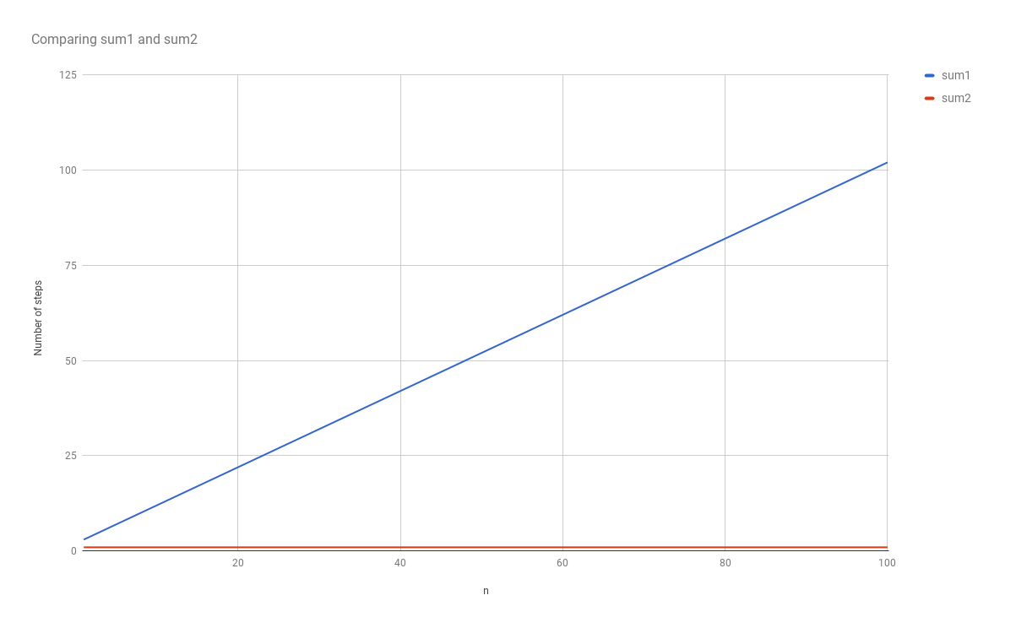
Visualizing Difference

Slide 12
Algorithm growth rates (13.2)
We measure runtime in proportion to the input data size, N.
growth rate: Change in runtime as N changes.
Say an algorithm runs 0.4N³ + 25N² + 8N + 17 statements.
Consider the runtime when N is extremely large .
We ignore constants like 25 because they are tiny next to N.
The highest-order term (N³) dominates the overall runtime.
We say that this algorithm runs "on the order of" N³.
or O(N³) for short ("Big-Oh of N cubed")

Slide 13
Complexity classes
complexity class: A category of algorithm efficiency based on the algorithm's relationship to the input size N.
Class | Big-Oh | If you double N, ... | Example
constant | O(1) | unchanged | 10ms
logarithmic | O(log₂ N) | increases slightly | 175ms
linear | O(N) | doubles | 3.2 sec
log-linear | O(N log₂ N) | slightly more than doubles | 6 sec
quadratic | O(N²) | quadruples | 1 min 42 sec
cubic | O(N³) | multiplies by 8 | 55 min
... | ... | ... | ...
exponential | O(2^{N}) | multiplies drastically | 5 * 10⁶¹ years

Slide 14
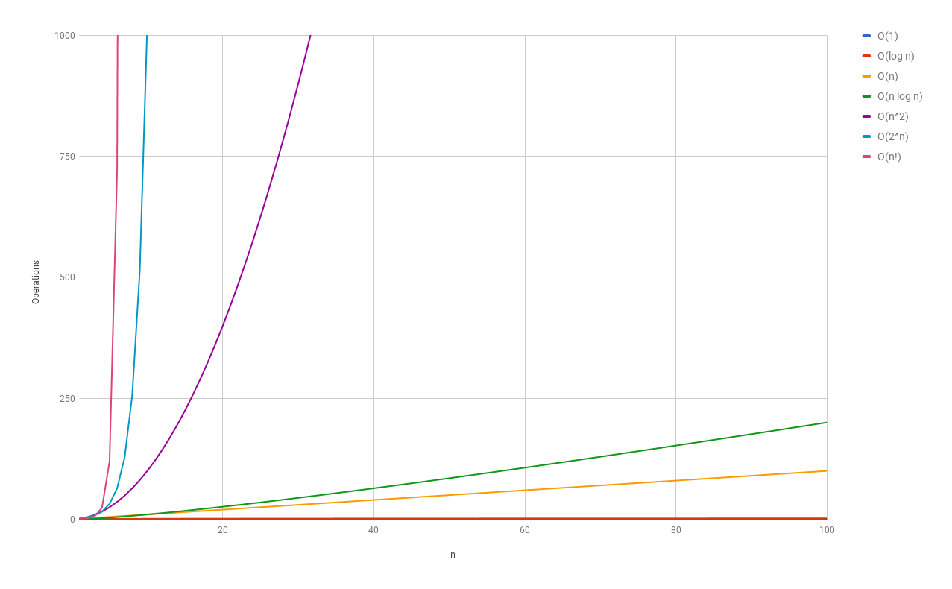
Complexity classes
http://recursive-design.com/blog/2010/12/07/comp-sci-101-big-o-notation/ - post about a Google interview

Slide 15
Range algorithm
What complexity class is this algorithm? Can it be improved?
// returns the range of values in the given array;
// the difference between elements furthest apart
// example: range({17, 29, 11, 4, 20, 8}) is 25
public static int range(int[] numbers) {
int maxDiff = 0; // look at each pair of values
for (int i = 0; i < numbers.length; i++) {
for (int j = 0; j < numbers.length; j++) {
int diff = Math.abs(numbers[j] – numbers[i]);
if (diff > maxDiff) {
maxDiff = diff;
}
}
}
return diff;
}

Slide 16
Range algorithm
What complexity class is this algorithm? Can it be improved?
// returns the range of values in the given array;
// the difference between elements furthest apart
// example: range({17, 29, 11, 4, 20, 8}) is 25
public static int range(int[] numbers) {
int maxDiff = 0; // look at each pair of values
for (int i = 0; i < numbers.length; i++) {
for (int j = 0; j < numbers.length; j++) {
int diff = Math.abs(numbers[j] – numbers[i]);
if (diff > maxDiff) {
maxDiff = diff;
}
}
}
return diff;
}

Slide 17
Range algorithm 2
The last algorithm is O(N²). A slightly better version:
// returns the range of values in the given array;
// the difference between elements furthest apart
// example: range({17, 29, 11, 4, 20, 8}) is 25
public static int range(int[] numbers) {
int maxDiff = 0; // look at each pair of values
for (int i = 0; i < numbers.length; i++) {
for (int j = i + 1; j < numbers.length; j++) {
int diff = Math.abs(numbers[j] – numbers[i]);
if (diff > maxDiff) {
maxDiff = diff;
}
}
}
return diff;
}

Slide 18
Range algorithm 3
This final version is O(N). It runs MUCH faster:
// returns the range of values in the given array;
// example: range({17, 29, 11, 4, 20, 8}) is 25
public static int range(int[] numbers) {
int max = numbers[0]; // find max/min values
int min = max;
for (int i = 1; i < numbers.length; i++) {
if (numbers[i] < min) {
min = numbers[i];
}
if (numbers[i] > max) {
max = numbers[i];
}
}
return max - min;
}

Slide 19
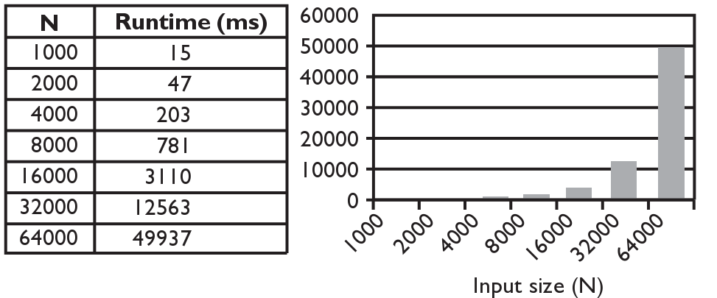
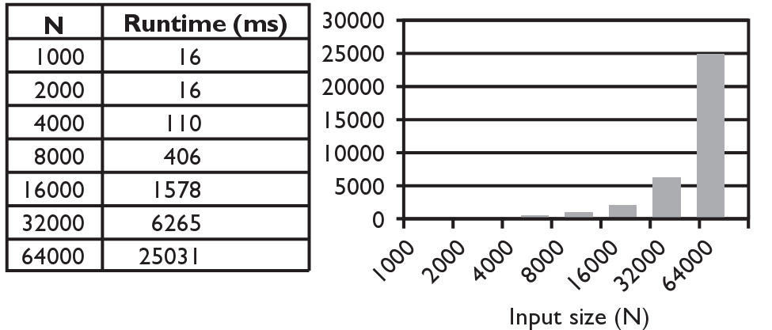
Runtime of first 2 versions
Version 1:
Version 2:

Slide 20
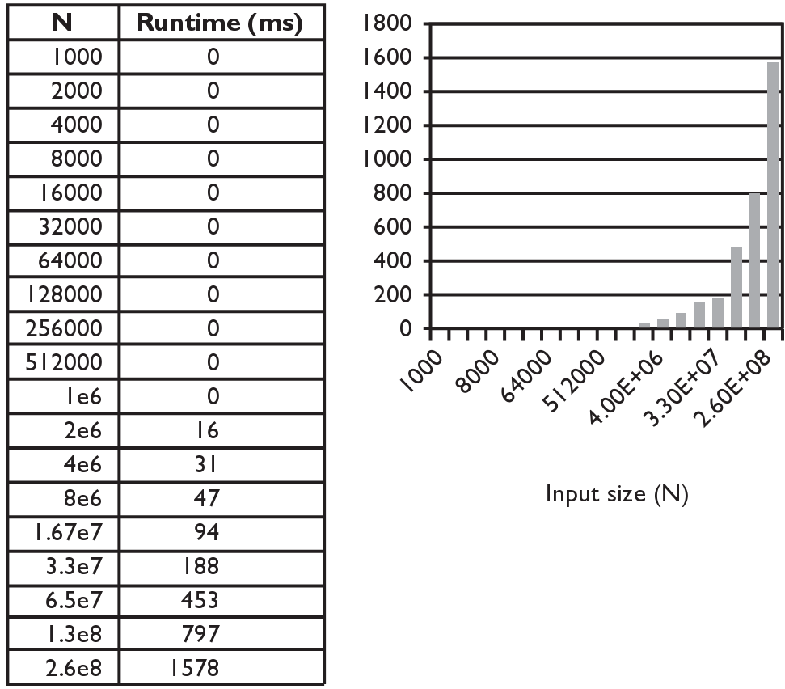
Runtime of 3rd version
Version 3:

Slide 21
Searching methods
Implement the following methods:
indexOf – returns first index of element, or -1 if not found
contains - returns true if the list contains the given int value
Why do we need isEmpty and contains when we already have indexOf and size ?
Adds convenience to the client of our class:
// less elegant // more elegant
if (myList.size() == 0) { if (myList.isEmpty()) {
if (myList.indexOf(42) >= 0) { if (myList.contains(42)) {

Slide 22
Sequential search
sequential search: Locates a target value in an array / list by examining each element from start to finish. Used in indexOf.
How many elements will it need to examine?
Example: Searching the array below for the value 42:
The array is sorted. Could we take advantage of this?
index | 0 | 1 | 2 | 3 | 4 | 5 | 6 | 7 | 8 | 9 | 10 | 11 | 12 | 13 | 14 | 15 | 16
value | -4 | 2 | 7 | 10 | 15 | 20 | 22 | 25 | 30 | 36 | 42 | 50 | 56 | 68 | 85 | 92 | 103
i

Slide 23
Sequential search
What is its complexity class?
public int indexOf(int value) {
for (int i = 0; i < size; i++) {
if (elementData[i] == value) {
return i;
}
}
return -1; // not found
}
On average, "only" N/2 elements are visited
1/2 is a constant that can be ignored
N
index | 0 | 1 | 2 | 3 | 4 | 5 | 6 | 7 | 8 | 9 | 10 | 11 | 12 | 13 | 14 | 15 | 16
value | -4 | 2 | 7 | 10 | 15 | 20 | 22 | 25 | 30 | 36 | 42 | 50 | 56 | 68 | 85 | 92 | 103

Slide 24
Binary search (13.1)
binary search: Locates a target value in a sorted array or list by successively eliminating half of the array from consideration.
How many elements will it need to examine?
Example: Searching the array below for the value 42:
index | 0 | 1 | 2 | 3 | 4 | 5 | 6 | 7 | 8 | 9 | 10 | 11 | 12 | 13 | 14 | 15 | 16
value | -4 | 2 | 7 | 10 | 15 | 20 | 22 | 25 | 30 | 36 | 42 | 50 | 56 | 68 | 85 | 92 | 103
min
mid
max

Slide 25
Arrays.binarySearch
// searches an entire sorted array for a given value
// returns its index if found; a negative number if not found
// Precondition: array is sorted
Arrays.binarySearch(array, value)
// searches given portion of a sorted array for a given value
// examines minIndex (inclusive) through maxIndex (exclusive)
// returns its index if found; a negative number if not found
// Precondition: array is sorted
Arrays.binarySearch(array, minIndex, maxIndex, value)
The binarySearch method in the Arrays class searches an array very efficiently if the array is sorted.
You can search the entire array, or just a range of indexes (useful for "unfilled" arrays such as the one in ArrayIntList)

Slide 26
Using binarySearch
// index 0 1 2 3 4 5 6 7 8 9 10 11 12 13 14 15
int[] a = {-4, 2, 7, 9, 15, 19, 25, 28, 30, 36, 42, 50, 56, 68, 85, 92};
int index = Arrays.binarySearch(a, 0, 16, 42); // index1 is 10
int index2 = Arrays.binarySearch(a, 0, 16, 21); // index2 is -7
binarySearch returns the index where the value is found
if the value is not found, binarySearch returns:
-(insertionPoint + 1)
where insertionPoint is the index where the element would have been, if it had been in the array in sorted order.
To insert the value into the array, negate insertionPoint + 1
int indexToInsert21 = -(index2 + 1); // 6

Slide 27
Binary search
binary search successively eliminates half of the elements.
Algorithm: Examine the middle element of the array.
If it is too big, eliminate the right half of the array and repeat.
If it is too small, eliminate the left half of the array and repeat.
Else it is the value we're searching for, so stop.
Which indexes does the algorithm examine to find value 42?
What is the runtime complexity class of binary search?
index | 0 | 1 | 2 | 3 | 4 | 5 | 6 | 7 | 8 | 9 | 10 | 11 | 12 | 13 | 14 | 15 | 16
value | -4 | 2 | 7 | 10 | 15 | 20 | 22 | 25 | 30 | 36 | 42 | 50 | 56 | 68 | 85 | 92 | 103
min
mid
max

Slide 28
Binary search runtime
For an array of size N, it eliminates ½ until 1 element remains.
N, N/2, N/4, N/8, ..., 4, 2, 1
How many divisions does it take?
Think of it from the other direction:
How many times do I have to multiply by 2 to reach N?
1, 2, 4, 8, ..., N/4, N/2, N
Call this number of multiplications "x".
2^{x} = N
x = log₂ N
Binary search is in the logarithmic complexity class.

Slide 29
Collection efficiency
Efficiency of our Java's ArrayList and LinkedList methods:
* Most of the time!
Method | ArrayList | LinkedList
add
add(index, value)
indexOf
get
remove
set
size
Method | ArrayList | LinkedList
add | O(1)* | O(1)
add(index, value) | O(N) | O(N)
indexOf | O(N) | O(N)
get | O(1) | O(N)
remove | O(N) | O(N)
set | O(1) | O(N)
size | O(1) | O(1)

Slide 30
Max subsequence sum
Write a method maxSum to find the largest sum of any contiguous subsequence in an array of integers.
Easy for all positives: include the whole array.
What if there are negatives?
(Let's define the max to be 0 if the array is entirely negative.)
Ideas for algorithms?
index | 0 | 1 | 2 | 3 | 4 | 5 | 6 | 7 | 8
value | 2 | 1 | -4 | 10 | 15 | -2 | 22 | -8 | 5
index | 0 | 1 | 2 | 3 | 4 | 5 | 6 | 7 | 8
value | 2 | 1 | -4 | 10 | 15 | -2 | 22 | -8 | 5
Largest sum: 10 + 15 + -2 + 22 = 45

Slide 31
Algorithm 1 pseudocode
maxSum(a):
max = 0.
for each starting index i:
for each ending index j:
sum = add the elements from a[i] to a[j].
if sum > max,
max = sum.
return max.
index | 0 | 1 | 2 | 3 | 4 | 5 | 6 | 7 | 8
value | 2 | 1 | -4 | 10 | 15 | -2 | 22 | -8 | 5

Slide 32
Algorithm 1 code
What complexity class is this algorithm?
O(N³). Takes a few seconds to process 2000 elements.
public static int maxSum1(int[] a) {
int max = 0;
for (int i = 0; i < a.length; i++) {
for (int j = i; j < a.length; j++) {
// sum = add the elements from a[i] to a[j].
int sum = 0;
for (int k = i; k <= j; k++) {
sum += a[k];
}
if (sum > max) {
max = sum;
}
}
}
return max;
}

Slide 33
Flaws in algorithm 1
Observation: We are redundantly re-computing sums.
For example, we compute the sum between indexes 2 and 5: a[2] + a[3] + a[4] + a[5]
Next we compute the sum between indexes 2 and 6: a[2] + a[3] + a[4] + a[5] + a[6]
We already had computed the sum of 2-5, but we compute it again as part of the 2-6 computation.
Let's write an improved version that avoids this flaw.
index | 0 | 1 | 2 | 3 | 4 | 5 | 6 | 7 | 8
value | 2 | 1 | -4 | 10 | 15 | -2 | 22 | -8 | 5

Slide 34
Algorithm 2 code
What complexity class is this algorithm?
O(N²). Can process tens of thousands of elements per second.
public static int maxSum2(int[] a) {
int max = 0;
for (int i = 0; i < a.length; i++) {
int sum = 0;
for (int j = i; j < a.length; j++) {
sum += a[j];
if (sum > max) {
max = sum;
}
}
}
return max;
}
index | 0 | 1 | 2 | 3 | 4 | 5 | 6 | 7 | 8
value | 2 | 1 | -4 | 10 | 15 | -2 | 22 | -8 | 5

Slide 35
A clever solution
Claim 1 : A max range cannot start with a negative-sum range.
Claim 2 : If sum(i, j-1) ≥ 0 and sum(i, j) < 0, any max range that ends at j+1 or higher cannot start at any of i through j.
Together, these observations lead to a very clever algorithm...
i | ... | j | j+1 | ... | k
< 0 |  |  | sum(j+1, k)
sum(i, k) < sum(j+1, k)
i | ... | j-1 | j | j+1 | ... | k
≥ 0 |  |  | < 0 | sum(j+1, k)
< 0 |  |  |  | sum(j+1, k)
 |  | sum(?, k) < sum(j+1, k)

Slide 36
Algorithm 3 code
What complexity class is this algorithm?
O(N). Handles many millions of elements per second!
public static int maxSum3(int[] a) {
int max = 0;
int sum = 0;
int i = 0;
for (int j = 0; j < a.length; j++) {
if (sum < 0) { // if sum becomes negative, max range
i = j; // cannot start with any of i - j-1
sum = 0; // (Claim 2)
}
sum += a[j];
if (sum > max) {
max = sum;
}
}
return max;
}

