Slide 1
Computer Animation
w00t

Slide 2
Early Animation
5200 year old bowl found in Iran
Zoetrope (AD 180)
http://www.youtube.com/watch?v=-3yarT_h2ws&t=0m16s

Slide 3
Disney
Popularizes animated films in 1937
http://www.youtube.com/watch?v=hQZ6zzLpoNQ&t=0m43s

Slide 4
CG Animation
Late 70s Through Early 90s
CG appears in Hollywood movies
Alien
Tron
Ghost Busters
Terminator 2
Jurassic Park

Slide 5
Pixar
First feature length CG film
http://www.youtube.com/watch?v=KYz2wyBy3kc&t=0m19s

Slide 6
Basic Animation
What’s the simplest kind of animation you can think of? You probably did this in grade school, but it started in the 1800s
http://www.youtube.com/watch?v=UocF4ycBnYE

Slide 7
DrawingPanel with loops
What can we do with loops?

Slide 8
DrawingPanel with loops
What can we do with loops?
Change location of shapes
Change size of shapes
Change colors
Gradients
Change text that’s displayed

Slide 9
Gradients
Demo!

Slide 10
Motion, Size
Demos

Slide 11
Animation at UW
3 quarter program through CS
Learn all parts of animation pipeline
Collaboratively create an animated film

Slide 13
Production Pipeline
Story
Concept Art
Modeling/Rigging
Animation/Effects
Shading/Lighting
Rendering/Compositing
Editing

Slide 15
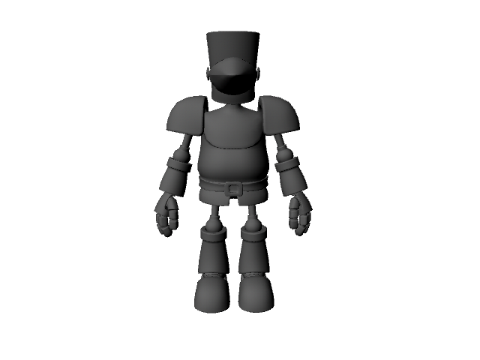
Modeling

Slide 16
Rigging
Set up controls for the animator
http://www.youtube.com/watch?v=tQd-8XEBcnE
Animator sets the position/rotation of controls at specific frames to create motion

Slide 17
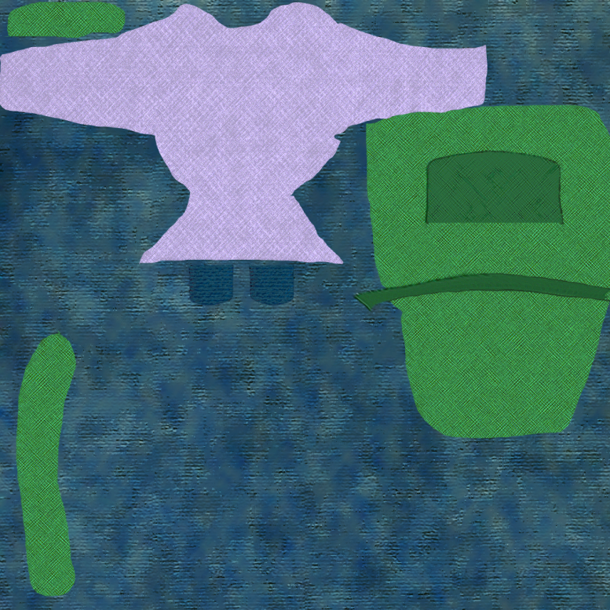
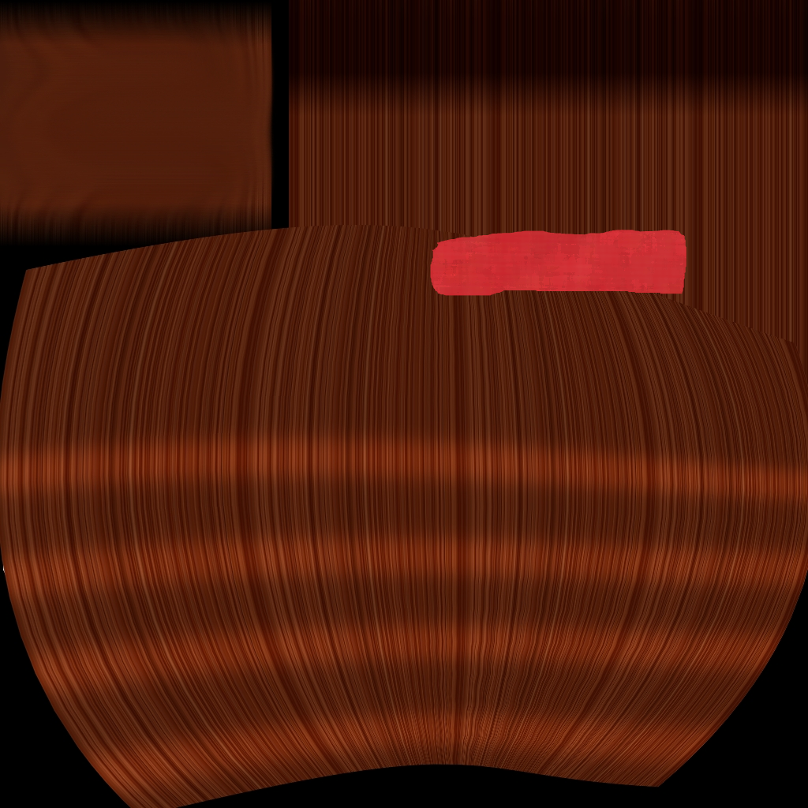
Shading

Slide 18
Effects/Lighting
http://www.youtube.com/watch?v=7NpAXMdBWTQ&t=0m38s
http://www.youtube.com/watch?v=oMuWfspj3qo&t=0m30s

Slide 19
Rendering/Compositing
Rendering
Taking the data about objects in space and turning it into a picture
Compositing
Putting video/images together
http://www.youtube.com/watch?v=oTUs7hDq2PA

Slide 20
Animatic to Film
Demos!

Slide 21
How does this all work?
Graphics
CSE457
http://www.youtube.com/watch?v=AARfZNFdms0&context=C3acb873ADOEgsToPDskI72hJ4NLkOrvPfFelR4VuZ

Slide 22
Let’s just watch some films (:

