Slide 1
Data Abstraction
UW CSE 140
Winter 2014

Slide 2
What is a program?
What is a program?
A sequence of instructions to achieve some particular purpose
What is a library?
A collection of functions that are helpful in multiple programs
What is a data structure?
A representation of data, and
Routines to manipulate the data
Create, query, modify

Slide 3
Why break a program into parts?
Easier to understand each part
Abstraction: When using a part, understand only its specification (documentation string); ignore its implementation
Easier to test each part
Reuse parts

Slide 4
Breaking a program into parts: the parts, and how to express them
Organizing the program & algorithm:
Function (procedure)
Library (collection of useful functions)
Data structure (representation + methods)
Organizing the code (related but not the same!):
Files
Modules
Namespaces

Slide 5
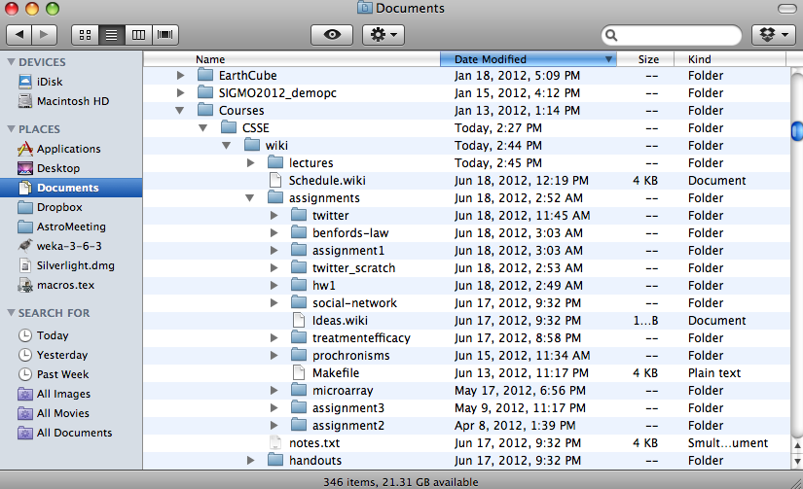
Namespace
Disambiguates duplicate variable names
Examples:
math.sin
File system directories

Slide 6
Review: Accessing variables in a namespace
import math
... math.sin ...
import networkx as nx
g = nx.Graph()
module name
alias
from networkx import Graph, DiGraph
g = Graph()
Graph and DiGraph are now available in the global namespace

Slide 7
Recall the design exercise
We created a module or library: a set of related functions
The functions operated on the same data structure
a dictionary associating words with a frequency count
a list of tuples of measurements
Each module contained:
A function to create the data structure
Functions to query the data structure
We could have added functions to modify the data structure

Slide 8
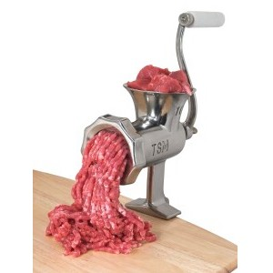
Two types of abstraction
Abstraction: Ignoring/hiding some aspects of a thing
In programming, ignore everything except the specification or interface
The program designer decides which details to hide and to expose
Procedural abstraction:
Define a procedure/function specification
Hide implementation details
Data abstraction:
Define what the datatype represents
Define how to create, query, and modify
Hide implementation details of representation and of operations
Also called “encapsulation” or “information hiding”

Slide 9
Data abstraction
Describing field measurements:
“A dictionary mapping strings to lists, where the strings are sites and each list has the same length and its elements corresponds to the fields in the data file.”
“FieldMeasurements”
Which do you prefer? Why?
(This must appear in the documentation string of every function related to field measurements!)
Notes:
encapsulation: commits us to a particular implementation, which makes it harder to change down the road

Slide 10
Representing a graph
A graph consists of:
nodes/vertices
edges among the nodes
Representations:
Set of edge pairs
(a, a), (a, b), (a, c), (b, c), (c, b)
For each node, a list of neighbors
{ a: [a, b, c], b: [c], c: [b] }
Matrix with boolean for each entry
a
b
c
 | a | b | c
a | ✓ | ✓ | ✓
b |  |  | ✓
c |  | ✓
Notes:
In terms of information content, all of them are the same.
Some might be more efficient in some contexts, and

Slide 11
Text analysis module (group of related functions) representation = dictionary
# program to compute top 10:
wordcounts = read_words(filename)
result = topk(wordcounts, 10)
def read_words(filename):
"""Return a dictionary mapping each word in filename to its frequency"""
words = open(filename).read().split()
wordcounts = {}
for w in words:
wordcounts.setdefault(w, 0) # set wordcounts[w] to 0 if not set
wordcounts[w] += 1
return wordcounts
def wordcount(wordcounts, word):
"""Given a frequency dictionary, return the count of the given word"""
return wordcounts[word]
def topk(wordcounts, k=10):
"""Given a frequency dictionary, return the top k most frequent words, in order"""
scores_with_words = [(c,w) for (w,c) in wordcounts.items()]
scores_with_words.sort(reverse=True)
return scores_with_words[0:k]
def totalwords(wordcounts):
"""Return the total number of words in the file"""
return sum([c for (w,c) in wordcounts])

Slide 12
Problems with the implementation
# program to compute top 10:
wordcounts = read_words(filename)
result = topk(wordcounts, 10)
The wordcount dictionary is exposed to the client: the user might corrupt or misuse it.
If we change our implementation (say, to use a list), it may break the client program.
We prefer to
Hide the implementation details from the client
Collect the data and functions together into one unit

Slide 13
Datatypes and classes
A class creates a namespace for:
Variables to hold the data
Functions to create, query, and modify
Each function defined in the class is called a method
Takes “self” (a value of the class type) as the first argument
A class defines a datatype
An object is a value of that type
Comparison to other types:
Type is int, value is 22
Type is the class, value is an object also known as an instantiation or instance of that type

Slide 14
Recall the text analysis implementation
# program to compute top 10:
wordcounts = read_words(filename)
result = topk(wordcounts, 10)
def read_words(filename):
"""Populate a WordCounts object from the given file"""
words = open(filename).read().split()
wordcounts = {}
for w in words:
wordcounts.setdefault(w, 0)
wordcounts[w] += 1
return wordcounts
def wordcount(wordcounts, word):
"""Return the count of the given word"""
return wordcounts[word]
def topk(wordcounts, k=10):
"""Return a list of the top k most frequent words in order"""
scores_with_words = [(c,w) for (w,c) in wordcounts.items()]
scores_with_words.sort(reverse=True)
return scores_with_words[0:k]
def totalwords(wordcounts):
"""Return the total number of words in the file"""
return sum([c for (w,c) in wordcounts])

Slide 15
Text analysis, as a class
The type of wc is WordCounts
# program to compute top 10:
wc = WordCounts()
wc.read_words(filename)
result = wc.topk(10)
Defines a class (a datatype) named WordCounts
class WordCounts:
"""Represents the words in a file."""
# Internal representation:
# variable wordcounts is a dictionary mapping words to their frequency
def read_words(self, filename):
"""Populate a WordCounts object from the given file"""
words = open(filename).read().split()
self.wordcounts = {}
for w in words:
self.wordcounts.setdefault(w, 0)
self.wordcounts[w] += 1
def wordcount(self, word):
"""Return the count of the given word"""
return self.wordcounts[word]
def topk(self, k=10):
"""Return a list of the top k most frequent words in order"""
scores_with_words = [(c,w) for (w,c) in self.wordcounts.items()]
scores_with_words.sort(reverse=True)
return scores_with_words[0:k]
def totalwords(self):
"""Return the total number of words in the file"""
return sum([c for (w,c) in self.wordcounts])
topk takes 2 arguments
The type of self is WordCounts
Modifies a WordCounts object
read_words does not return a value; it mutates self
Queries a WordCounts object
The namespace of a WordCounts object:
dict
Each function in a class is called a method. Its first argument is of the type of the class.
wordcounts
read_words
wordcount
topk
totalwords
fn
fn
fn
fn

Slide 16
# program to compute top 10:
wc = WordCounts()
wc.read_words(filename)
result = wc.topk(10)
result = WordCounts.topk(wc, 10)
Weird constructor: it does not do any work
You have to call a mutator immediately afterward
A value of type WordCounts
Two equivalent calls
A namespace, like a module
A function that takes two arguments

Slide 17
Class with constructor
# program to compute top 10:
wc = WordCounts(filename)
result = wc.topk(10)
class WordCounts:
"""Represents the words in a file."""
# Internal representation:
# variable wordcounts is a dictionary mapping words to their frequency
def __init__(self, filename):
"""Create a WordCounts object from the given file"""
words = open(filename).read().split()
self.wordcounts = {}
for w in words:
self.wordcounts.setdefault(w, 0)
self.wordcounts[w] += 1
def wordcount(self, word):
"""Return the count of the given word"""
return self.wordcounts[word]
def topk(self, k=10):
"""Return a list of the top k most frequent words in order"""
scores_with_words = [(c,w) for (w,c) in self.wordcounts.items()]
scores_with_words.sort(reverse=True)
return scores_with_words[0:k]
def totalwords(self):
"""Return the total number of words in the file"""
return sum([c for (w,c) in self.wordcounts])

Slide 18
Alternate implementation
# program to compute top 10:
wc = WordCounts(filename)
result = wc.topk(10)
class WordCounts:
"""Represents the words in a file."""
# Internal representation:
# variable words is a list of the words in the file
def __init__(self, filename):
"""Create a WordCounts object from the given file"""
self.words = open(filename).read().split()
def wordcount(self, word):
"""Return the count of the given word"""
return self.words.count(word)
def topk(self, k=10):
"""Return a list of the top k most frequent words in order"""
scores_with_words = [(self.wordcount(w),w) for w in set(self.words)]
scores_with_words.sort(reverse=True)
return scores_with_words[0:k]
def totalwords(self):
"""Return the total number of words in the file"""
return len(self.words)
Exact same program!
The namespace of a WordCounts object:
list
words
__init__
wordcount
topk
totalwords
fn
fn
fn
fn

Slide 19
Quantitative analysis
# Program to plot
mydict = read_measurements(filename)
result = mydict.Stplot()
def read_measurements(filename):
"""Return a dictionary mapping column names to data.
Assumes the first line of the file is column names."""
datafile = open(filename)
rawcolumns = zip(*[row.split() for row in datafile])
columns = dict([(col[0], col[1:]) for col in rawcolumn])
return columns
def tofloat(measurements, columnname):
"""Convert each value in the given iterable to a float"""
return [float(x) for x in measurements[columnname]]
def STplot(measurements):
"""Generate a scatter plot comparing salinity and temperature"""
xs = tofloat(measurements, "salt")
ys = tofloat(measurements, "temp")
plt.plot(xs, ys)
plt.show()
def minimumO2(measurements):
"""Return the minimum value of the oxygen measurement"""
return min(tofloat(measurements, "o2"))

Slide 20
Quantitative analysis, as a class
# Program to plot
mm = Measurements()
mm.read_measurements(filename)
result = mm.Stplot()
class Measurements:
"""Represents a set of measurements in UWFORMAT.""“
def read_measurements(self, filename):
"""Populate a Measurements object from the given file.
Assumes the first line of the file is column names."""
datafile = open(filename)
rawcolumns = zip(*[row.split() for row in datafile])
self.columns = dict([(col[0], col[1:]) for col in rawcolumn])
return columns
def tofloat(self, columnname):
"""Convert each value in the given iterable to a float"""
return [float(x) for x in self.columns[columnname]]
def STplot(self):
"""Generate a scatter plot comparing salinity and temperature"""
xs = tofloat(self.columns, "salt")
ys = tofloat(self.columns, "temp")
plt.plot(xs, ys)
plt.show()
def minimumO2(self):
"""Return the minimum value of the oxygen measurement"""
return min(tofloat(self.columns, "o2"))

Slide 21
Quantitative analysis, with a constructor
# Program to plot
mm = Measurements(filename)
result = mm.Stplot()
class Measurements:
"""Represents a set of measurements in UWFORMAT.""“
def __init__(self, filename):
"""Create a Measurements object from the given file.
Assumes the first line of the file is column names."""
datafile = open(filename)
rawcolumns = zip(*[row.split() for row in datafile])
self.columns = dict([(col[0], col[1:]) for col in rawcolumn])
def tofloat(self, columnname):
"""Convert each value in the given iterable to a float"""
return [float(x) for x in self.columns[columnname]]
def STplot(self):
"""Generate a scatter plot comparing salinity and temperature"""
xs = tofloat(self.columns, "salt")
ys = tofloat(self.columns, "temp")
plt.plot(xs, ys)
plt.show()
def minimumO2(self):
"""Return the minimum value of the oxygen measurement"""
return min(tofloat(self.columns, "o2"))

