Slide 1
Introduction to Data Programming
CSE 140
University of Washington
Winter 2014
Ruth Anderson
Slides based on previous versions by Michael Ernst and earlier versions by Bill Howe

Slide 2
Welcome to CSE 140!
CSE 140 teaches core programming concepts with an emphasis on real data manipulation tasks from science, engineering, and business
Goal by the end of the quarter: Given a data source and a problem description, you can independently write a complete, useful program to solve the problem

Slide 3
Course staff
Lecturer:
Ruth Anderson
TAs:
Sasha Babayan
Krittika D'Silva
Isaac Reynolds
Evan Whitfield
Ask us for help!

Slide 4
Learning Objectives
Computational problem-solving
Writing a program will become your “go-to” solution for data analysis tasks
Basic Python proficiency
Including experience with relevant libraries for data manipulation, scientific computing, and visualization.
Experience working with real datasets
astronomy, biology, linguistics, oceanography, open government, social networks, and more.
You will see that these are easy to process with a program, and that doing so yields insight.

Slide 5
What this course is not
A “skills course” in Python
…though you will become proficient in the basics of the Python programming language
…and you will gain experience with some important Python libraries
A data analysis / “data science” / data visualization course
There will be very little statistics knowledge assumed or taught
A “project” course
the assignments are “real,” but are intended to teach specific programming concepts
A “big data” course
Datasets will all fit comfortably in memory
No parallel programming

Slide 6
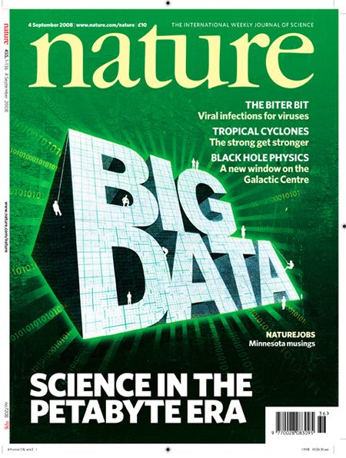
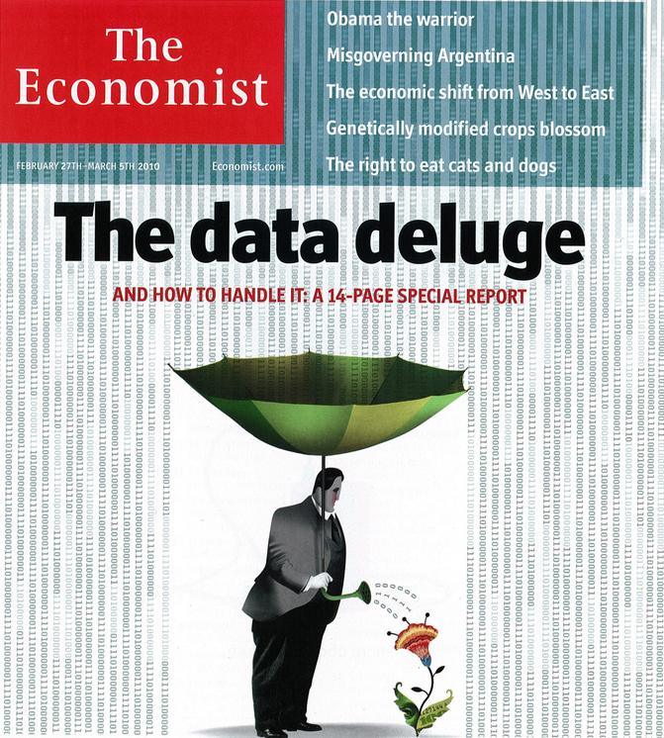
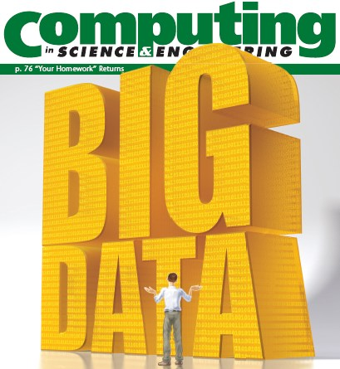
“It’s a great time to be a data geek.”
-- Roger Barga, Microsoft Research
“The greatest minds of my generation are trying
to figure out how to make people click on ads”
-- Jeff Hammerbacher, co-founder, Cloudera

Slide 7
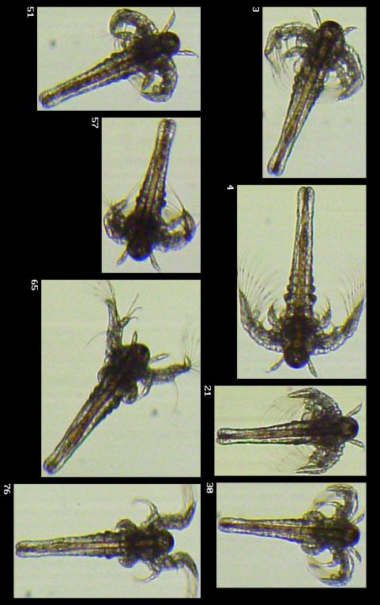
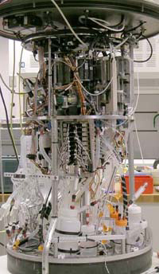
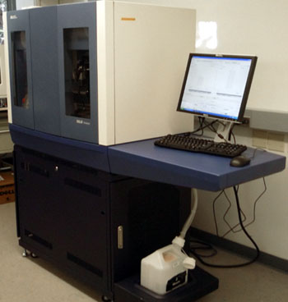
All of science is reducing to computational data manipulation
Old model: “Query the world” (Data acquisition coupled to a specific hypothesis)
New model: “Download the world” (Data acquisition supports many hypotheses)
Astronomy: High-resolution, high-frequency sky surveys (SDSS, LSST, PanSTARRS)
Biology: lab automation, high-throughput sequencing,
Oceanography: high-resolution models, cheap sensors, satellites
40TB / 2 nights
~1TB / day
100s of devices
Notes:
Slide from Bill Howe, eScience Institute, his notes:
Drowning in data; starving for information
We’re at war with these engineering companies. FlowCAM is bragging about the amount of data they can spray out of their device. How to use this enormous data stream to answer scientific questions is someone else’s problem.
“Typical large pharmas today are generating 20 terabytes of data daily. That’s probably going up to 100 terabytes per day in the next year or so.”
“tens of terabytes of data per day” -- genome center at Washignton University
Increase data collection exponentially with flowcam

Slide 8
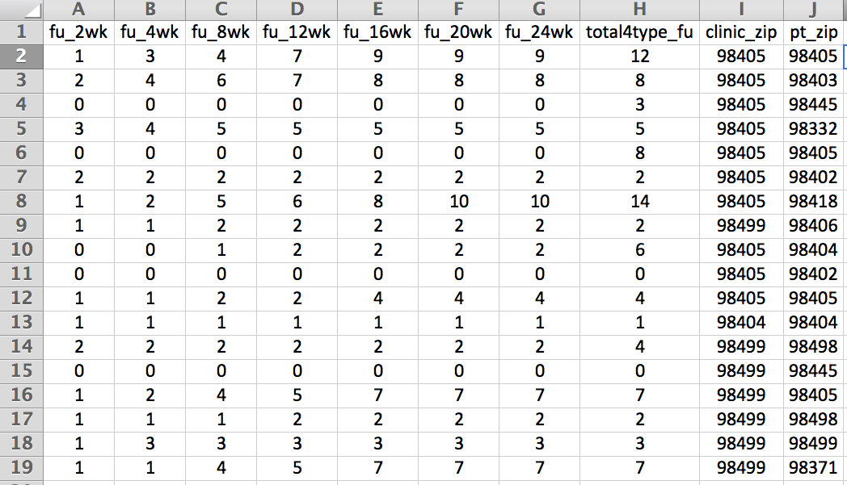
Example: Assessing treatment efficacy
number of follow ups within 16 weeks after treatment enrollment.
Zip code of clinic
Zip code of patient
Question: Does the distance between the patient’s home and clinic influence the number of follow ups, and therefore treatment efficacy?

Slide 9
Python program to assess treatment efficacy
# This program reads an Excel spreadsheet whose penultimate
# and antepenultimate columns are zip codes.
# It adds a new last column for the distance between those zip
# codes, and outputs in CSV (comma-separated values) format.
# Call the program with two numeric values: the first and last
# row to include.
# The output contains the column headers and those rows.
# Libraries to use
import random
import sys
import xlrd # library for working with Excel spreadsheets
import time
from gdapi import GoogleDirections
# No key needed if few queries
gd = GoogleDirections('dummy-Google-key')
wb = xlrd.open_workbook('mhip_zip_eScience_121611a.xls')
sheet = wb.sheet_by_index(0)
# User input: first row to process, first row not to process
first_row = max(int(sys.argv[1]), 2)
row_limit = min(int(sys.argv[2]+1), sheet.nrows)
def comma_separated(lst):
return ",".join([str(s) for s in lst])
headers = sheet.row_values(0) + ["distance"]
print comma_separated(headers)
for rownum in range(first_row,row_limit):
row = sheet.row_values(rownum)
(zip1, zip2) = row[-3:-1]
if zip1 and zip2:
# Clean the data
zip1 = str(int(zip1))
zip2 = str(int(zip2))
row[-3:-1] = [zip1, zip2]
# Compute the distance via Google Maps
try:
distance = gd.query(zip1,zip2).distance
except:
print >> sys.stderr, "Error computing distance:", zip1, zip2
distance = ""
# Print the row with the distance
print comma_separated(row + [distance])
# Avoid too many Google queries in rapid succession
time.sleep(random.random()+0.5)
23 lines of executable code!

Slide 10
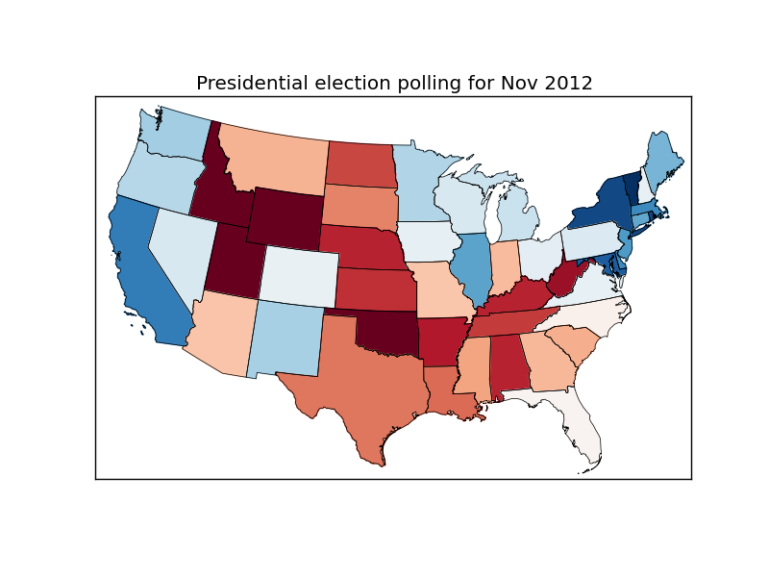
Demo: Election polling

Slide 11
Course logistics
Website: http://www.cs.washington.edu/cse140
See the website for all administrative details
Read the handouts and required texts, before the lecture
There is a brief reading quiz due before each lecture
Take notes!
Homework 1 part 1 is due Wednesday
As is a survey (and a reading quiz before lecture)
You get 5 late days throughout the quarter
No assignment may be submitted more than 3 days late. (contact the instructor if you are hospitalized)
If you want to join the class, email rea@cs.washington.edu, from your @u address

Slide 12
Academic Integrity
Honest work is required of a scientist or engineer
Collaboration policy on the course web. Read it!
Discussion is permitted
Carrying materials from discussion is not permitted
Everything you turn in must be your own work
Cite your sources, explain any unconventional action
You may not view others’ work
If you have a question, ask
I trust you completely
I have no sympathy for trust violations – nor should you

Slide 13
How to succeed
No prerequisites
Non-predictors for success:
Past programming experience
Enthusiasm for games or computers
Programming and data analysis are challenging
Every one of you can succeed
There is no such thing as a “born programmer”
Work hard
Follow directions
Be methodical
Think before you act
Try on your own, then ask for help
Start early

Slide 14
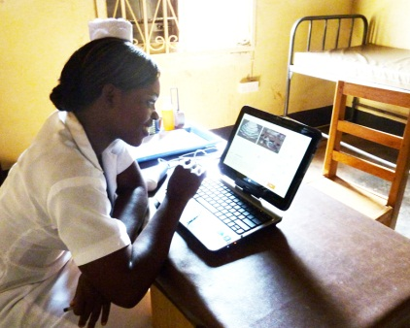
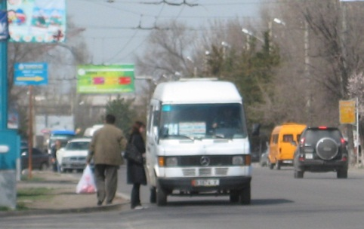
Me (Ruth Anderson)
Grad Student at UW: in Programming Languages, Compilers, Parallel Computing
Taught Computer Science at the University of Virginia for 5 years
PhD at UW: in Educational Technology, Pen Computing
Current Research: Computing and the Developing World, Computer Science Education

Slide 15
Bring to Section on Thursday:
Name
Email address
Major
Year (1,2,3,4,5)
Hometown
Interesting Fact or what I did over break.

