Slide 1
Precipitation Prediction
Inspiration: Precipitation is a really important fact that affects people’s lives
Research Question:
a. If we have a set of previous weather data and precipitation, how could we predict the future precipitation with given data;
b. How big should the training data size be so that we could predict the data as precisely and stable as possible?
Data Conversion: Need to classify the float value of precipitation to some integer labels, because ……
Exact value of precipitation is not necessary
More easy to process the data

Slide 2
About SVM (Support Vector Machine)
Precipitation Prediction Using Support Vector Machine
We only need to know how it works generally, we do not need to implement ourselves
There is already a cool implementation for SVM, which is LibSVM, and we could use its python interface

Slide 3
How I used LibSVM
Standardize the training data
There are19 weather features and precipitation for every day, and we have data for ten years
For each weather feature x, calculate its mean, m and standard deviation, sd, calculate x = (x - mean) / (2 * sd)
Classify precipitation values, preci, into five labels:
Label 1: preci == 0.0
Label 2: 0.0 < preci <= 0.2
Label 3: 0.2 < preci <= 0.5
Label 4: 0.5 < preci <= 1.0
Label 5: preci > 1.0
Feed the standardized training data into SVM and get a SVM model
Linear model should be fine
Read the features that need to predict
Standardize the features as we did before
Use the same mean and standard deviation that we calculated from training data
Call svm_predict() to get a predicted label for these features and we can see how it performance.

Slide 4
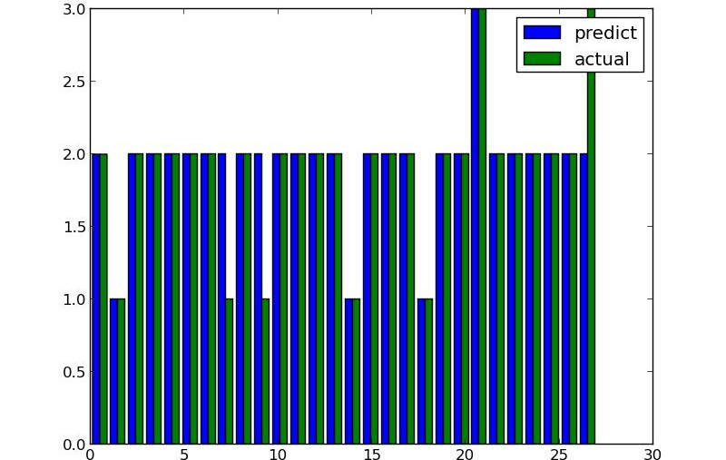
Prediction Result

Slide 5
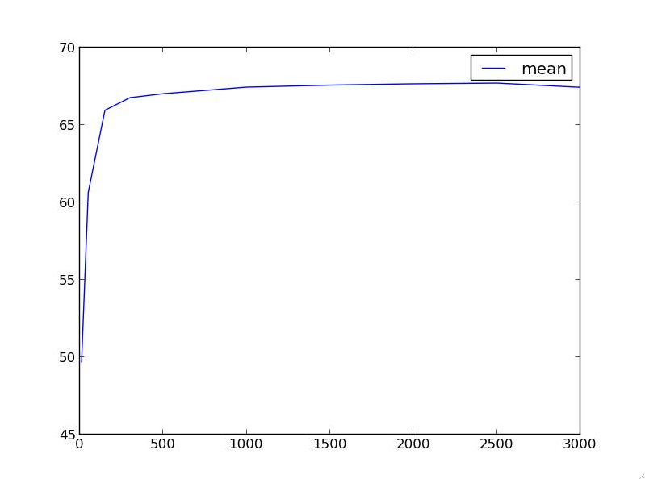
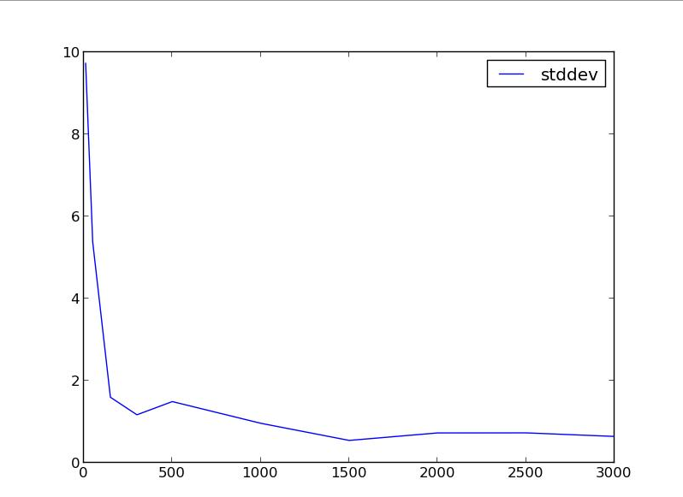
Performance

