Slide 1
NFL QB stats Calculations
Question
Is there a correlation between the National Football League player stats and their salaries?
Answer
Yes and No
Motivation
Fantasy football
Notes:
Answer: yes in that to be paid a lot you must have a good QB score, No in that having a great score doesn’t guarantee a higher pay grade

Slide 2
Analysis
1st analysis was between NFL’s QB score and his salary
Based on % completion, yards per attempt, % of TD pass, and % of interception
2nd type of analysis based only on my calculation of score and salary
Based on % of completion and yards per attempted multiplied by different coefficents

Slide 3
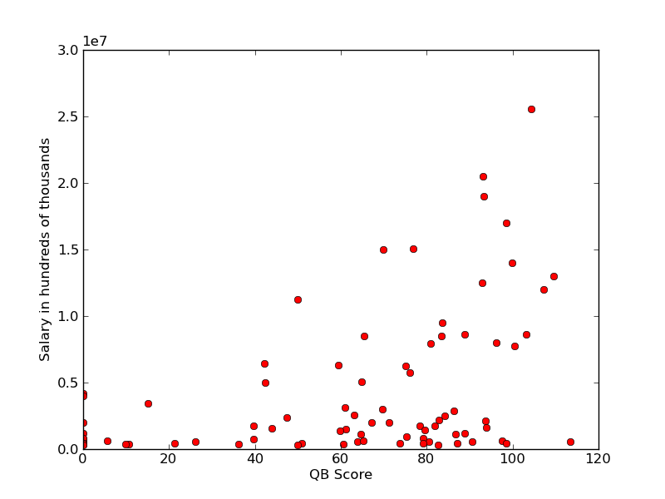
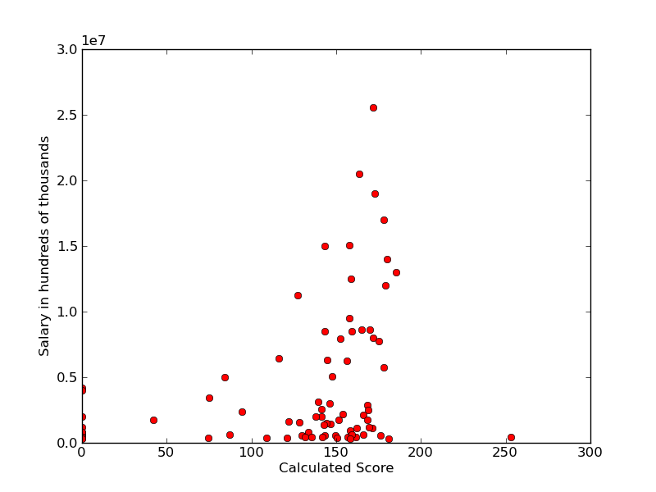
Results
Graph of Salary Vs. QB Score 2009 season
Graph of calculated Score
Vs. salary

Slide 4
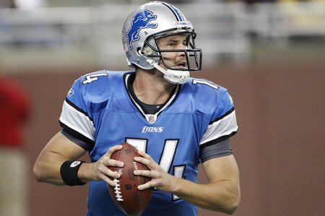
Conclusion
Graph 1
Example:
Shawn Hill
Russell Wilson Vs. Joe Flacco
Graph 2
Same skills at high level of play

