Slide 1
Best Airline of the Month
Yepingzhi Kuang (Field)
CSE 140 Final Project

Slide 2
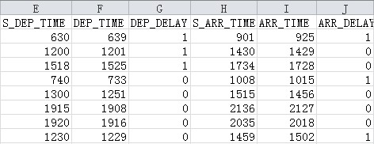
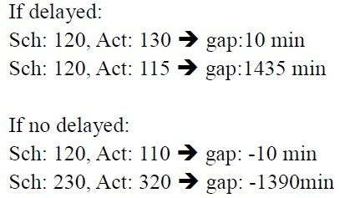
Top 5 airlines of lowest delay time (minutes)
No.1 Airline: VX Delay Time: 332642
No.2 Airline: HA Delay Time: 335444
No.3 Airline: F9 Delay Time: 526674
No.4 Airline: YV Delay Time: 661379
No.5 Airline: AS Delay Time: 764882

Slide 3
Top 10 airlines of lowest delay percentage
No.1 Airline: VX Delay Percentage: 31.76%
No.2 Airline: DL Delay Percentage: 36.23%
No.3 Airline: 9E Delay Percentage: 38.27%
No.4 Airline: HA Delay Percentage: 38.34%
No.5 Airline: AS Delay Percentage: 40.06%
No.6 Airline: YV Delay Percentage: 40.31%
No.7 Airline: US Delay Percentage: 44.63%
No.8 Airline: MQ Delay Percentage: 45.86%
No.9 Airline: OO Delay Percentage: 46.86%
No.10 Airline: B6 Delay Percentage: 49.2%

Slide 4
Top 3 airlines of longest total traveled distances (miles)
No.1 Airline: WN Distance Traveled: 58546415
No.2 Airline: UA Distance Traveled: 49302836
No.3 Airline: DL Distance Traveled: 48801468
Top 3 airlines of largest number of flight routes
No.1 Airline: EV Number of routes: 1055
No.2 Airline: WN Number of routes: 1008
No.3 Airline: OO Number of routes: 810

Slide 5
Top 10 Best Airlines of the Month
No.1 Airline: DL Overall ranking: 5.0
No.2 Airline: 9E Overall ranking: 6.25
No.3 Airline: VX Overall ranking: 7.0
No.4 Airline: OO Overall ranking: 7.25
No.5 Airline: US Overall ranking: 7.25
No.6 Airline: UA Overall ranking: 7.5
No.7 Airline: EV Overall ranking: 7.75
No.8 Airline: AS Overall ranking: 8.0
No.9 Airline: WN Overall ranking: 8.0
No.10 Airline: B6 Overall ranking: 8.75

