Slide 1
American Crime Rate Analysis from 1960 to 1999
By: Hudson Poissant and Krittika D’Silva

Slide 2
Overall Summary
Our analysis was focused on looking at how crime rates were changing in America relative to population rates
We had population data from 1960 to 1999 from the US Census Bureau website
We also had a data set containing the total count and type of crime in each state per year
For each year, we calculated the change in population and the change in total crimes compared to the prior year
We calculated the following ratio for each state:
$\frac{\text{Δ} \text{Number} \text{of} \text{total} \text{crimes}}{\text{Δ} \text{Population}}$

Slide 3
Motivation
By looking at the ratios of different states we would have an understanding about how effectively (or ineffectively) each state implemented crime preventative measures
If, for example, we had seen that a state had high ratios and then consistently low ratios – perhaps that state implemented effective crime enforcement laws

Slide 4
Research Questions
Which states have experienced the largest increase in crime rate relative to their state population change per year?
Relative to other states, how quickly (or slowly) has Washington’s crime rate increased with respect to its population?

Slide 5
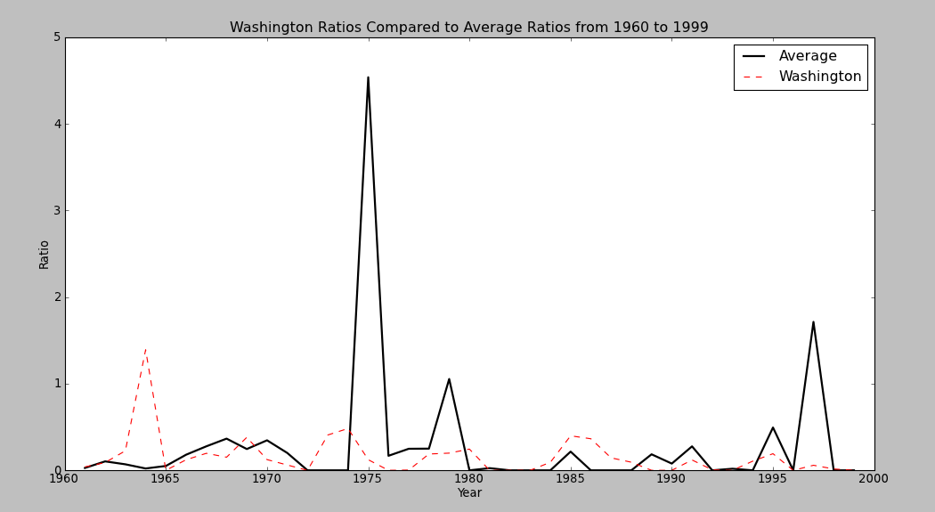
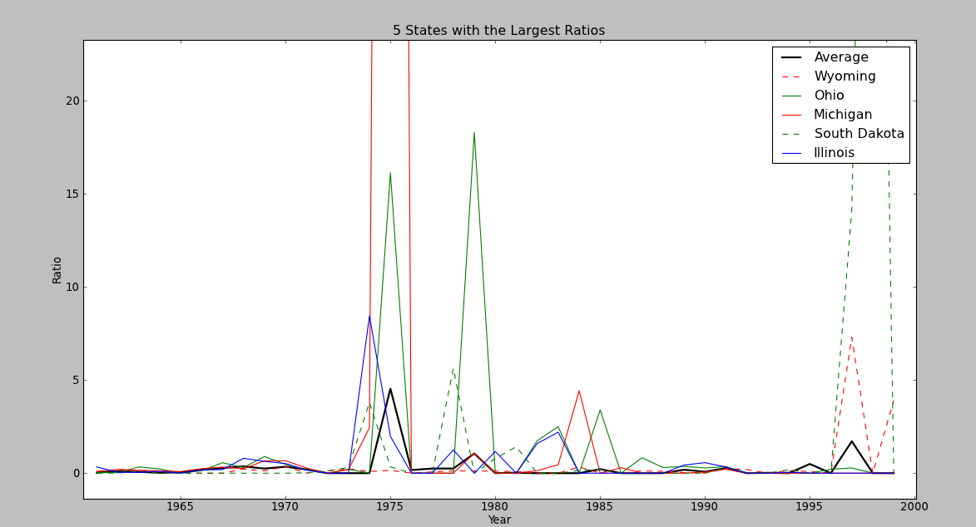
Results
Question 2
Question 1

