Slide 1
The Internet and Current Issues
Thomas Johnson and James Prow

Slide 2
Motivation
The internet has changed everything
Has it made the world a better place?
Many ways of judging this
Gross domestic product (GDP), “buying power”
Literacy rate
Life expectancy

Slide 3
Research Questions
150 countries
Information technology investment
Operationally defined as internet users per population
Which issue is most related?
Gross domestic product (GDP), “buying power”
Literacy rate
Life expectancy
Determine based on MSEs

Slide 4
Results
MSEs
GDP: 0.0777
Literacy Rate: 0.0026
Life Expectancy: 0.0029
Pearson’s rs
GDP: 0.1875
Literacy Rate: 0.6812
Life Expectancy: 0.7747
All vs rate of internet users per population

Slide 5
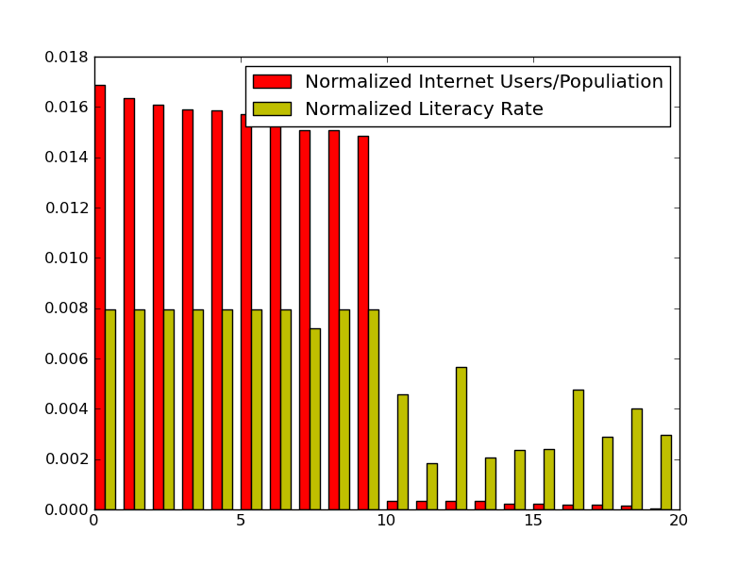
Results
Iceland, Norway, Netherlands, Sweden, Luxembourg, Denmark, Finland, Qatar, New Zealand, Liechtenstein,
Papua New Guinea, Mali, Madagascar, Chad, Guinea, Niger, Burundi, Ethiopia, Timor-Leste, Sierra Leone

