Slide 1
Douban and Weibo followee analysis
Jianhao Zhou

Slide 2
Average Followees

Slide 3
HI based at N
HI: Herd Index, the percentage of popular accounts in a user’s followees.
N: Popular accounts are the top N% popular accounts.

Slide 4
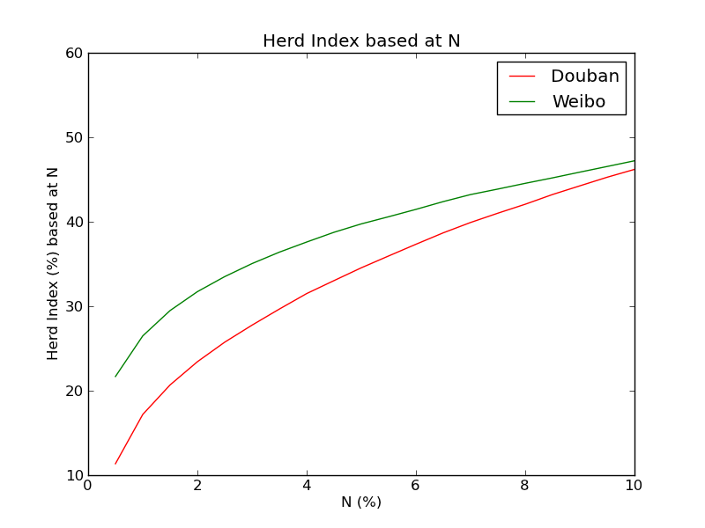
Amazing results!

Slide 5
Different popular accounts
Weibo popular accounts are mainly commercial accounts.
Douban popular accounts are more personal.

