Slide 1
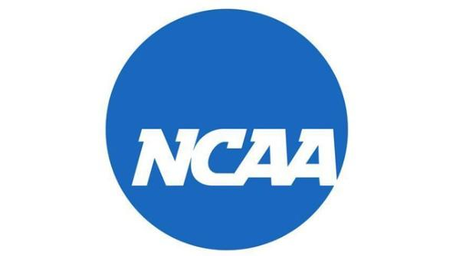
An Iterative Strength Based Model for the Prediction of NCAA Basketball Games
Jeff Harrison & Philip Tan

Slide 2
Motivations
Money
Betting
Pattern Prediction
Economic
Scientific
Extrapolation to Future

Slide 3
Research Questions & Method
Questions:
What method of predicting college basketball games should we use to obtain the best results?
Can we alter the basic algorithm to produce more accurate predictions of the NCAA tournament?
Methods:
Ranking Systems
ISR System
Tweaking the Standard
Determining the Winner
"Winner Takes All"- Higher Ranking = Better Team
Problem: Does not consider how close the rankings are.
Markov Chain
Determining win probability as a function of difference in ranking
If the rankings are close, there is a probability that the lower ranked team will win

Slide 4
Iterative Strength Ranking Overview
Set all teams to an initial ranking.
Go through every game of the season.
Give winner their opponents ranking + a constant bonus
Give the loser their opponents ranking - a constant bonus
Use the ranking generated by this iteration as the starting point for another iteration. (Recursion!)
When two successive iterations yield the same ranking, You're Done!

Slide 5
Results
Winner Takes All:
Close game 79.37%
Smart Winner:
Standard 82.54%
Biases:
Data already known
Applicability:
Difficult to apply to future
NCAA basketball volatile

Slide 6
End

