Slide 1
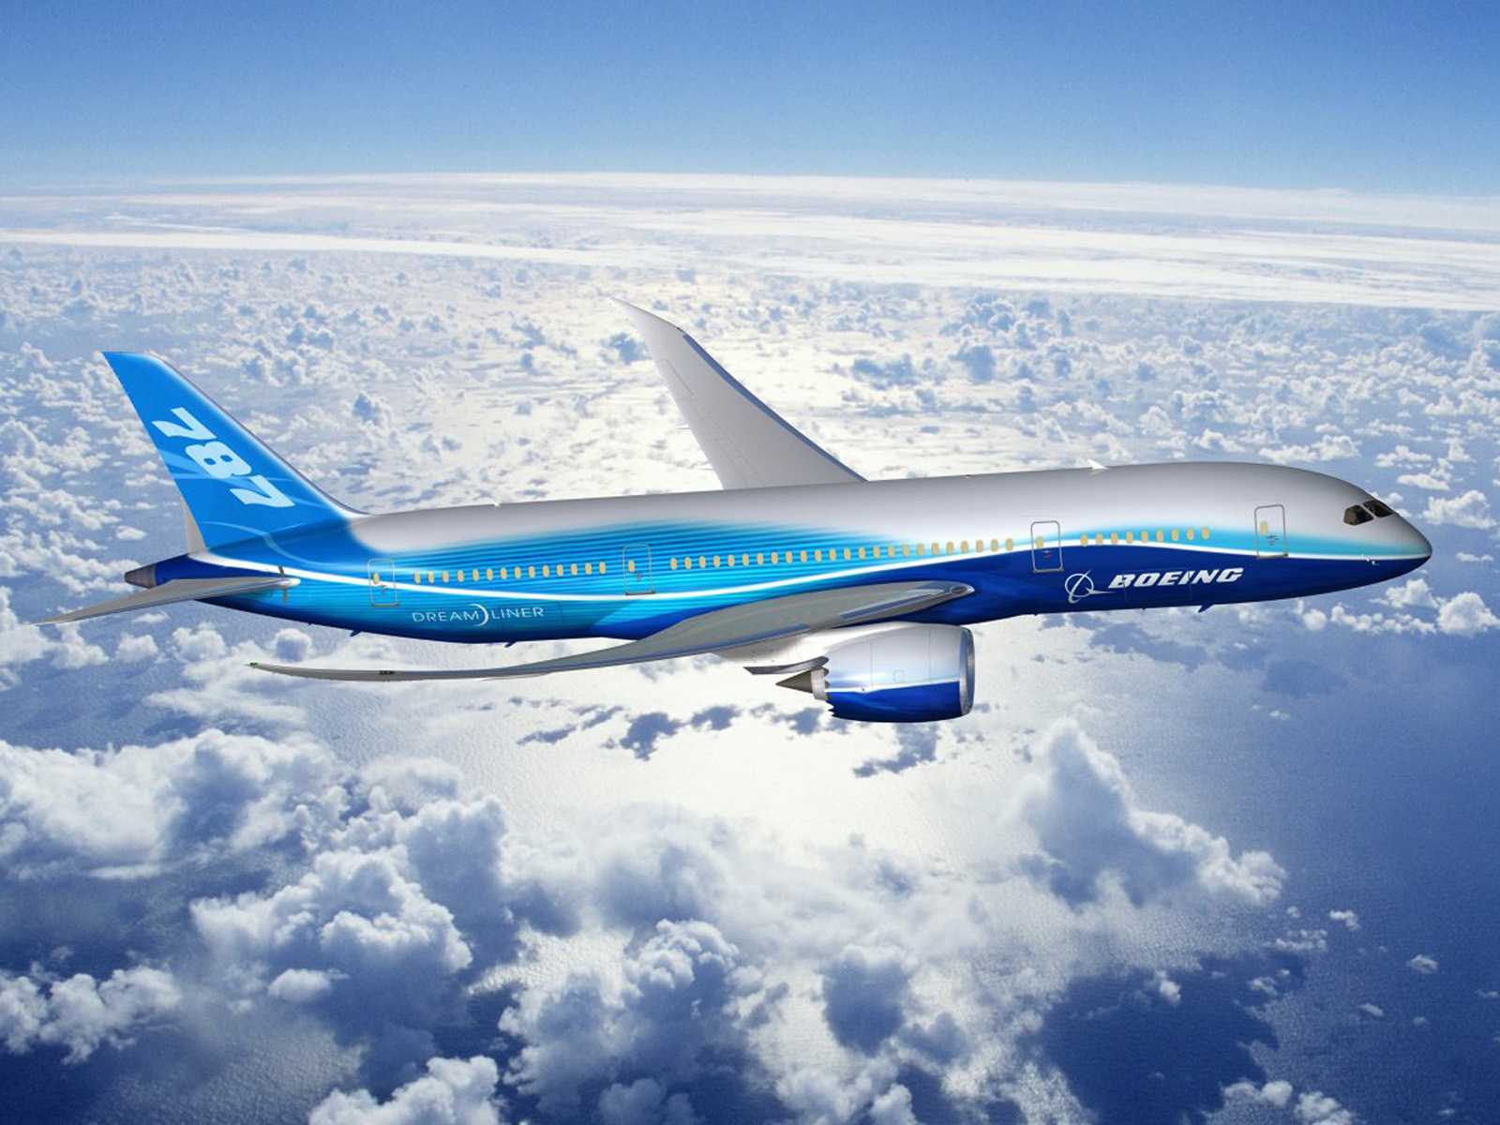
Airplane Delay Analyze
Encheng Zhang

Slide 2
Questions?
What are the key factors that cause the delay?
I. Is it cause by airport? Is some airport just performance so bad?
II. Is it cause by distance? Is longer or shorter distance delay more often
III. Is some specific day that it is more often that will delay
IV. Is some airline just performance so bad than the other?

Slide 3
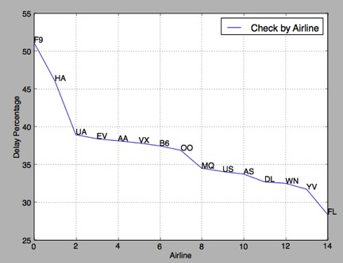
Analyze data by airline
After sort the information base on airlines and get the delay percentage, airline is a big factor for delay.

Slide 4
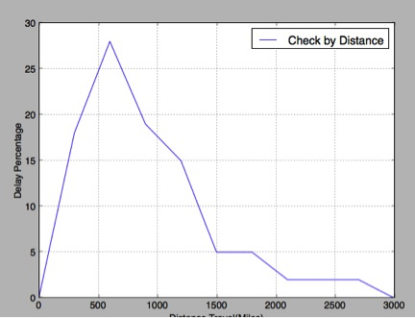
Analyze by travel distance
Travel distance due affect the delay, but it make not as we think, the shorter the distance travel, the more often to get delay

Slide 5
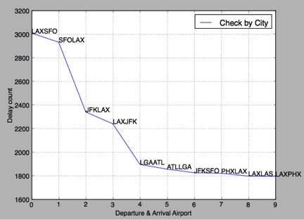
Finally, analyze by travel city
The departure and arrival city also is a key factor that impact the delay.

