Slide 1
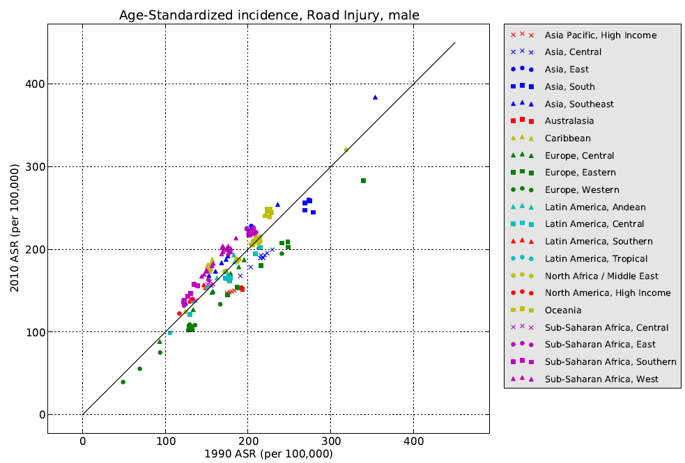
visualizing disease and injury rates
Ian Bolliger
Institute for Health Metrics and Evaluation

Slide 2
Background
DisMod 3 model produces country-age-sex-year-specific prevalence, incidence, excess mortality
Over 20,000 estimates per disease cause
Models can be very sensitive to parameter choice
Need a way to evaluate plausibility of each disease model along several criteria
Solution: Visualizations

Slide 3
Challenges
Model results stored in several formats (i.e. CSV, JSON)
Model is still evolving
Result formats will continue to change
Need to adapt to researchers desiring new visualizations

Slide 4
Implementation
Two types of summary figures deemed most valuable
Age pattern of disease by region
Scatterplot of age-standardized rate in 1990 and 2010 by country
Class developed to standardize format of model results at country and region level
MeanEstimates
Methods within this class written to produce plots

Slide 5
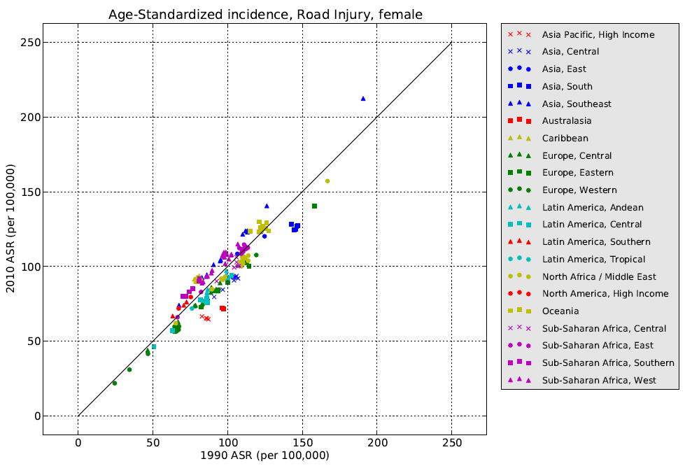
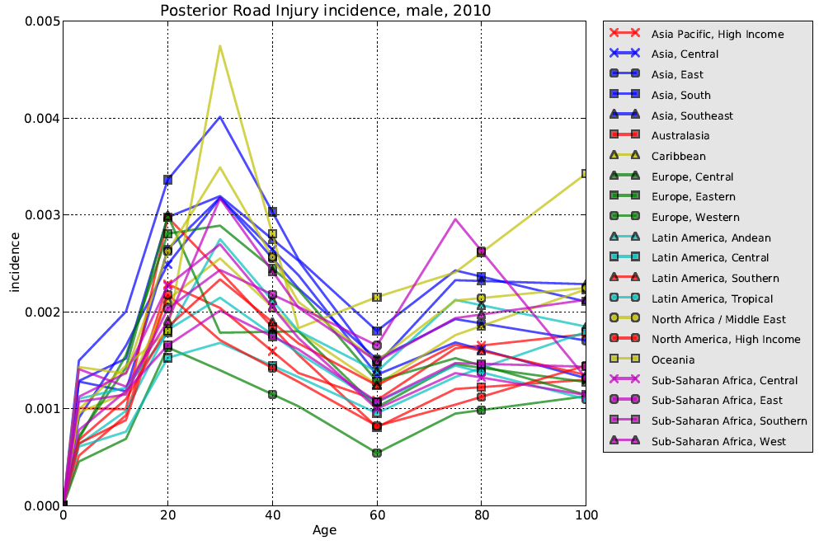
Results

