Slide 1
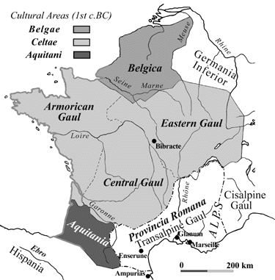
Debugging
Michael Ernst
CSE 190p
University of Washington

Slide 2
Two key ideas
The scientific method
Divide and conquer
If you master those, you will find debugging easy, and possibly enjoyable

Slide 3
The scientific method
Create a hypothesis
Design an experiment to test that hypothesis
Ensure that it yields insight
Understand the result of your experiment
If you don’t understand, then possibly suspend your main line of work to understand that
Tips:
Be systematic
Never do anything if you don't have a reason
Don’t just flail
Random guessing is likely to dig you into a deeper hole
Don’t make assumptions (verify them)

Slide 4
Example experiments
An alternate implementation of a function
Run all your test cases afterward
A new, simpler test case
Examples: smaller input, or test a function in isolation
Can help you understand the reason for a failure

Slide 5
Your scientific notebook
Record everything you do
Specific inputs and outputs (both expected and actual)
Specific versions of the program
If you get stuck, you can return to something that works
You can write multiple implementations of a function
What you have already tried
What you are in the middle of doing now
This may look like a stack!
What you are sure of, and why
Your notebook also helps if you need to get help or reproduce your results

Slide 6
Divide and conquer
Where is the defect (or “bug”)?
Your goal is to find the one place that it is
Finding a defect is often harder than fixing it
Initially, the defect might be anywhere in your program
It is impractical to find it if you have to look everywhere
Idea: bit by bit reduce the scope of your search
Eventually, the defect is localized to a few lines or one line; then you can fix it

Slide 7
Divide and conquer in the program
Localize the defect to part of the program (e.g., one function, or one part of a function)
Code that isn’t executed cannot contain the defect
Test one function at a time
Add assertions or print statements
The defect is executed before the failing assertion (and maybe after a succeeding assertion)
Split complex expressions into simpler ones
Example: Failure in
a = set({graph.neighbors(user)})
Change it to
x = graph.neighbors(user)
y = {x}
a = set(x)
(but with better variable names).
The error occurs on the "y = {x}" line

Slide 8
Debugging via print (or “logging”) statements
A sequence of print statements is a record of the execution of your program
The print statements let you see and search multiple moments in time
Print statements are a useful technique, in moderation
Be disciplined
Too much output is overwhelming rather than informative
Remember the scientific method: have a reason (a hypothesis to be tested) for each print statement
Don’t only use print statements

Slide 9
Divide and conquer in time
The code used to work (for some test case)
The code now fails
The defect is related to some line you changed
This is useful only if you kept a version of the code that worked (use good names!)
This is most useful if you have made few changes
Moral: test often!
Fewer lines to compare
You remember what you were thinking/doing recently

Slide 10
Divide and conquer in test cases
Your program fails when run on some large input
It’s hard to comprehend the error message
The log of print statement output is overwhelming
Try a smaller input
Choose an input with some but not all characteristics of the large input
Example: Unicode characters, zeroes in data, …

