Slide 1
Computers: A Look Behind The Curtain
Sam Wolfson
CSE 120, Winter 2020

Slide 2
Administrivia
Assignments
Controlling Elli due tonight
Portfolio Update 2 due next Wednesday (Feb 26)
Tic-Tac-Toe (last programming assignment until your final project!) due next Thursday (Feb 27)
Looking ahead…
Final project design document due next Friday (Feb 28)
Living Computers Museum report due Mar 2
Guest lecture next Monday: HCI

Slide 3
Quiz Recap

Slide 4
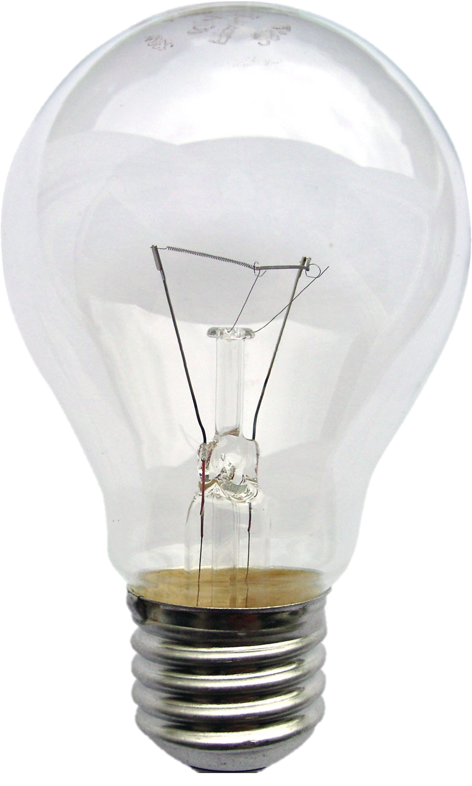
A Light Switch
The switch interrupts the circuit when it is off
-
+

Slide 5
A Light Switch
…and completes the circuit when it is on
-
+

Slide 6
A Transistor
…is just like a switch (but controlled by electricity)!
-
+
+
-

Slide 7
A Transistor
…is just like a switch (but controlled by electricity)!
-
+
+
-
Connecting the small circuit turns on the large circuit!

Slide 8
Transistors
Idea: use a small amount of electricity to control a (possibly larger) amount of electricity
Example: amplifiers
In computers: use circuits to control other circuits!
Notes:
Amplifiers use the small currents produced by reading CDs, radio signals, etc. and use them to control larger currents that drive the speakers.

Slide 9
Building Logic With Transistors
In Processing: can compare boolean values
In hardware:
false means the circuit is off
true means the circuit is on
How to implement comparison with transistors?
A && B
A || B
!A

Slide 10
AND gate
false: circuit off
true: circuit on
Goal: OUT = A && B
voltage
-
+
ground
Notes:
Don’t worry about the “R”s here (they’re resistors to prevent short-circuits) – talk with me after class if you’re interested.

Slide 11
AND gate
false: circuit off
true: circuit on
Goal: OUT = A && B
voltage
-
+
ground

Slide 12
AND gate
false: circuit off
true: circuit on
Goal: OUT = A && B
voltage
OUT is only true when both A and B are true!
-
+
ground

Slide 13
OR gate
false: circuit off
true: circuit on
Goal: OUT = A || B
voltage
OUT is true when either A and B are true!
ground
Notes:
I’ve omitted the wires to the battery here, but the same idea applies, can apply voltage to A or B.
Here, you can complete the circuit in two possible ways – if either transistor lets electricity through, then there will be electricity on out.

Slide 14
NOT gate
false: circuit off
true: circuit on
Goal: OUT = !A
voltage
OUT is true when A is false!
ground
Notes:
When T1 lets voltage through, it goes directly to ground instead of OUT.
When T1 blocks voltage, it goes to OUT instead.

Slide 15
Gates Galore!
Q = A || B
Q = A && B
Q = A ^ B
Q = !(A || B)
Q = !(A && B)
Q = !A
Notes:
“XOR” means A or B but not both

Slide 16
Gates can be combined…
To build more complex circuits
Addition, subtraction, multiplication, comparison, etc.
The CPU in your computer contains billions of transistors arranged into these circuits
Performs these operations billions of times per second
How do we tell the CPU what to do?
Could switch wires on and off, but…
Notes:
Much easier to represent these wires on/off as instructions

Slide 17
Computer Instructions
We can feed certain instructions into a computer and retrieve the results.
But what does an instruction look like? How do we know which one to use?
Like all other data on a computer, instructions are just binary! (literally translated to electricity on wires)
Example: the number 0x83 tells computers with Intel processors to add two numbers together.
An executable file (program) contains the binary encoding of all its instructions and data.
Example: .exe files on Windows
Notes:
On some level, we’re just putting voltages on wires to instruct circuits to connect in certain ways and perform the instructions that we want.

Slide 18
Instructions Are Limited
The number and types of instructions that a CPU can perform is always limited.
Can’t change the circuits after the CPU is built!
Example: with Lightbot, you could only perform a certain number of actions:
The instructions that a specific type of computer can understand are defined by the Instruction Set Architecture (ISA).
The CPU and other hardware are designed to understand only these predefined instructions.

Slide 19
Types of Instructions
What kinds of operations do you think would be useful for a computer to support?
Talk with your neighbor!
Shut down the computer
Arithmetic
User input
Taking pictures
Internet access

Slide 20
Types of Instructions
Arithmetic operations
Control flow: what should we do next?
Normally, instructions are executed sequentially. However, we can use control flow instructions to:
Jump to function calls
Possibly jump on conditional branches
Possibly jump in loops
Transfer data between CPU and memory
Load data from memory into CPU
Store data from CPU into memory
c = a + b;
z = x * y;
i = h && j;
int i = 0;
while (i < 3) {
i = i + 1;
}

Slide 21
Aside: Memory
We need somewhere to store information
Instructions for the computer to execute
Data (e.g., variables, files, etc.)
Treat memory like a single, massive array
Each entry is the same size (1 byte)
Each entry has an index (address) and a value (data)
If instructions need to reference data stored in memory, they can look it up using the address
Just like indexing into an array

Slide 22
Generating Instructions
We need to specify complex tasks using only simple actions provided by instructions
Luckily, this is done for us – by other programs!
High-Level Language
(Processing)
temp = v[k];
v[k] = v[k+1];
v[k+1] = temp;
Compiler
mov (%rsp), %edx
mov (%rsp,4), %ecx
mov %edx, (%rsp,4)
mov %ecx, (%rsp)
Assembly Language
(x86, MIPS, ARM)
Assembler
Machine Language
(Executable File)
0000 1001 1100 0110 1010 1111 0101 1000 1010 1111 0101 1000 0000 1001 1100 0110 1100 0110 1010 1111 0101
Notes:
How can you run your Processing program, with all of its complex logic, if-statements, drawing, etc., on a CPU that only offers a few instructions?
This all happens in real time when you hit “run”!
Compiled code and assembled code mean the same thing; the only difference is that compiled code is written so that humans can understand what it means, whereas assembled code is just bytes.

Slide 23
Bootstrapping
But wait – if we use another program to compiler our program, how was that program compiled?
Who compiles the compiler?
The first compilers were written directly in binary.
Bootstrapping: we can use simple languages to create increasingly complex ones.
Processing
Java
Python
C
Abstraction
Assembly

Slide 24
Instruction Execution
The agent (in this case, the CPU) follows instructions flawlessly and mindlessly.
Identical inputs → identical results
The program counter (PC) contains the memory address of the current instruction.
So the CPU knows what to execute
Updated after each instruction is executed, sometimes jumping around based on the program's control flow.
Notes:
Throwback to Lightbot

Slide 25
Fetch-Execute Cycle
The most basic operation of a computer is to continually perform the following cycle:
Fetch the next instruction (read from memory).
Execute the instruction based on its purpose and data.
Execute portion broken down into:
Instruction decode
Data fetch
Instruction computation
Store result
Update PC
Fetch
Instruction
Store Data
Decode Instruction
Compute Instruction
Fetch
Relevant Data

Slide 26
Fetch-Execute Cycle (Worksheet)
CPU
Memory
PC
Output
Address | Value
0x00 | 12
0x01 | 6
0x02 | add 0x00, 0x01
0x03 | store 0x01
0x02
Current Instruction

Slide 27
Fetch-Execute Cycle
CPU
Memory
PC
Output
Address | Value
0x00 | 12
0x01 | 6
0x02 | add 0x00, 0x01
0x03 | store 0x01
0x02
??
Current Instruction
??

Slide 28
Fetch-Execute Cycle
CPU
Memory
PC
Output
Address | Value
0x00 | 12
0x01 | 6
0x02 | add 0x00, 0x01
0x03 | store 0x01
0x02
??
Current Instruction
??
The Program Counter points to the address 0x02 in memory.

Slide 29
Fetch-Execute Cycle
CPU
Memory
PC
Output
Address | Value
0x00 | 12
0x01 | 6
0x02 | add 0x00, 0x01
0x03 | store 0x01
0x02
??
$$x+y$$
Current Instruction
add 0x00, 0x01
Fetch the instruction.

Slide 30
Fetch-Execute Cycle
CPU
Memory
PC
Output
Address | Value
0x00 | 12
0x01 | 6
0x02 | add 0x00, 0x01
0x03 | store 0x01
0x02
??
$$x+y$$
Current Instruction
add 0x00, 0x01
Decode the instruction.

Slide 31
Fetch-Execute Cycle
CPU
Memory
PC
Output
Address | Value
0x00 | 12
0x01 | 6
0x02 | add 0x00, 0x01
0x03 | store 0x01
0x02
??
$$12+6$$
Current Instruction
add 0x00, 0x01
Fetch the relevant data from memory.

Slide 32
Fetch-Execute Cycle
CPU
Memory
PC
Output
Address | Value
0x00 | 12
0x01 | 6
0x02 | add 0x00, 0x01
0x03 | store 0x01
0x02
??
$$12+6=18$$
Current Instruction
add 0x00, 0x01
Compute the result…

Slide 33
Fetch-Execute Cycle
CPU
Memory
PC
Output
Address | Value
0x00 | 12
0x01 | 6
0x02 | add 0x00, 0x01
0x03 | store 0x01
0x02
18
$$12+6=18$$
Current Instruction
add 0x00, 0x01
…and place it in temporary storage.

Slide 34
Fetch-Execute Cycle
CPU
Memory
PC
Output
Address | Value
0x00 | 12
0x01 | 6
0x02 | add 0x00, 0x01
0x03 | store 0x01
0x03
18
Current Instruction
add 0x00, 0x01
Now, advance the Program Counter to point to the next instruction.

Slide 35
Fetch-Execute Cycle
CPU
Memory
PC
Output
Address | Value
0x00 | 12
0x01 | 6
0x02 | add 0x00, 0x01
0x03 | store 0x01
0x03
18
Current Instruction
add 0x00, 0x01
Now, advance the Program Counter to point to the next instruction.

Slide 36
Fetch-Execute Cycle
CPU
Memory
PC
Output
Address | Value
0x00 | 12
0x01 | 6
0x02 | add 0x00, 0x01
0x03 | store 0x01
0x03
18
Current Instruction
store 0x01
Fetch the instruction into the CPU.

Slide 37
Fetch-Execute Cycle
CPU
Memory
PC
Output
Address | Value
0x00 | 12
0x01 | 6
0x02 | add 0x00, 0x01
0x03 | store 0x01
0x03
18
Current Instruction
store 0x00
Decode the instruction: “store the output value into memory at 0x00.”

Slide 38
Fetch-Execute Cycle
CPU
Memory
PC
Output
Address | Value
0x00 | 12
0x01 | 6
0x02 | add 0x00, 0x01
0x03 | store 0x01
0x03
18
Current Instruction
store 0x01
Execute the instruction.

Slide 39
Fetch-Execute Cycle
CPU
Memory
PC
Output
Address | Value
0x00 | 18
0x01 | 6
0x02 | add 0x00, 0x01
0x03 | store 0x01
0x03
18
Current Instruction
store 0x01
Execute the instruction.

Slide 40
Fetch-Execute Cycle
CPU
Memory
PC
Output
Address | Value
0x00 | 18
0x01 | 6
0x02 | add 0x00, 0x01
0x03 | store 0x01
0x04
18
Current Instruction
store 0x01
And so on, and so forth…

Slide 41
Clock Rate
The speed at which your computer can perform the Fetch-Execute cycle.
Must ensure that the clock rate is slow enough to accommodate the slowest instruction.
Clock rate is usually given in Hertz.
Example: $2 Ghz=2∗{10}^{9} Hz=2 billion \frac{instructions}{second}$
However, clock rate is often not a good indicator of speed
Modern CPUs spend a lot of their time idle, waiting for data from memory, disk drives, networks, etc.
$$1 hertz=\frac{1 instruction}{second}$$
Notes:
Equally important: speed of storage (SSD vs. hard drive), also important: speed of network.

Slide 42
Example: Running Processing
The Processing environment compiles your code into machine language (0s and 1s, which becomes electricity on wires in the CPU)
Memory is automatically set aside for the program's instructions, variables, and data.
Starting from the beginning of your program (in the case of Processing, the setup() function) the computer will continuously perform the Fetch-Execute cycle.
It will continue executing until the end of the program is reached, or it encounters an error.

