Slide 1
Images, Strings CSE 120 Winter 2020
Instructor: Teaching Assistants:
Sam Wolfson Yae Kubota Eunia Lee Erika Wolfe
The 2020 Election Will Be a War of Disinformation
“Every presidential campaign sees its share of spin and misdirection, but this year’s contest promises to be different. In conversations with political strategists and other experts, a dystopian picture of the general election comes into view—one shaped by coordinated bot attacks, Potemkin local-news sites, micro-targeted fearmongering, and anonymous mass texting. Both parties will have these tools at their disposal. But in the hands of a president who lies constantly, who traffics in conspiracy theories, and who readily manipulates the levers of government for his own gain, their potential to wreak havoc is enormous.”
https://www.theatlantic.com/magazine/archive/2020/03/the-2020-disinformation-war/605530/

Slide 2
Administrivia
Assignments:
Arrays and Elli [checkoff] due Friday (2/14)
Recommend getting checked off by the end of section on Thursday
Color Filters [checkoff] due Tuesday (2/18)
Word Guessing [checkoff] due Tuesday (2/18)
Quiz 3 this Friday
Topics and snippets posted on website
We’ll drop your lowest quiz
Big Ideas: Artificial Intelligence
Reading Check 6 due Thursday (2/13) before section
Notes:
Why drop lowest quiz?
This is a significant & new change to this course
We know that there are a lot of assignments and we want to hopefully relieve a little bit of the pressure

Slide 3
Report
Field trip out to the Living Computers: Museum + Labs in SoDo
Admission is paid for you!
Transportation: Link + walk, bus, drive
Go when you can: open Wed-Sun each week
Report: PDF including photos and responses due 2/26
Part 1: Favorite Exhibit
Part 2: Computer History
Part 3: Modern Tech Exhibit Reflection

Slide 4
Outline
Images
Compression
Strings

Slide 5
Images
An image is just a 2-dimensional set of pixels
The image has a width and a height
Each pixel has an associated (RGB) color
Notes:
Annotate a couple of pixels: black, white
Annotate ← width → and ^ \/ height

Slide 6
Images
An image is just a 2-dimensional set of pixels
The image has a width and a height
Each pixel has an associated (RGB) color
In Processing, an image is represented as an array of color data
Can explicitly use color[] myImage
Processing also provides special datatype PImage
Notes:
Each color in the array has an RGB color, so we can just stuff them all into an array

Slide 7
Using Images in Processing
Load an image from a file into a Processing variable
Use the loadImage("photo.jpg") function
The image name is a String representing the path to the file, similar to your website
Store the return value from loadImage() into a PImage variable
e.g. PImage myImg = loadImage("img/sam.jpg");
Draw the image on your canvas using the image() function
image(<PImage var>, <x>, <y>)
e.g. image(myImg, 0, 0);
Notes:
first, load the image
loadImage returns a PImage variable
Then, draw the image using image() function.
X and y pos refer to upper left corner (like rect)

Slide 8
The Canvas as an Image
The drawing canvas itself is also treated as an image!
Retrieve the current canvas image data (i.e. array of color data) using the loadPixels() function
loadPixels() has no parameters or return value
The canvas image data will be automatically stored into the system variable pixels[]
You can manually manipulate the data in pixels[]
e.g. pixels[0] = color(0); // set to black
Update the drawing canvas with the current/new data in pixels[] using the updatePixels() function
updatePixels() also has no parameters or return value
Notes:
Can also treat the entire canvas like an image!
loadPixels: canvas → pixels array
updatePixels: pixels array → canvas

Slide 9
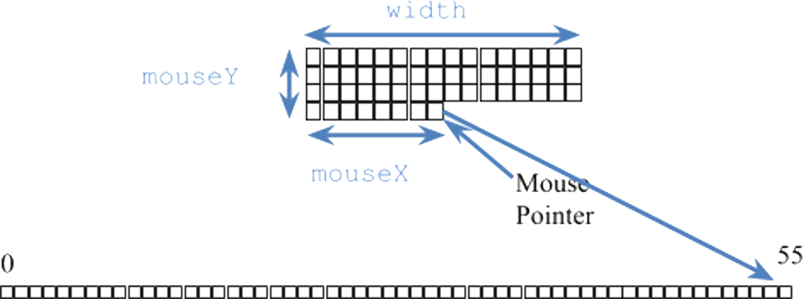
Linearizing an Image
Despite being 2-D in nature (i.e. x- and y- coordinates), we deal with image data in a 1-D array (i.e. pixels[])
As we increment our array index, we move left-to-right horizontally and then top-to-bottom vertically
Notes:
TODO This diagram is confusing: should show that this is only a partial view of the image.
Need to think of 2D image in terms of 1D array
Move horizontally across until we hit width-1, then back to the first col of next row, etc.
Example: suppose we want to find the pixel that the mouse is hovering over, width = 16
Draw chart: row 0, starting index 0
row 1 starting index 16
etc.
In general: index = row * width + col
Last pixel in example image is row 3, col 7 → index 55

Slide 10
Color as Data in Processing
Recall: all data on a computer is stored using binary encoding
Including colors, though we won’t cover exactly how
Processing has a special color datatype
We’re used to using the color(R, G, B) function to specify colors
Represents colors but looks nonsensical if you try to print it
Can retrieve the RGB triplet values using the functions red(), green(), and blue()
Notes:
Red() extracts just R values, etc. (draw arrows)

Slide 11
Color Filters
Learn the basics of using and manipulating images in Processing
You choose a photo to display
Display the RGB of the pixel your mouse is hovering over
Key presses will filter the colors of your image appropriately
Notes:
Looking ahead: this assignment will be next week

Slide 12
Outline
Images
Compression
Strings
Notes:
We covered this a little bit in Algorithms, but let’s see an example of how it’s actually done with relation to images.

Slide 13
Compression
Compression is the process of encoding information/data using fewer bits than the original representation
Lossless: original bits can be exactly recovered from transformed bits
Lossy: original bits cannot be exactly recovered from transformed bits (i.e. some data is lost)
Notes:
Two types of compression – we’ll mainly cover lossless

Slide 14
Lossless Compression
Eliminates bits that can be recovered again
Consider this 6 x 6 black-and-white image:
Uncompressed:
WWWWWW BBBBBB BWWWWB BWWWWB BBBBBB WWWWWW
Notes:
How can we reduce the size of this data without losing any information?

Slide 15
Lossless Image Format: RLE
Run Length Encoding
Not used commonly, but found in formats ( TIFF and Bitmap)
For repeated data/color, encode # of repeats
Many variations on actual encoding exist
Black-and-white example:
6W 7B 4W 2B 4W 7B 6W
Flag example:
HU = 45:R,45:W,45:G
IT = 5:G,5:W,5:R,5:G,5:W,5:R 5:G,5:W,5:R,5:G,5:W,5:R 5:G,5:W,5:R,5:G,5:W,5:R 5:G,5:W,5:R,5:G,5:W,5:R5:G,5:W,5:R
Notes:
PackBits: https://www.print-driver.com/stories/packbits-tiff
Bitmap: https://docs.microsoft.com/en-us/windows/desktop/gdi/bitmap-compression

Slide 16
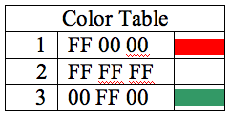
Lossless Image Format: GIF, PNG
Graphics Interchange Format
Uses a 256-color palette (not RGB) encoded in a Color Table
Why GIFs may not seem like “true color”
Uses LZW Encoding (Lempel-Ziv-Welch)
Create encodings based on strings of colors in image
Supplanted RLE for lossless compression
Portable Network Graphics
Improved, non-patented replacement for GIF
Doesn’t support animations
Notes:
Specifics of LZW beyond the scope of this course, but you can think of it as somewhat of a refinement to RLE
More on LZW: https://www.geeksforgeeks.org/lzw-lempel-ziv-welch-compression-technique/

Slide 17
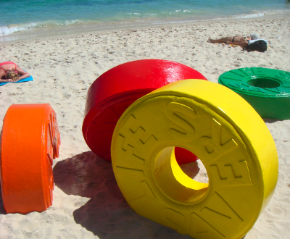
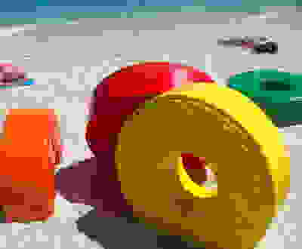
Lossy Image Format: JPEG/JPG
Joint Photographic Experts Group
Tradeoff between amount of compression and image quality
Areas of similar color are represented by a single shade
Based on quantization of discrete cosine transform (DCT) operation

Slide 18
Outline
Images
Compression
Strings

Slide 19
Strings
A string is 0 or more characters “strung” together
Strings cannot be modified, but string variables can be reassigned
Individual characters can be accessed (not modified), numbered from left-to-right starting at 0
String literal: an unnamed string specified between double-quotes
e.g. "hello", "!@#$%^&*()_+ ?~", "xoxo <3"
"" is known as the empty string (0 characters in it)
Notes:
Characters include letters, numbers, symbols, spaces, …

Slide 20
Using Strings
Declaration: String str;
Assignment: str = "hello";
Get character using str.charAt(i)
Get length using str.length()
Concatenation: join strings using ‘+’ operator
e.g. "hi " + "there" gives you "hi there"
Conversion to string usually occurs implicitly
Can also explicitly use str()
Notes:
String variable str
Assign string value with double quotes in Processing
Annotate position 0-4
Dot notation: retrieve characters (remember 0-indexed), get length (similar to array but with parens)
Join strings together with +: ”concatenate” when used with strings, “plus” when used with numbers
Can also join strings with non-strings, they will be converted implicitly (or can be explicitly)
e.g.,
Int x = 120;
“CSE” + x ←→ ”CSE” + str(x)

Slide 21
Strings vs. Arrays
Strings are sort of like arrays of characters:
 | Array | String
Declare
Initialize
Get element
Get length
Notes:
Char[] chArray String str
chArray = { … } str = “…”
chArray[n] str.charAt(n)
chArray.length str.length()

Slide 22
Example: Recording User Input
keyPressed() lets you read user input 1 character at a time
Use a String variable to “store”
Add/append new characters using concatenation

Slide 23
Example: Recording User Input
keyPressed() lets you read user input 1 character at a time
Use a String variable to “store”
Add/append new characters using concatenation
String input = "";
void draw() {
}
void keyPressed() {
input = input + str(key);
println("input = " + input);
}
Notes:
Start w/ empty string
Every time key is pressed…
Convert the char to a string
Append the key to input
Print input

Slide 24
Word Guessing
Learn to use text input & output
Player 1 enters a secret phrase
Player 2 tries to guess the secret phrase
Game tells you how many letters correct & # of attempts
Notes:
Looking forward: word guessing

Slide 25
Strings and Arrays Worksheet
Declaration: String str;
Assignment: str = "hello";
Get character using str.charAt(i)
Get length using str.length()
Concatenation: join strings using ‘+’ operator
e.g. "hi " + "there" gives you "hi there"
Conversion to string usually occurs implicitly
Can also explicitly use str()

