Slide 1
Basic Input and Output CSE 120 Winter 2020
Instructor: Teaching Assistants:
Sam Wolfson Yae Kubota Erika Wolfe Eunia Lee
Avast’s Free Antivirus Harvests All Your Clicks, Sells Them to Third-Parties
“As we’ve learned time and time again, “free” things on the internet are almost never truly free. If you’re not paying with money, you’re probably paying with your data. That’s the case with the free antivirus products from Avast, which harvest browsing history for sale to major corporations. Despite claims that its data is fully anonymized, an investigation by our sister site PCMag and Motherboard shows how easy it is to unmask individual users.
“Avast, which offers antivirus products under its own brand as well as AVG, has traditionally gotten high marks for its malware blocking prowess. When setting up the company’s free AV suite, users are asked to opt into data collection. Many do so after being assured all the data is anonymized and aggregated to protect their identities. However, Avast is collecting much more granular data than anyone expected, and that puts your privacy at risk.”
https://www.extremetech.com/internet/305344-avasts-free-antivirus-harvests-all-your-clicks-sells-them-to-third-parties

Slide 2
Administrivia
Assignments:
Reading Check 4 due tomorrow @ 3:30 pm (1/30)
Jumping Monster due Friday (1/31)
“Big Idea” this week: Digital Distribution
Quiz 2 this Friday
Topics posted on course website
New: memorization of short code snippets
Upcoming: Creativity Project

Slide 3
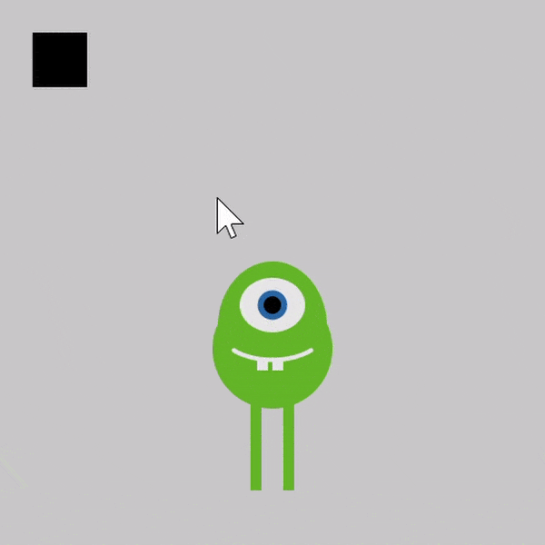
Jumping Monster
Using expressions and conditionals in conjunction with variables and user input (today) to control what is drawn as well as motion:
Notes:
Before we get into user input, we’re going to talk about some other cool stuff you can do in Processing.

Slide 4
Lecture Outline
Other Useful Processing Tools
User Input and Output
Mouse (input)
Keyboard (input)
Text (output)

Slide 5
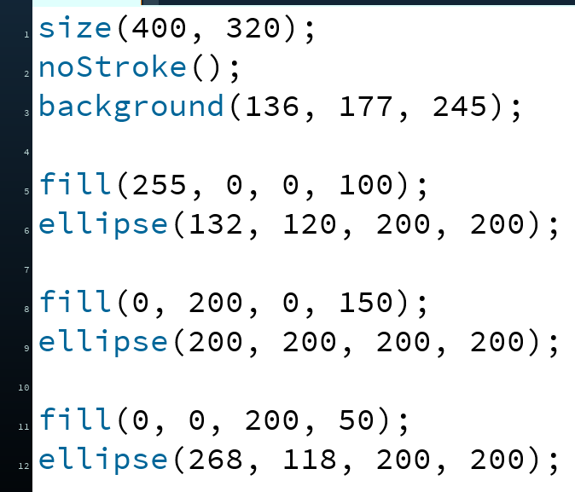
Transparency/Opacity
You can add a 4th argument to a color!
This also applies to the fill() and stroke() functions
This argument also takes an integer between 0–255
0 is fully transparent (invisible)
255 is fully opaque (the default)
Notes:
4th argument to fill() causes transparency – can now see overlapping parts of image

Slide 6
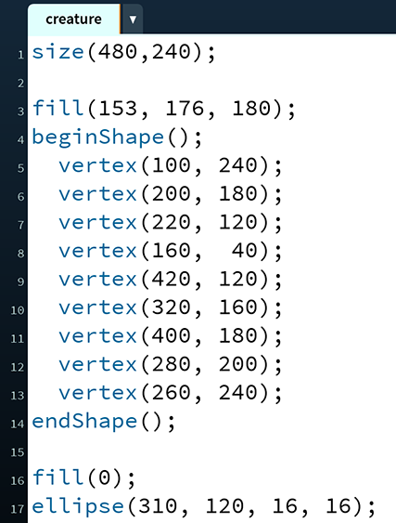
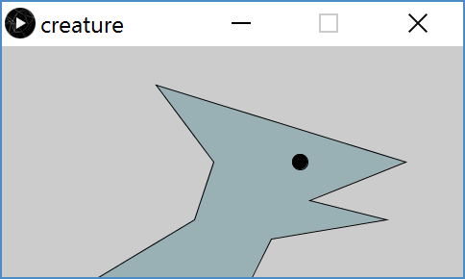
Custom Shapes
Define vertices between beginShape() and endShape()
If planning to reuse, best to create in a separate function
Notes:
You can draw custom shapes between beginShape() and endShape(), by drawing vertices at (x, y).
Place in a separate function so we can use them like the built-in shapes.
(100, 240) is lower left side of animal → (200, 180) → (220, 120), etc.

Slide 7
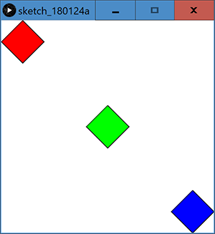
Functions Practice: Diamond
h
(x,y)
Fill in the code to produce:
w
_____ diamond( ______________________________ ) {
beginShape();
vertex( ______, ______ );
vertex( ______, ______ );
vertex( ______, ______ );
vertex( ______, ______ );
vertex( ______, ______ );
endShape();
}
void draw() {
}
Notes:
Arguments: float x, float y, float width, float height
X, y are the center
Vertices: - x, y-h/2
x+w/2, y
X, y+h/2
X-w/2, y
Back to beginning: x,y-h/2
In draw():
Fill(255, 0, 0);
Diamond(50, 50, 100, 100);
Fill(0, 255, 0);
Diamond(250, 250, 100, 100);
Fill(0, 0, 255);
Diamond(450, 450, 100, 100);

Slide 8
Lecture Outline
Other Useful Processing Tricks
User Input and Output *
Mouse
Keyboard
Text
* We will look at a subset of the available Processing commands. For a full list, see the Processing Reference.
Notes:
There is more stuff we haven’t covered! See the reference for a full guide.

Slide 9
Reminder: System Variables
Special variables that hold values related to the state of the program, often related to user input
You don’t need to declare these variables
These variables will update automatically as the program runs
Colored pink/magenta-ish in the Processing environment
We’ve used some of these already:
width, height, frameCount
We’ll see a lot more today
Notes:
We’ve seen some of these already – we’ll see more today.
Automatically updated when as the program runs
Reflect some of the state of your program

Slide 10
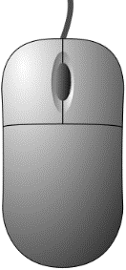
The Mouse
System variables:
mouseX – x-coordinate of mouse in current frame
mouseY – y-coordinate of mouse in current frame
pmouseX – x-coordinate of mouse in previous frame
pmouseY – y-coordinate of mouse in previous frame
mousePressed – is a button currently being pressed?
Built-in functions:
mousePressed() – called very time a button is pressed
mouseReleased() – called every time a button is released
Notes:
mouseX, mouseY: current frame
pmouseX, pmouseY: previous frame
mousePressed() vs. mousePressed: should only use one of them
the function runs if the mouse is pressed
The variable is true if the mouse is pressed

Slide 11
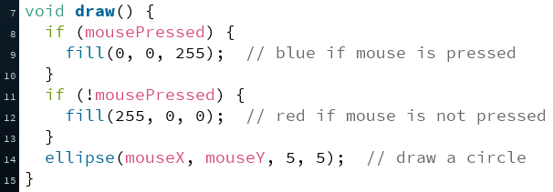
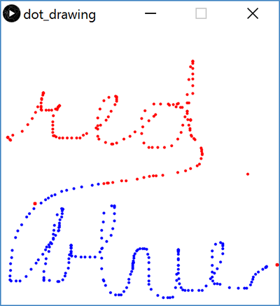
Example: Drawing Dots
Notes:
Already seen this example on Monday.

Slide 12
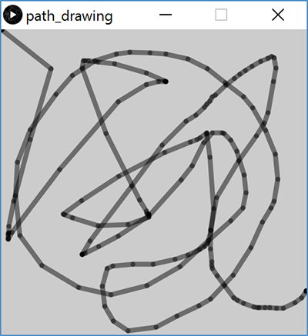
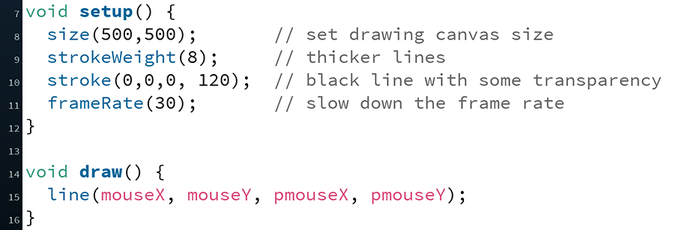
Example: Path Drawing
We just wrote a dot-drawing program
We can additionally use pmouseX and pmouseY to create a path-drawing program
Notes:
Line() draws the path that your mouse takes.
(If I switch mouse* and pmouse*, will that make a difference?)

Slide 13
Hovering Over a Rectangle
(x,y)
h
w
if(mouseX >= x)
if(mouseX <= x + w)
Notes:
Using mouseX and mosueY, we can check if the mouse is within a certain area!
Check if it is within the x coordinates – false in white area / true in lined areas

Slide 14
Hovering Over a Rectangle
(x,y)
h
w
if(mouseY >= y)
if(mouseY <= y + h)

Slide 15
Hovering Over a Rectangle
(x,y)
h
w
if( (mouseX >= x) &&
(mouseX <= x + w) && (mouseY >= y) && (mouseY <= y + h) )
Notes:
Need to check 4 different conditions!

Slide 16
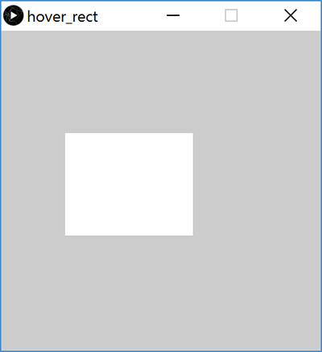
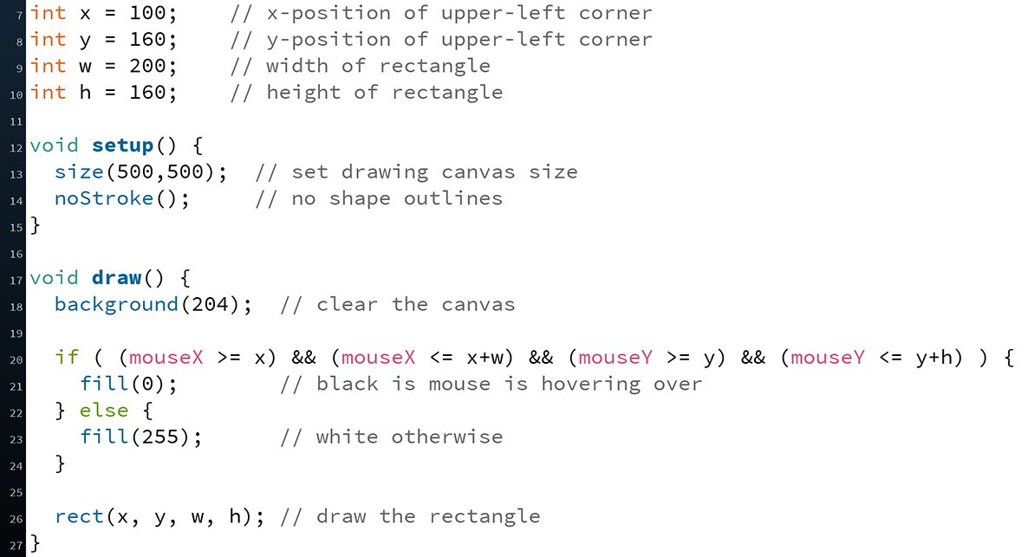
Hovering Over a Rectangle

Slide 17
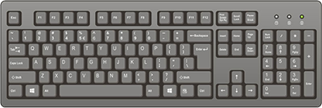
The Keyboard
System variables:
key – stores the ASCII value of the last key press
keyCode – stores codes for non-ASCII keys (e.g. UP, LEFT)
keyPressed – is any key currently being pressed?
Built-in functions:
keyPressed() – called every time a key is pressed
New datatype: char
Stores a single character (really just a number)
Should be surrounded by single quotes
e.g. char letter = 'a';
Notes:
Remember ASCII?
Recommend only using keyPressed (variable) or keyPressed() (function) – not both
When you press a key, key will store the value as a character (‘char’)
Surrounded by single quotes
Initialized as you expect – really just ascii values

Slide 18
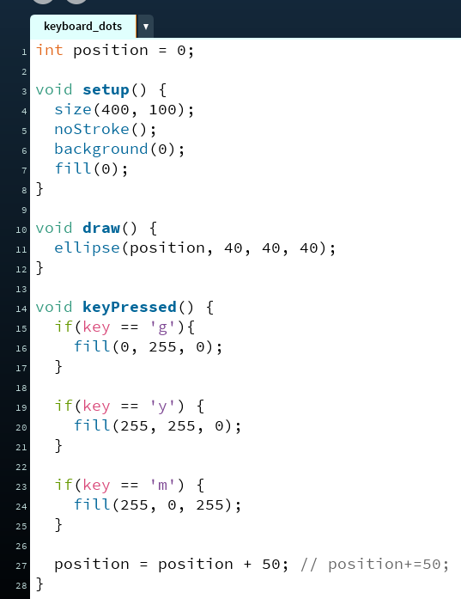
Example: What does this code do?
Notes:
Ellipse() draws circle at (pos, 40) every frame
keyPressed() runs anytime any key is pressed
Depending on the key color, change the fill
Next circle will be drawn with new fill color
Position changes so new circle will be drawn in new spot

Slide 19
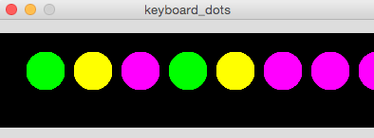
Example: Keyboard Dots

Slide 20
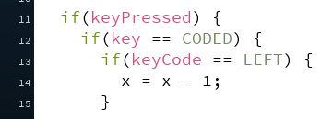
Example: Moving a Rectangle
Note: non-character keys, such as the arrow keys (UP, DOWN, LEFT, RIGHT) are coded keys
Notes:
Special keys: UP, DOWN, LEFT, RIGHT are “coded”
Check if a key is coded, then check if it’s the one that you want.

Slide 21
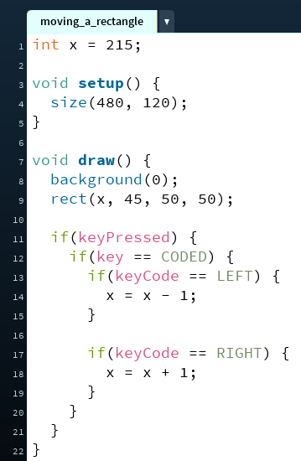
Example: Moving a Rectangle

Slide 22
Text Output
println(yourText);
Prints yourText to the console, which is the black area below your Processing code
Useful for debugging
text(yourText, x, y);
Prints yourText on the drawing canvas, starting with the bottom-left corner at coordinate (x,y)
Change the size of your text using textSize(size);
yourText should be between double quotes
We will talk more about the datatype String later
Notes:
Char: one character, single quotes, ‘q’
String: one or more characters, double quotes, ”hello”
Println() prints to the console
Text() prints to the canvas
Need to use double quotes for text – more on why later.

Slide 23
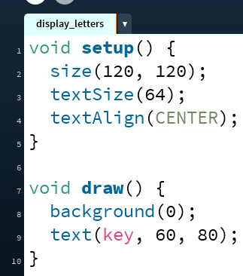
Example: Displaying Typed Keys

Slide 24
Looking Forward
Next week is the Creativity Assignment
In pairs, you will be asked to brainstorm TWO Processing projects of your choice
You will implement and submit ONE of your two projects
The point is to use the tools available to you to make something fun and creative!
Planning document due Tuesday (2/4)
Actual programs due next Friday (2/7)
Portfolio Update 1 is due Wednesday (2/6)
Taijitu, Logo Design, Lego Family, Animal Functions
Ask your TAs for assistance if you encounter problems!

