Slide 1
Algorithms CSE 120 Winter 2020
Instructor: Teaching Assistants:
Sam Wolfson Yae Kubota Eunia Lee Erika Wolfe
Quiz 1
You will have 20 minute to complete the quiz.
No outside materials are allowed – just your mind ☺
If you have a question, raise your hand.
Finish: 3:51

Slide 2
Administrivia
Monday (1/20) is a holiday – no class!
Yae may hold informal “office hours” – email her if you are interested (ykubota@uw.edu)
Assignments:
Logo Design [submit] is due Monday (1/20)
You should submit four different sketches of your logo as well as a detailed mockup.
Lego Family [submit] due on Friday (1/24)
Make sure you read the rubric before submitting!

Slide 3
Lego Family
Create an abstracted family/group of characters
Can’t use the Simpsons or Teenage Mutant Ninja Turtles
Be careful with level of detail vs. time you want to spend
Add motion to get them to come together
Notes:
This is something that we’ll talk more about next week but as a quick introduction.

Slide 4
Definition
An algorithm is “any well-defined computational procedure that takes some value, or set of values, as input and produces some value, or set of values, as output.” “An algorithm is thus a sequence of computational steps that transform the input into the output.”
From textbook Introduction to Algorithms (link)
Algorithm
(well-defined computational procedure)
Inputs
Outputs
Notes:
In CS, ”algorithm” has a somewhat different meaning than in society at large.
Quote from the “bible” of algorithms.
Needs to be well-defined
Needs to do computation
Needs to have a set of inputs (could be 0) and outputs
Kind of like a black box otherwise

Slide 5
Computational Problems
Can think of an algorithm as a tool for solving a computational problem
The problem statement specifies desired input/output (I/O) relationship
The algorithm describes a specific computational procedure that gives you the desired input/output (I/O) relationship
Example: Sorting is a computational problem
Problem statement: Given a sequence of numbers, put them in order
Example I/O: [1, 9, 3, 6, 2] $→$ [1, 2, 3, 6, 9]
Notes:
Computational problem just describes what the problem is that you want to solve – not how to do it.
e.g., ”give me back the number squared”
Algorithm describes the procedure to solve the problem
Sorting example: input → output

Slide 6
Early Algorithms
The concept of algorithms pre-dates computers
Dances, ceremonies, recipes, and building instructions are all conceptually similar to algorithms
Mathematical algorithms go way back:
Babylonians defined many fundamental procedures ~3600 years ago, more formal algorithms in Ancient Greece
Al-Khwarizmi laid out many algorithms for computation using decimal numbers
You implicitly use hundreds of numerical algorithms!
Nature runs algorithms (e.g. genes and development)
Notes:
Algorithms have been around since way before computers – computers just oftentimes solve them faster
dances, etc., not algorithms because they don’t solve computational problems but similar
Math algorithms have been around for a looong time
Al-Khwarizmi pronounced something like “algebra”
When you learned math, you were learning algorithms, just by a different name
Some algorithm from embryo to a person…we don’t understand it, but it exists
https://en.wikipedia.org/wiki/Muhammad_ibn_Musa_al-Khwarizmi

Slide 7
Properties of Algorithms
Algorithms can be combined to make new algorithms
It helps to know standard algorithms
Building from correct algorithms helps ensure correctness
There are many algorithms to solve the same computational problem
Developing a new algorithm to solve a problem can lead to insight about the problem
Notes:
Feed the output of an algorithm into another one to create a new algorithm that solves a larger computational problem
Specific CS courses to teach standard algorithms, can be composed to create new ones solving more complex problems
Sounds like abstraction! Solving smaller problems to build up complex ones
Have many options about how to solve a problem depending on what you care about (speed, size, readability, power usage)
Learn a “trick” about trying to solve a problem can help you understand it in a new way

Slide 8
Algorithms You’ve Seen
Create a Taijitu from rectangles and ellipses
Converting a binary number to decimal
Make a character move into place on the screen
… and many more!
Notes:
Ha! We’ve already been doing algorithms!
Can break these problems into computational steps

Slide 9
An Algorithm You’ve Seen Before
Multiplying two numbers:
Another multiplication algorithm?
Common core “box” method:
2
23
x 7
161
20 + 3_
7
140
21
140+21=161
Notes:
Multiplication is an algorithm! A defined set of steps to solve a problem.
Many ways to solve the same problem! Common core method to solve the same problem, but in a different way.
You might prefer one or the other

Slide 10
More Famous Algorithms
PageRank algorithm
Google’s measure of the “reputation” of web pages
EdgeRank algorithm
Facebook’s method for determining what to show on your News Feed
Luhn algorithm
Credit card number validation
Deflate
Lossless data compression
RSA Encryption
Encrypt (secure) data for transmission
Notes:
In section yesterday you might have discussed some of these
Luhn: can validate credit card number based on formula even without checking against company
Deflate: a single pixel is 3B of data, a movie is 1hr long, 30 fps, 1920x1080 pixels, how to squeeze massive data into smaller size?

Slide 11
Peanut Butter Jelly Time!
https://youtu.be/cDA3_5982h8
Notes:
This dad asks his kids to write down algorithms instructing him how to make a PB&J sandwich. Watch through 2:30.

Slide 12
Be Specific!
Algorithms need to be expressed in an unambiguous way for all participants
Natural language is often ambiguous
“Time flies like an arrow, fruit flies like a banana”
Notes:
A computer doesn’t have the ability to think – just following instructions
So you need to be extremely specific about what you ask it to do
To some extent, true for humans as well

Slide 13
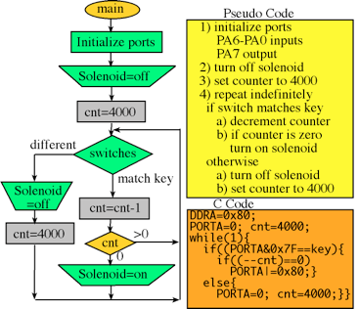
Ways to Express Algorithms
Many ways to specify an algorithm:
Natural Language (e.g. English, 中國) or Pseudocode
Easy for humans to understand, but can be ambiguous or vague
Visual and text-based programming languages (e.g. Scratch, Processing)
Have an exact meaning with no ambiguity
Can be run on a computer
Other information-conveying ways
e.g. flowcharts or pictures
Notes:
Describe how to perform an algorithm in words
Usually easy for humans to understand – but not computers
Also, can be ambiguous
For more specific algorithms, can use a programming language
Can also express algorithms e.g., in flowcharts

Slide 14
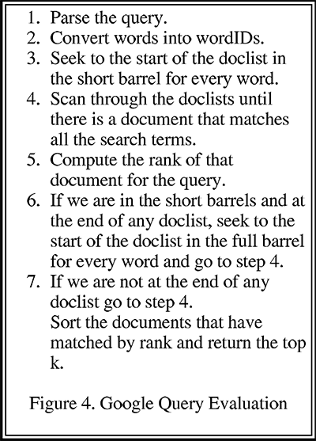
Google Query
From Larry Page and Sergey Brin’s research paper The Anatomy of a Large-Scale Hypertextual Web Search Engine
Notes:
Before google was started, this is how they expressed the algorithm that they used to rank pages.
- Has definitely evolved since then

Slide 15
Specifying Algorithms Practice
The following algorithms will “operate” on playing cards
Starting hand:
We will be playing the role of a computer
Rules and restrictions:
Using values: A$→$1, J$→$11, Q$→$12, K$→$13
You can only look at one card/value at a time
Anything you need to remember must be stored in a “variable”
Comparisons can only be done between two values
Notes:
Go through all the rules.

Slide 16
1) Search an Unordered List
Input: , desired card
Output: Yes if desired number is in the list, No otherwise
Algorithm:
Check each card starting from the left
If card is the one you’re looking for, then report Yes
If a different card, then move on (don’t report)
If done with numbers, then report No
Notes:
Use cards.
As a computer, can only look at one card at a time.
Can anyone come up with an algorithm to solve this computational problem?
Ask: someone tell me a card to search for.
Without higher-order reasoning skills, can still accomplish this algorithm.

Slide 17
2) Sort an Unordered List (version 1)
Input:
Output: The same list, but now in numerical order
Algorithm:
Starting from the left, compare two adjacent cards and swap them if they are not in order. Move one card over and repeat until you reach the end of the list.
Repeat until list is ordered.
This algorithm is called Bubble Sort
Notes:
Same starting list, want to end up with something sorted.
We’re going to use an algorithm called bubble sort
Since we can only compare two cards, will do that repeatedly

Slide 18
3) Find the Smallest Number in a List
Input:
Output: The index/position of the smallest number (5 in this case, since Ace is in the 5th position)
Algorithm:
Look at the first card and write down (or remember) the card value and the index 1.
Check the rest of the cards 1-by-1: if card value is smaller, then write (or remember) the new value and index.
Notes:
Remember, the computer can only see one card at a time.
Ask: how to solve this? Similar to search unordered list, but now, keep track of the smallest number. Reuse!

Slide 19
4) Sort an Unordered List (version 2)
Input:
Output: The same list, but now in numerical order
Algorithm:
Find the smallest number (algorithm 3) and move it to the front of the list.
Repeat this entire procedure, but for the rest of the list.
This algorithm is called Selection Sort
Notes:
https://visualgo.net/bn/sorting

Slide 20
5) Find Median of a List
Note: This is an actual job interview question!
Problem: Given a list of numbers (odd length, no repeats), return the median
Example: { should output 6
Algorithm:
Sort the list (algorithm 2 or 4).
Take the number in the middle index (N+1)/2.

Slide 21
Sorting
Sorting is a mind-bogglingly common task
Still difficult because it depends on (1) how many things you are sorting and (2) the initial ordering
We showed some simple sorting algorithms, but there are a lot cleverer ones
https://visualgo.net/bn/sorting
https://www.toptal.com/developers/sorting-algorithms
Notes:
There are a LOT of ways to sort lists. Some are clever, some are complex, some are stupuid (https://en.wikipedia.org/wiki/Bogosort), etc.

Slide 22
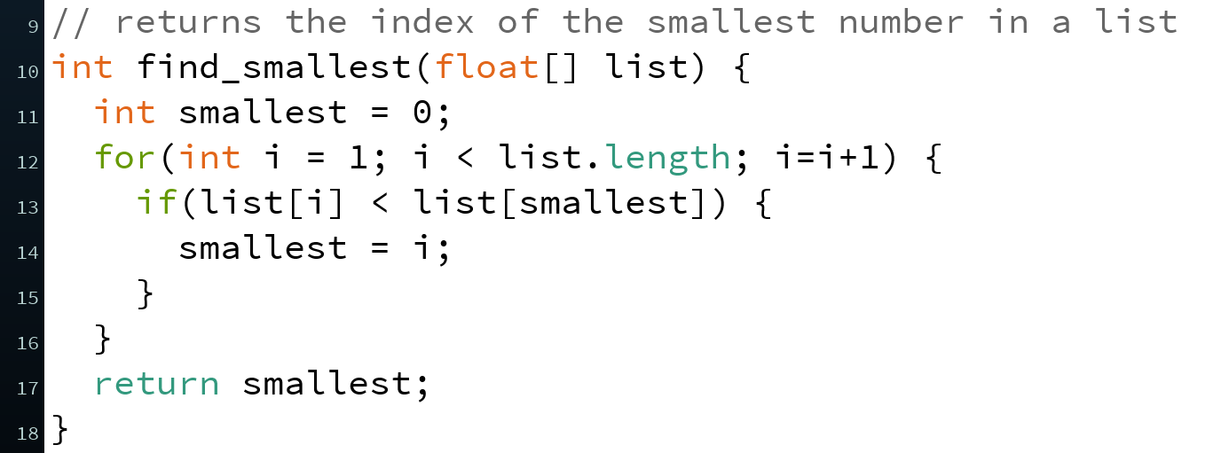
Implementations
If we specify an algorithm using code in a programming language, we say that the code implements the algorithm
A function or program that can be run on a computer
Example: Find index of smallest in list
Algorithm 3 of demo
Pseudocode/natural language
Function in Processing
Implementation
Notes:
Subtle difference between algorithm and implementation.
Specify the algorithm in a way that the computer can understand.

Slide 23
Which Language to Use?
Different languages are better suited for expressing different algorithms
Some languages are designed for specific domains, and are better for expressing algorithms in those domains
e.g. Unix shell scripts, SQL, HTML
https://en.wikipedia.org/wiki/Domain-specific_language
Language choice can affect things like efficiency, portability, clarity, or readability
Clarity and readability are VERY important considerations
Doesn’t affect existence of algorithmic solution
Notes:
Some languages lend themselves more easily to certain algorithms

Slide 24
Conceptual Question
I hand you a cooking recipe with no name – is this equivalent to a computational problem, algorithm, or implementation?
What can and can’t I do with just the recipe?
Talk with your neighbors!
Computational Problem
Algorithm
Implementation
Notes:
Computational problem: what is the i/o relationship?
[CORRECT] algorithm: procedure from input → output
Implementation: how a computer can do it

Slide 25
Summary
A computational problem is a problem statement with desired I/O relationship
An algorithm describes a computational procedure that satisfies/solves a computational problem
An implementation is an algorithm written out in a programming language (unambiguous, executable)
Properties of algorithms:
Can be combined to make new algorithms
Knowledge of existing algorithms & correctness help
There are many algorithms to solve the same computational problem

