Slide 1
Computer Science Principles CSE 120, Winter 2020
Instructor: Teaching Assistants:
Sam Wolfson Yae Kubota Eunia Lee Erika Wolfe
The biggest tech trends of 2020, according to top experts
In 2020, technologies will move toward the mainstream and begin impacting daily life. The next generation of wireless network, 5G, will begin to take hold, for example, and may work as a catalyst for other things like smart cities and smarter mobile and wearable devices. Augmented reality eyewear, which places digital content in the context of the real world, will begin to appear, and may use fast 5G connections to the cloud to identify people and things for us. The role of AI will increase in business, and the public will become more aware of it.
Next year’s tech will appear in the context of a turbulent political scene and perhaps the biggest election in U.S. history, a warming planet, an inefficient healthcare system, and a growing skepticism that tech companies will do no evil. Tech companies (and their investors) will be more aware of the public’s expectation that new products solve real, non-trivial, problems
https://www.fastcompany.com/90374432/here-are-the-top-tech-trends-of-2020-according-to-top-experts
Notes:
Hello & welcome!
At the beginning of each lecture, I’ll find an article about “CS in the news” with something relevant to the lecture/course/or at least something that I think is interesting

Slide 2
Who: Course Staff
Your Instructor: Sam
From Seattle
I like: teaching, skiing, hardware hacking
I’ve been a TA for this course twice, and last summer I taught a different CSE course here at UW.
TAs:
Available during lab, in office hours, and on Piazza
An invaluable source of information and assistance
Get to know us
We are here to help you succeed!
Notes:
Super excited to teach CSE principles because I think it’s a super interesting course and something that deserves more attention in an increasingly computer-centric world.
Your TAs and I will hold office hours, answer questions on our discussion board, etc. We’re here to help you, so get to know us!
This is a fairly small lecture, so we should all be able to get to know one another.
We have an awesome staff of TAs this quarter who collectively have lots of experience with teaching in general, and with CSE 120 in particular!
Here to help you succeed, let us know if you are having trouble.
TODO add TAs

Slide 3
Who: You!
25 students registered
Undergrads from many different majors (or pre-majors)
This class is intended for students without significant previous experience with computing/programming
Get to know each other and help each other out!
Learning is much more fun with friends
Working well with others is a valuable life skill
Diversity of perspectives expands your horizons
Please submit the Pre-Course Survey so we can learn more about you!
Notes:
You’ll also be interacting a lot with your fellow students!
Lots of students from different majors here
This course is really intended for students with no prior programming experience (talk to me if you aren’t sure whether this is the right course for you)
Designed to be lower-pressure than many other (intro) CSE courses, you’ll be doing a lot of work with other students who all have lots of diverse experiences
Pre-course survey on Canvas – staff bios are on the course website (or will be soon) – click our faces!
If you have taken APCS, or a previous text-based programming course, this is not the right class for you—consider enrolling in CSE142 instead.

Slide 4
Why Study Computer Science?
Massive impact on our lives and society as a whole
Increasingly useful for all fields of study and areas of employment
Notes:
Even if it’s not your focus, it has a massive impact on society
Also tends to be useful for lots of disparate fields
Audience: break into groups, get responses for careers they think don’t involve any computing.

Slide 5
Computing in Your Future
Computing and its data are inescapable
You generate “digital footprints” all the time
Computing is a regular part of every job
Use computers and computational tools
Generate and process data
Dealing with IT and software people
Understanding the computational portion of projects
Our goal is to help you make sense of the “Digital Age” that we now all live in
Notes:
I will try to convince you that computing is inescapable (unless you want to live in the woods, but even then…) (whether or not this is a good thing is it’s own topic entirely, but we’ll save that for a later lecture)
Computing is important for every jobs: creating and processing data
We don’t have enough time to make you super skilled programmers, but we do want you to have a sense of how CS impacts you and how you can be actively understand it – even if you never take another CS course. Fair enough?
And maybe some of you will decide you want to continue with CS – that’s great!
And some of you won’t – that’s fine too! But you’ll make the informed decision and you’ll know more about how it affects you

Slide 6
Computing and Society
Thumbs up/down if you or someone you know:
Work primarily from home
Have “stalked” someone online
Communicate mostly using 🐺👶 instead of words
Have taken extra trips outside to catch that Pokémon (does anyone still play that?)
Get the majority of your news from social media (yes, this includes Reddit)
Have had their identity or credit card number stolen online
Has seen a parent quiet a child by giving them a digital device
Notes:
How has computing affected our society?
Telecommuting is something that computing has enabled, for better or for worse – when are you really “off the clock”?
Have you looked up info about someone instead of asking them directly? (employers do this now too…)
I know I use lots of emojis instead of words – a whole new way to communicate & express emotions
Interactions between digital & physical world – anyone have a newer example of this?
New ways to enable theft
Change interactions with children & how we raise them
Lots of ways that they interact!

Slide 7
What This Course IS
This course is split into two major themes:
Computational Thinking
How can you use computers to solve problems
Using programming as a tool
Computational Principles
The “big ideas of computing” that we think everyone should know
e.g. bits can represent anything and everything, what a computer can and can’t compute, how the Internet works, social implications of computing
Notes:
Split into two parts:
CT is more of the thinking process of generally what types of problems that you could use a computer to solve, and how you would solve them – programming will enable you to actually do the problem-solving
Programming as a means to express CT
Principles: a survey of relevant and interesting topics in CSE that we think everyone should be aware of

Slide 8
What This Course Is NOT
Preparation for CSE 142: Computer Programming I
This is not just a programming course
We’ll introduce you to the concepts, but we will not expect you to master them
But great if you feel motivated to continue afterward!
Trivial
Supposed to be material you haven’t seen before
A technical class that asks you to read and write and be creative 🌈
Boring and exhausting
Intended to be fun, interesting, and reasonable
Notes:
Not intended to prepare you for 142 – purely a programming course focused on concepts
here, we don’t expect you to master them – but if you want to go on to take 142, that’s great
Not trivial: will teach you lots of new (& hopefully interesting) things
Not boring: we really want you to enjoy what you’re learning and the work you’re doing, and we want you to find it interesting
Feedback welcome ☺

Slide 9
About Programming
programming $≠$ computational thinking
Computational thinking is knowing how to break down and solve a problem in a way that a computer can do it
Programming is the tool you use to execute your solution
We use programming in this course as a way of teaching computational thinking
Can be learned, just like any other skill
Not black magic; there’s no such thing as a “coding gene”
Yes, at first it may be challenging and mind-bending – just like learning your first non-native language
My hope is that you will think differently after this course
Notes:
We're not just here to teach you programming, we have a broader goal
Programming is just a way to express CT, but is not the most important part of computer science
Programming like learning a language – once you have a generalized idea of what you’re trying to solve, the details of the specific language are less important
In this course we’re focusing more on CT, but using programming to teach it
CT is something that might be scary & foreign at first, but it’s not impossible – just another skill to learn

Slide 10
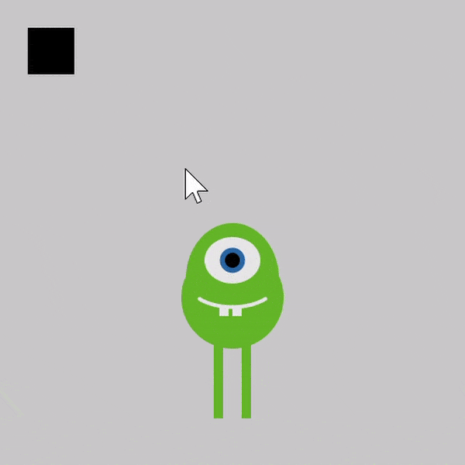
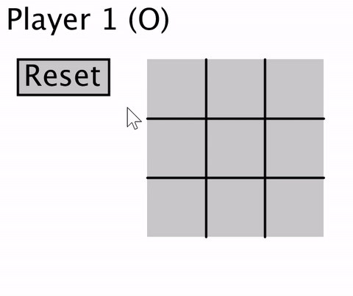
Programming in CSE 120
We’ll use a language called Processing
Text-based language that is good for visuals and interaction
We will use Java syntax
At the end of the day, the language you use doesn’t matter as long as you develop computational thinking skills
Notes:
We’ll use Processing for this course
Syntax is based on Java (like 142) but we’re primarily using it because it’s specifically designed to create visual & interactive programs
But, like I’ve been saying, the language doesn’t really matter in general
Here are some cool things you’ll create during this course!

Slide 11
Big Ideas of Computing
Exposure to a broad range of topics in computer science
Not going to dive into the details
These are the motivations & the applications for why it’s worth it to learn programming (the tool)
Focus on what to be aware of to navigate the digital world
Goal: become “literate” in computing
As new innovations arise, can you read about it, understand its consequences, and form your own opinion?
This course will ask you to read, discuss, present, and write about computing innovations
Notes:
The other piece: programming is only a small piece of computer science – all driven by big ideas!
Examples:
Artificial intelligence
Privacy
Algorithms
These lectures should be particularly fun – will cover a wide range of interesting topics, some will be given by guest lecturers
Goal: understand how new computing innovations will affect your life!
Because of that, we’ll ask you to explore computing innovations

Slide 12
Lecture Outline
Course Introduction
Course Syllabus & Policies
https://courses.cs.washington.edu/courses/cse120/20wi/syllabus
Abstraction
Notes:
Boring policy stuff…should all be on the course website as well

Slide 13
Communication
Website: http://cs.uw.edu/120
Calendar, schedule, policies, links, assignments, etc.
Grade book and assignment submissions via Canvas
Note: calendar uses 24-hour time
Discussion: http://piazza.com/washington/winter2020/cse120/
Ask and answer questions – staff will monitor & contribute
ALL questions on course material should go here
Office Hours: spread throughout the week
Can also email to make individual appointments
Anonymous feedback form
Notes:
Most information will be posted on our course website (bookmark it!)
Discussions will be on Piazza – you can ask questions, and they can be answered by course staff or by fellow students
Please don’t email us unless you have an unusual situation – you’ll get a faster response on the discussion board. You can make a private post to JUST the course staff if you are posting something that might give away an answer.

Slide 14
Weekly Schedule
Lectures are Mon, Wed, Fri (3 hr)
Friday lectures will generally be reserved for “Big Ideas”
Weekly reading is due before 3:30 pm on Thursday
All readings online, complete “reading check” to prep
Labs on Tue, Thu (3 hr)
Worksheets and work time with help from TAs
First half hour or so of Thursday lab will be spent doing group presentations on the readings
Can be a demanding schedule but should be fun! 😁
Monday | Tuesday | Wednesday | Thursday | Friday
Lecture | Lab | Lecture | Lab (Reading) | Lecture
Notes:
Three lectures per week, two lab sections
Friday lectures primary big ideas, should be fun, will include some guest lecturers
Weekly readings before each Thursday section and small reading check assignment on Canvas due before lab
Labs are time to work on projects, get extra help from TAs, discuss and present readings
Pull up course calendar.

Slide 15
Technology & Gadgets in 120
Gadgets reduce focus and learning
Bursts of info (e.g. emails, IMs, etc.) are addictive
Heavy multitaskers have more trouble focusing and shutting out irrelevant information
http://www.npr.org/2016/04/17/474525392/attention-students-put-your-laptops-away
This applies to all aspects of life, not just lecture
We will, however, require you to use computers in sections and some lectures
Be disciplined in your usage; don’t distract others
Lectures for which you’ll need a computer are marked with 💻 on the course calendar
Notes:
Personally if I’m sitting in class and on my computer, I’ll look up after a few minutes and realize I have no idea what’s going on
I’m not your parent, and you’re adults, so do what you want – but just know that research suggests you should minimize usage ☺
If you insist, please just make sure you’re not disrupting others
Some lectures will include programming – will be marked with :computer: on calendar
NPR segment: play until 2:28

Slide 16
Course Components and Grading
Programming Assignments (35%)
Includes a website portfolio of your work
Final Project (20%)
Of your own choosing!
Written Assignments (15%)
Reading checks, field trip report, mini research report
In-Lecture Quizzes (20%)
Every other Friday
Double-check your understanding of concepts
EPA: Effort, Participation, and Altruism (10%)
Encourage class-wide learning
Notes:
Not just a programming course – also includes reading, writing, etc.
We’ll also have a final project that you can choose!
Quizzes: fairly low-stakes and non-cumulative, but will help us make sure you’re understanding everything
EPA: participation by showing up, contributing on discussion board, helping other students
More details available on the syllabus

Slide 17
To-Do List
Bookmark and explore website thoroughly: http://cs.uw.edu/120
Read through the full course policies!!!
Check that you are registered on Piazza and Canvas
Pre-Course (Introduction) Survey due tomorrow (1/7)
More assignments will be introduced in lab tomorrow
First reading check due Thursday (1/9)

Slide 18
Lecture Outline
Course Introduction
Course Policies
Abstraction
Notes:
Any questions????
Abstraction: somewhat difficult to describe, has anyone heard of this or used it some way before?
Research paper: starts with abstract (short summary)
So, what is the goal of abstraction?

Slide 19
Complexity and Abstraction
Programming is straightforward, as long as your programs are small
Complexity is our enemy
Abstraction is the key to conquering complexity
Abstraction allows us to build general-purpose artifacts
Detail Removal: Hide unnecessary details from users and designers
Generalization: Avoid unnecessary repetitive work
Learning to reason using the most appropriate abstraction is a key goal of computational thinking
Notes:
…to deal with complexity.
If you just want to draw a few things, it’s fairly straightforward. But as it gets more complex, there’s a lot more “stuff” that you need to contend with.
Detail removal: only expose the parts that are necessary for the task at hand
Generalization: don’t reinvent the wheel, try to apply existing tools to similar but new problems
What is the most appropriate abstraction that allows you to solve a problem?
We’ll start with detail removal.

Slide 20
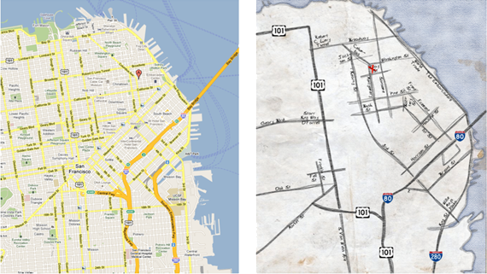
Abstraction: Detail Removal
“The act or process of leaving out of consideration one or more properties of a complex object so as to attend to others.”
Henri Matisse “Naked Blue IV”
Maps for directions
Notes:
Read out quote
What is missing from each of these examples?
1: missing features – how can tell that it’s a person? Has legs, head, etc., even though missing details that a real person would have
2: missing trees/buildings/people/etc. (not necessary for purpose)
3: missing small streets (what if google maps is down – how much detail can we remove and still solve the problem at hand? Don’t even need most of the streets)

Slide 21
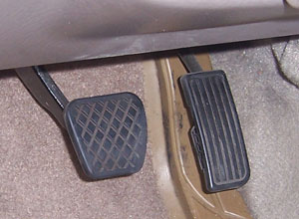
Abstraction: Detail Removal
Detail removal example:
Modern user interface: Right pedal is “accelerate”, left is “decelerate”
Even as underlying technology has changed, this abstraction has not!
Computer controlled fuel injection
Anti-lock brakes (ABS)
Electric cars
Notes:
User interface stays the same even as the underlying technology changes: pedals and steering wheel, shape is generally the same, position is the same
don’t need to know what’s going on under the hood as long as you understand the interface – it’s all abstracted away!
Nowadays, the pedals don’t even directly control systems, just sends a signal to a computer

Slide 22
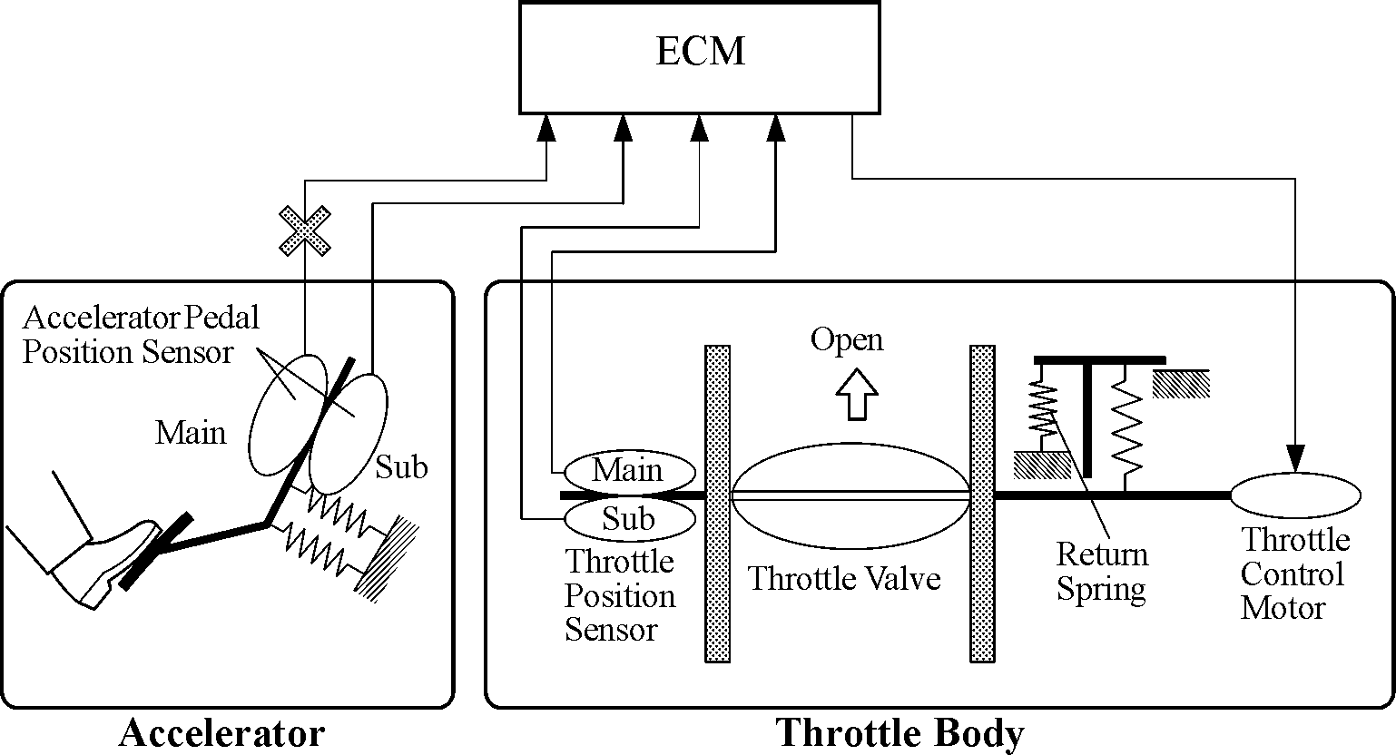
Abstraction: Detail Removal
Detail removal example:
Hide unnecessary details from other designers
e.g. Engine Control Module (ECM) designer doesn’t care about the return spring inside the Throttle!
Notes:
Detail removal also applies to how the car is designed
People who design accelerator pedal don’t even need to know the people who design the piece that actually sends fuel to the engine
“abstraction barrier” between accelerator and throttle body – don’t need to understand details of each other

Slide 23
Abstraction: Detail Removal
Detail removal example:
Hide unnecessary details from other designers
e.g. Engine Control Module (ECM) designer doesn’t care about the return spring inside the Throttle!
Nice to be able to think of a system as a hierarchy of well defined “chunks” with precise functionality
In CS, we say that we have a separation of concerns
Engine Control Module
Accelerator
Throttle
Notes:
ECM serves as “abstraction barrier” between accelerator and throttle – designer of each part isn’t concerned with how the other ones work, as long as it can send/receive data to/from them.

Slide 24
Abstraction: Generalization
“The process of formulating general concepts by abstracting common properties of instances.”
Extensible shower rods
Adjustable hats and belts
Single recipe for <fruit> cheesecake
Feeding animals on a farm
To feed <animal>, put <animal> food in <animal> dish
Your brain makes generalizations every day, without you even consciously realizing it!
Notes:
Read quote
Shower rods: not every bathroom same size, but instead of building a rod for every single bathroom, just make one that’s extendable
Same for hats/belts
Dealing with situations: when making recipes, can substitute ingredients like fruit while keeping the majority of the recipe the same
Feeding animals: just substitute animal name for each food type
One generalizable solution for all situations

Slide 25
Audience Responses
Other examples of detail removal:
Other examples of generalization:
Notes:
Detail removal:
Flying an airplane (autopilot)
Using a computer (press button)
Light switches
Generalization
Writing programmed formula
General sizing in clothing (S/M/L) instead of exact measurements

Slide 26
Summary
Abstraction is one of the most important challenges in computer science
How do you identify the right abstraction you need (block to build) to solve your problem?
Think about computers:
How many of you actually know how a computer works?
I certainly don’t understand every detail (I don’t know if anyone does…)
How many of you can use a computer?
Thanks to abstraction!!!

