Slide 1
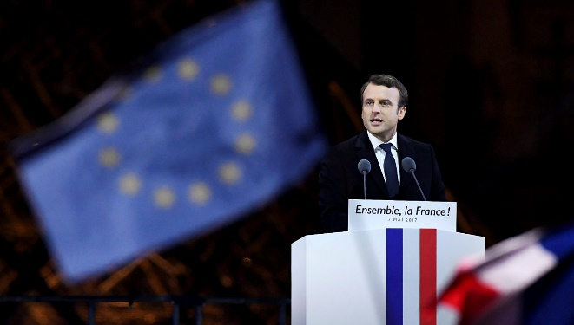
Developing an App CSE 120 Spring 2017
Instructor: Teaching Assistants:
Justin Hsia Anupam Gupta, Braydon Hall, Eugene Oh, Savanna Yee
Emmanuel Macron and how political campaigns will never be the same
The internet has become so big that trolls started to have a significant influence on the results of the elections. If you think Macron’s election proves that Facebook, Twitter, YouTube, 4chan, Reddit and other social media platforms don’t have a fake news problem anymore, you’re wrong. It’s been a nightmare, and it’s still going to be a nightmare for future elections.
It’s still hard to fix all your security weaknesses. It’s clear that all elections are going to be like this now. Political team members will all need to take a course on “Encryption 101” before joining a campaign.
https://techcrunch.com/2017/05/07/emmanuel-macron- and-how-political-campaigns-will-never-be-the-same/

Slide 2
Administrivia
Assignments:
Word Guessing due Thursday (5/11)
Living Computers Museum Report due Sunday (5/14)
Birthday Visualization due Monday (5/15)
Innovation Exploration post (5/21)
Guest lecture on Friday: Security
Reading Check (5/11) before lab section

Slide 3
Birthday Visualization
Data visualization for birthday frequencies
Learn how to read file data into Processing
Use color to visualize numbers
Detection of mouse location within a grid
int x_index, y_index;
if( (mouseX >= x) &&
(mouseX <= x + w) && (mouseY >= y) && (mouseY <= y + h) ) {
x_index = (mouseX-x)/(w/2);
y_index = (mouseY-y)/(h/2);
}
Notes:
x_index and y_index must be of datatype int!

Slide 4
Goals for Today
Collaborate!
TAs will also wander around to assist and answer questions
Practice testing, debugging, and refactoring
Don’t just wait for solution!
The real learning comes from exploring, creating, and making mistakes
Any real-world problem requires you to come up with a solution, not just follow directions

Slide 5
Outline
The Game
Design Phase
Coding Phase

Slide 6
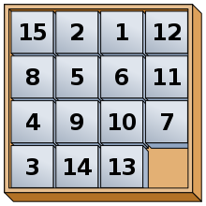
15 Puzzle
Sliding puzzle that consists of numbered square tiles in random order with one tile missing
Also known as “Mystic Square”
We will program just the game mechanics
Won’t do winning condition, since not all game states are solvable

Slide 7
App Mechanics
Tiles numbered 1-15 are shown on game board
One “open” or “empty” square
Clicking a tile next to the empty square will “slide” that tile into the empty space
Clicking other tiles has no effect
Clicking outside of the game board has no effect
Include a Reset button to return the game board to its initial state

Slide 8
Outline
The Game
Design Phase
Coding Phase

Slide 9
Design the Layout

Slide 10
Coding Decisions
How to represent the state of the game board?
How to implement the “slide” functionality?
How to respond to clicks?

Slide 11
Outline
The Game
Design Phase
Coding Phase

Slide 12
Create the Reset Button

Slide 13
Create the Tile Layout

Slide 14
Add Numbers to Tiles

Slide 15
Reset Functionality

Slide 16
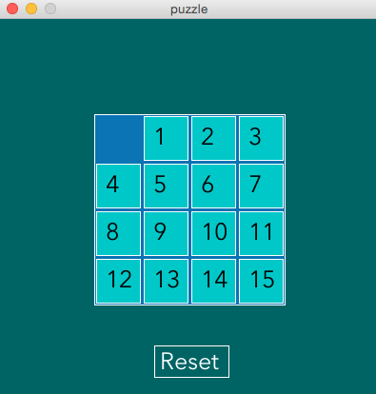
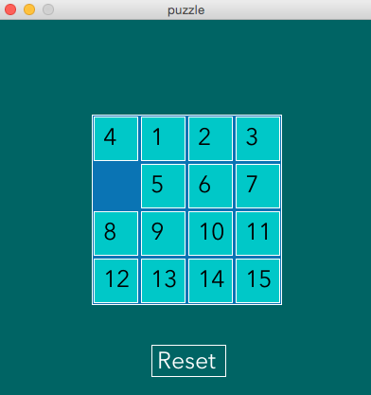
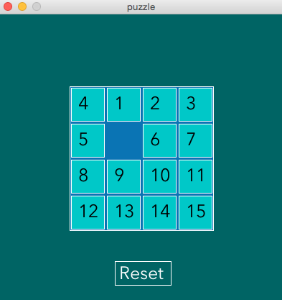
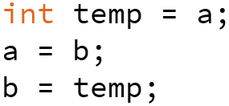
Tile Movements

Slide 17
If Time: Extensions
Change Reset button hover color
Create overReset() function that returns a boolean
Randomize initial tile placements
Tricky! How to avoid repeats?
Check for win condition: tiles ordered 0-15
Note: This is not achievable for many randomized starting orderings

Slide 18
Summary
Sketched the idea on paper
Planned out coding representations
Started with the things we knew how to do first
Built on previous work by adding one function or idea at a time
Ran the program after every improvement to make sure that it worked correctly
Unit and integration testing!!!

