Slide 1
Recursion II CSE 120 Spring 2017
Instructor: Teaching Assistants:
Justin Hsia Anupam Gupta, Braydon Hall, Eugene Oh, Savanna Yee
Braille Smartwatch Lets Users Feel Time, Texts And GPS Directions
Facebook, texting and GPS are commonplace tech that most of us use. But these apps… can be incredibly alienating for the visually impaired and blind.
The Dot smartwatch, which one could connect to a smartphone via Bluetooth, has a touch display where rising and falling dots spell out words in Braille.
Other smartwatches… [utilize] sound to read information on the screen through a speaker, but this method often robs disabled users of privacy.
http://www.huffingtonpost.com/entry/ braille-smartwatch-feel-messages-screen_us_58b489d1e4b060480e0aeceb

Slide 2
Administrivia
Assignments:
Mid-Quarter Survey due tonight (5/3)
Recursive Tree due Thursday (5/4)
Color Checker due Saturday (5/6)
Living Computers Museum Report (5/14)
Guest lecture on Friday: Proofs and Computation
Reading Check (5/4): mathematics
Midterm re-grade requests due tonight (5/3)
Adjusted scores will be uploaded to Canvas after regrade requests are handled

Slide 3
Recursion Review
A recursive function calls itself to solve its problem
Base Case:
What happens for special/simple inputs
Need base case(s) to prevent infinite recursion
Recursive Case:
Function calls itself one or more times on “smaller” problems
How to make the problem smaller varies $←$ this is the tricky part!

Slide 4
Outline
Example: Tower of Hanoi
Variable Scope Revisited
Example: Fibonacci
Example: Snowflake Fractal

Slide 5
Tower of Hanoi
Mathematical puzzle/game
Goal is to move entire stack from one peg to any other peg
Rules:
There are only 3 available pegs
Can only move one disk at a time
A disk cannot sit on top of a smaller one

Slide 6
Solving the Tower of Hanoi
The animation was probably daunting, but the recursive solution is surprisingly clean
Can still be mind-blowingly confusing to understand
For illustrative purposes – you’re not responsible for knowing this
Goal: Move the tower of height 5 from peg 1 to peg 3
Let’s assume our solution looks something of the form: moveTower(int height, int startPeg, int endPeg)
1
2
3

Slide 7
Solving the Tower of Hanoi
To reconstruct the tower on peg 3, we first need to get the largest disk (red) onto peg 3
Can’t do this while the other disks are on top
Solution: First move the 4 disks on top to peg 2
1
2
3

Slide 8
Solving the Tower of Hanoi
To reconstruct the tower on peg 3, we first need to get the largest disk (red) onto peg 3
Can’t do this while the other disks are on top
Solution: First move the 4 disks on top to peg 2
moveTower(4,peg1,peg2); $←$ just assume it works!
1
2
3

Slide 9
Solving the Tower of Hanoi
Now we can move the red disk to peg 3
1
2
3

Slide 10
Solving the Tower of Hanoi
Now we can move the red disk to peg 3
moveTower(1,peg1,peg3);
Next Goal: Move the tower of height 4 from peg 2 to peg 3
Solution: First move the 3 disks on top to peg 1, then move the orange disk to peg 3
1
2
3

Slide 11
Solving the Tower of Hanoi
Generalized recursive solution to move tower of height $H$ from source peg to destination peg:
Move tower of height $H$-1 from source peg to extra peg
Move the remaining bottom disk from source peg to destination peg
Move tower of height $H$-1 from extra peg to destination peg
1
2
3
“Source”
“Extra”
“Destination”

Slide 12
Solving the Tower of Hanoi
Generalized recursive solution to move tower of height $H$ from source peg to destination peg:
moveTower(H-1,peg1,peg2);
moveTower(1,peg1,peg3);
moveTower(H-1,peg2,peg3);
1
2
3
“Source”
“Extra”
“Destination”

Slide 13
Solving the Tower of Hanoi
What’s the base case?
Don’t recurse (but still move disk) when $H==1$
1
2
3
“Source”
“Extra”
“Destination”

Slide 14
Outline
Example: Tower of Hanoi
Variable Scope Revisited
Example: Fibonacci
Example: Snowflake Fractal

Slide 15
Variable Scope Revisited
Internal variables (i.e. parameters) only exist within the function they are declared
The variables “cease to exist” when the function returns
Each individual call of a recursive function contains a separate set of parameters, even though they have the same variable names
Parameters have initial values set by the passed arguments

Slide 16
Variable Scope Revisited
Local variables take precedent over variables of the same name
Detail Removal: internal variable names are independent of external variable names, even if the same names are used
We can think of every function call as creating a new function environment, which later disappears once the function returns
Global variables exist outside of these environments and are accessible to all of them

Slide 17
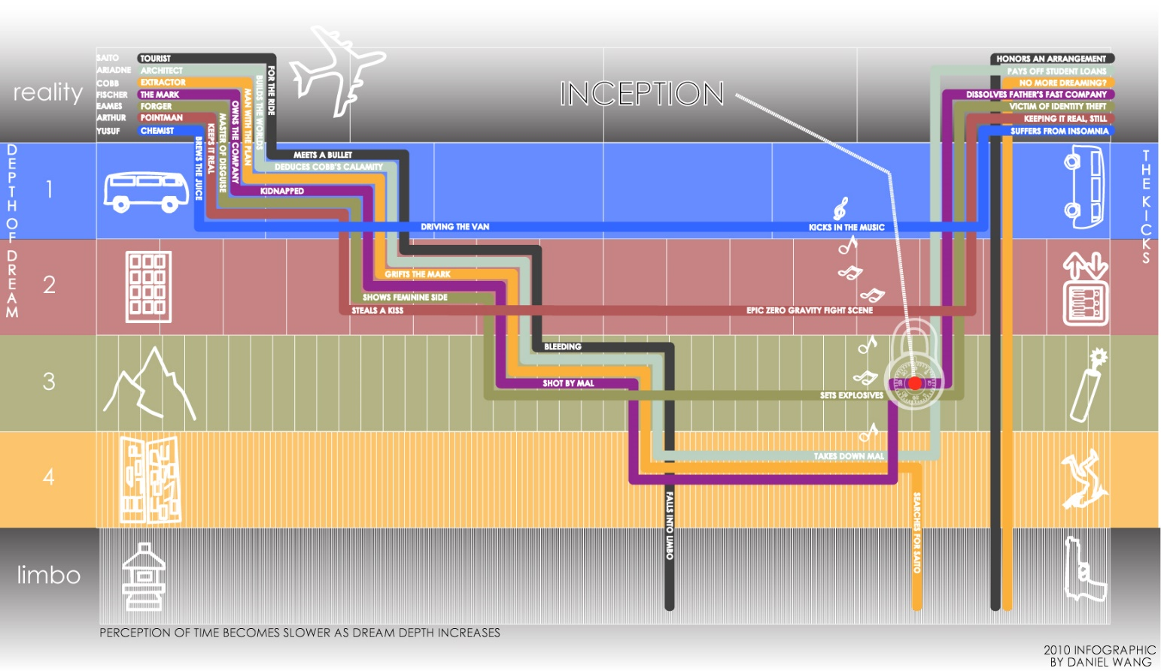
‘Inception’ Analogy (2010 film)
Each dream is a function call, each “kick” is a function return
e.g. the ‘reality’ function calls the ‘Robert Fischer dream’ function
Characters are the parameters – they may have the same names, but are different (clothes?) in every layer
http://images.fastcompany.com/upload/INCEPTION%20infographic%20v3.5.2_dwang.jpg

Slide 18
Add Example
Recursive add():
Environment diagram if we call add(3,2):
int add(int x, int y) {
if(y==0) {
return x;
} else {
return add(x+1,y-1);
}
}
4
x: 3
y: 2
return 5
1
3
x: 4
y: 1
return 5
2
x: 5
y: 0

Slide 19
Peer Instruction Question
In the shown code, what will be printed after "3: "?
Vote at http://PollEv.com/justinh
0
1
4
5
int x = 0;
void setup() {
x = 1;
}
void draw() {
println("1: " + x);
foo(4);
println("3: " + x);
noLoop();
}
void foo(int x) {
x = x + 1;
println("2: " + x);
}

Slide 20
Outline
Example: Tower of Hanoi
Variable Scope Revisited
Example: Fibonacci
Example: Snowflake Fractal

Slide 21
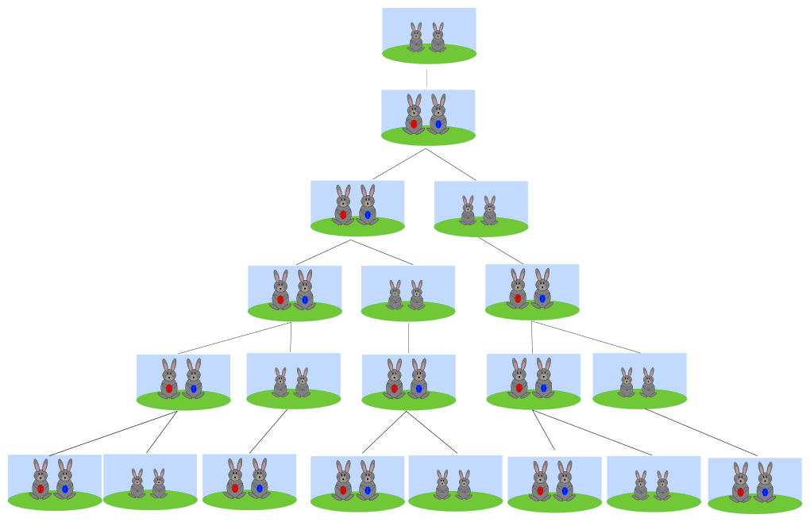
Fibonacci
The Fibonacci Sequence is as follows:
0, 1, 1, 2, 3, 5, 8, 13, 21, 34, 55, 89, 144, …
The first two numbers are 0 and 1
All following numbers are the sum of the previous two numbers
https://en.wikipedia.org/wiki/Fibonacci_number
Appeared as syllable counting in Indian mathematics, then more famously in a math puzzle regarding rabbit breeding:

Slide 22
Fibonacci
The Fibonacci Sequence is as follows:
0, 1, 1, 2, 3, 5, 8, 13, 21, 34, 55, 89, 144, …
fib(0) = 0, fib(1) = 1
Otherwise, fib(n) = fib(n-1) + fib(n-2)

Slide 23
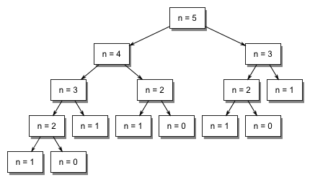
Fibonacci Call Structure
Call structure of add() looked like a call list
It contained one recursive call: add(x+1,y-1)
Fibonacci makes how many recursive calls?
fib() looks like a call tree – each recursive case makes two calls to fib()

Slide 24
Outline
Example: Tower of Hanoi
Variable Scope Revisited
Example: Fibonacci
Example: Snowflake Fractal
The following exercise is from the Beauty and Joy of Computing (BJC) curriculum: http://bjc.berkeley.edu/bjc-r/cur/programming/recur/fractals/snowflake.html

Slide 25
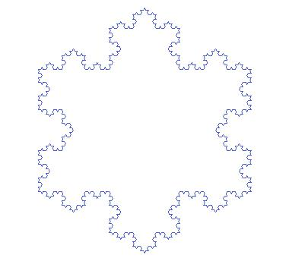
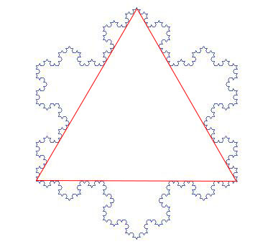
Koch Snowflake
A mathematical curve that is one of the earliest fractal curves to have been described
https://en.wikipedia.org/wiki/Koch_snowflake
3 arranged copies of the same fractal

Slide 26
Code: Triangle
Copies of fractal arranged in a triangle:
void draw() {
noLoop();
}

Slide 27
Code: Triangle
Copies of fractal arranged in a triangle:
void draw() {
translate(250,100); // start at top point
rotate(radians(60));
for(int i=0; i<3; i=i+1) {
line(0,0,len,0); // replace with fractal
translate(len,0);
rotate(radians(120));
}
noLoop();
}

Slide 28
Drawing the Fractal
Break each segment into 4 segments of equal length
First call:
Second call:
Third call:
Fourth call:

Slide 29
Code: Fractal
First call:
void snowflake_fractal(float len) {
line(0,0,len/3,0);
translate(len/3,0);
rotate(radians(-60));
line(0,0,len/3,0);
translate(len/3,0);
rotate(radians(120));
line(0,0,len/3,0);
translate(len/3,0);
rotate(radians(-60));
line(0,0,len/3,0);
translate(len/3,0);
}

Slide 30
Code: Make It Recursive
Recursive case
Instead of drawing a line, draw the fractal!
Each smaller segment is 1/3 the length of the larger segment
Replace line() and translate() command pairs with calls to snowflake_fractal()
Base case
Introduce level variable
Arbitrarily tells us how deep to recurse
When level==0, just draw line instead of fractal

Slide 31
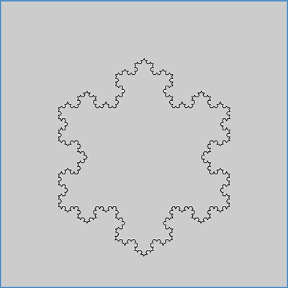
The Result
Can draw snowflake fractal of arbitrary depth!
level=1
level=2
level=3
level=4

