Slide 1
The Internet CSE 120 Spring 2017
Instructor: Teaching Assistants:
Justin Hsia Anupam Gupta, Braydon Hall, Eugene Oh, Savanna Yee
Alphabet will track health data of 10,000 volunteers to ‘create a map of human health’
Verily is launching today a four-year study called Project Baseline to find out why people transition from being generally healthy to getting sick.
Most doctors will treat symptoms as they arise, but have little indication into how the patient was faring in the years leading up to the illness. The Baseline researchers are hoping to find early warning signs for disease from all the data it is collecting, including on sleep, activity, heart rate, genomics and more, which might translate into new lifestyle or therapeutic interventions.
http://www.cnbc.com/2017/04/18/alphabet-verily-project-baseline-longitudinal-health-study.html

Slide 2
Administrivia
Assignments:
Binary Practice (4/21)
Creativity Assignment (4/24)
Midterm in class on Wednesday, 4/26
1 sheet of notes (2-sided, letter, handwritten)
Fill-in-the-blank(s), short answer questions, maybe simple drawing
Questions will cover lectures, assignments, and readings
Midterm Review sheet covered in lab next week (4/25)

Slide 3
Outline
Networks
Growth of the Internet
Sending Information

Slide 4
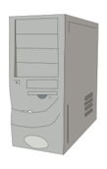
Communication Channels
We often transmit sequences of bits between computers – why?
Only capability we need because of binary encoding!
Via wire: Ethernet
Via wireless: WiFi, 3G/4G, Bluetooth
A network is a group of computing devices connected together, either by wire or wirelessly
Notes:
Access more information and software than is stored locally.
Help users communicate & exchange information.
Perform other remote services.

Slide 5
A Simple Model for Networks
One way to represent computer networks is as a graph
Each node represents one machine on the network
Each edge represents a connection between two machines
Below is a network of just two computers:
2 nodes and 1 edge
Node
Node
Edge

Slide 6
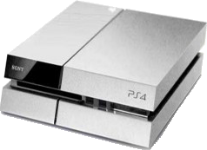
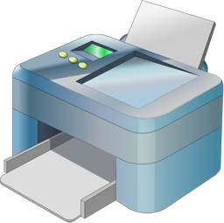
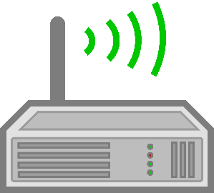
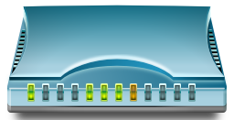
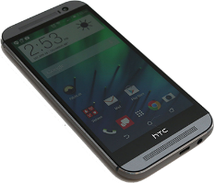
Example: Home Network
The network at my house: 7 nodes, 6 edges
Not counting the outside world

Slide 7
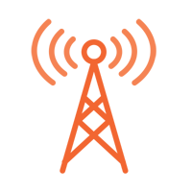
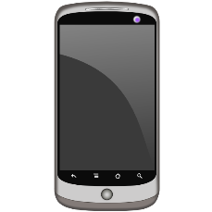
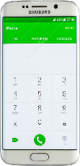
Example: Cellular Network

Slide 8
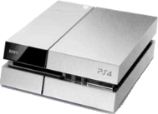
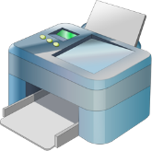
Internetworking
If you connect two networks, you still have a network
Sometimes called an “internetwork”
The largest network of networks on the planet is usually called “The Internet”

Slide 9
Network Scales
Table from an old UW Networking MOOC:
Scale | Type | Example
Vicinity | PAN (Personal Area Network) | Bluetooth (e.g. headset)
Building | LAN (Local Area Network) | WiFi, Ethernet
City | MAN (Metropolitan Area Network) | Cable, DSL
Country | WAN (Wide Area Network) | Large ISP
Planet | The Internet (network of all networks) | The Internet

Slide 10
The Interwebs?
The Internet vs. The World Wide Web (WWW)
Is there a difference?
The Internet: All of the hardware and data associated with the network of all networks (wires, fibers, switches, routers, servers, files, etc.)
The World Wide Web: The system used to access the Internet (data transmission via browsers, web servers, web services, etc.)

Slide 11
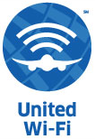
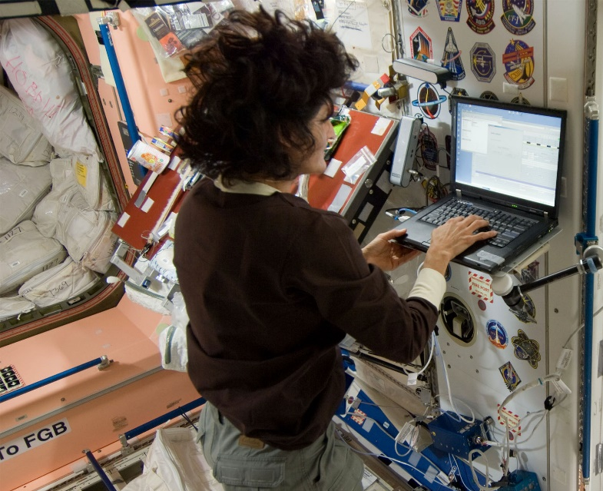
Internet Accessibility
Can now get Internet almost anywhere:
On a bus
On a plane
On a mountain
In outer space
StarTribune
united.com
Slash Gear
NASA

Slide 12
The Internet Today
Internet Usage as a Percentage of Population (2015)
By Jeff Ogden (W163) - Own work, based on figures from the Wikipedia:List of countries by number of Internet users article in the English Wikipedia, which is in turn based on figures from the International Telecommunications Union (ITU) for 2010 (updated to use figures for 2012 on 28 June 2013).iThe source code of this SVG is valid.This vector image was created with a text editor.This vector image includes elements that have been taken or adapted from this: BlankMap-World6.svg., CC BY-SA 3.0, https://commons.wikimedia.org/w/index.php?curid=19202338

Slide 13
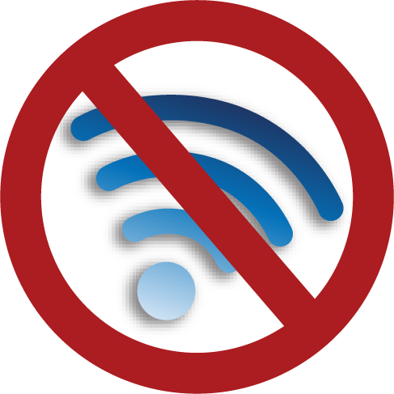
Question
In the last two years, what’s the longest stretch of time you’ve gone without internet?
Vote at http://PollEv.com/justinh
Several Hours
1-2 days
More than 2 days
Several weeks
More than several weeks

Slide 14
Audience Responses
Why no Internet?
Schoolwork (still used Internet)
Vacation in the wild
Rural area
Assignment to go without Internet (roadtrip)
Ran out of data
Layover without free airport internet

Slide 15
Outline
Networks
Growth of the Internet
Sending Information

Slide 16
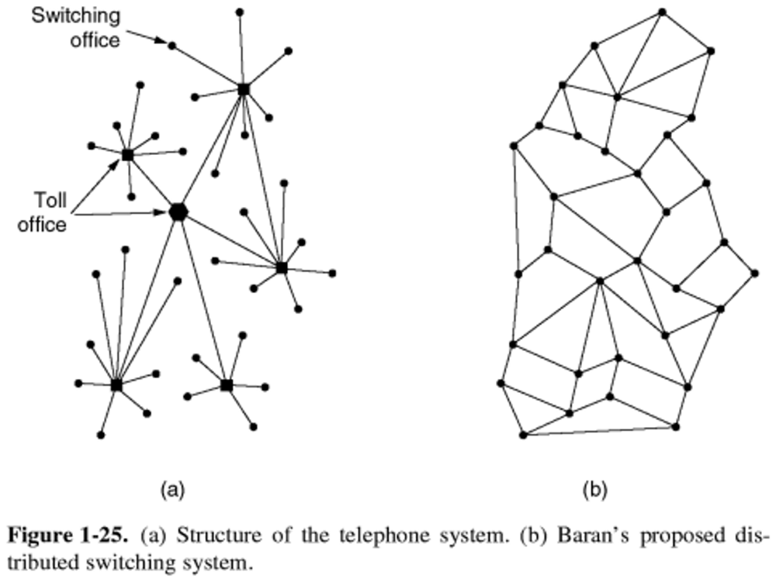
The DoD and Computer Networks
The Department of Defense (DoD) observed that central offices made communication network vulnerable to attack
1950s – The Cold War
Can we build a more robust, decentralized system?
Figure from Computer Networks by Tanenbaum and Wetherall

Slide 17
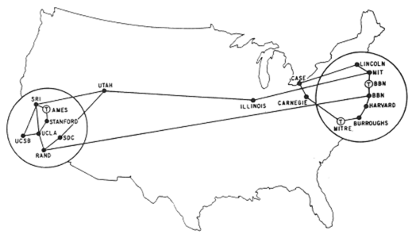
ARPANET
First 4 nodes of ARPANET connected in 1969
Stanford, UC Los Angeles, UC Santa Barbara, Utah
By Sept. 1971, there were 18 nodes across the US
Grew exponentially from there for a long, long time
ARPANET superseded by NSFNET in ‘86, Internet in ‘91

Slide 18
Growth of the Internet
The major point in building networks is agreement
The only way to get seamless integration
Open standards/protocols enabled rapid growth
Internet Engineering Task Force (IETF)
Request for Comments (RFC)
World Wide Web Consortium (W3C)
HTML
International Standards Organization (ISO)
JPEG, MPEG
Institute of Electrical and Electronics Engineers (IEEE)
WiFi

Slide 19
Outline
Networks
Growth of the Internet
Sending Information

Slide 20
Analogy: Mailing a Letter
Want to send a letter to my parents
Write their unique address on the envelope
Stamp it
Drop it in a mailbox
I rely on the abstraction that the US Postal Service will magically deliver the letter to the specified address

Slide 21
What Information?
Remember that all digital information is sent as bits
In order to make sense of anything, must follow communication protocols
Example protocols:
Ethernet
For physical connection in a LAN
TCP/IP
Transmission control protocol and internet protocol
HTTP
Hypertext transfer protocol for web pages

Slide 22
Internet Communication
Break the information into lots of tiny pieces called packets, about 1500 bytes long each
Packets are sent through the network (passing through many different machines) to their destination
The packets are reassembled on the other side
Packets must contain:
Destination address
Sequence/piece number
Content/data
addr | # | data

Slide 23
Internet Communication
Break the information into lots of tiny pieces called packets, about 1500 bytes long each
Packets are sent through the network (passing through many different machines) to their destination
The packets are reassembled on the other side
Advantages:
Packets can take separate routes
Can even originate from different locations
If packet is lost, only have to resend small amount of info

Slide 24
Internet Communication
Break the information into lots of tiny pieces called packets, about 1500 bytes long each
Packets are sent through the network (passing through many different machines) to their destination
The packets are reassembled on the other side
Disadvantages:
Extra transmission data
e.g. same destination address for many packets
Every computer along a packet’s path sees the content of the packet

Slide 25
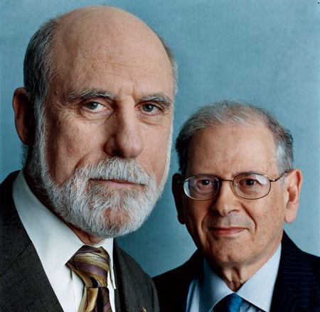
IP Addresses
In 1974, Vint Cerf and Bob Kahn completed the specifications for the Internet Protocol (IP)
Every device given a unique 32-bit address (IP address)
Large entities (e.g. companies, universities) can keep an IP address forever and allocate to physical machines as desired
For home machines, IP address is typically not permanent
Address is used to get information to the right computer on a network
Image: Archeologia Informatica

Slide 26
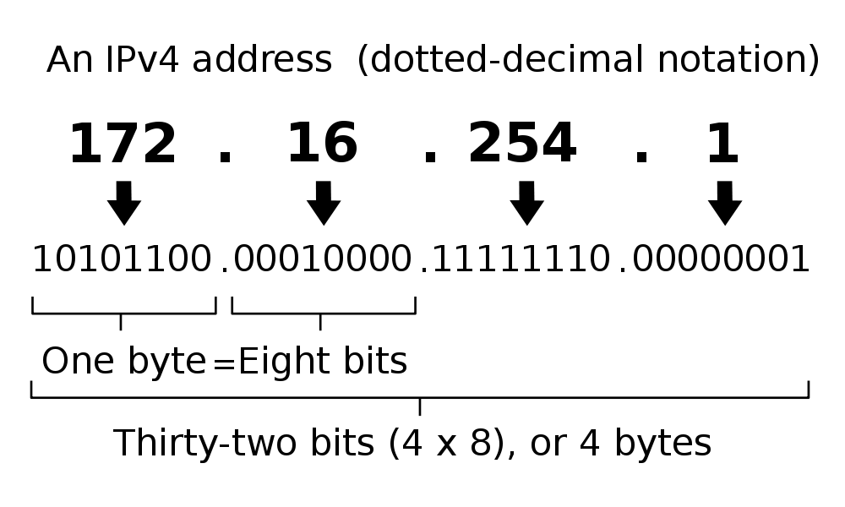
IPv4 Addresses
Broken into four 8-bit chunks, and specified in “dotted-decimal notation”
Split by network and computer: 172.16.254.1
Unlike a phone number, no “area code”

Slide 27
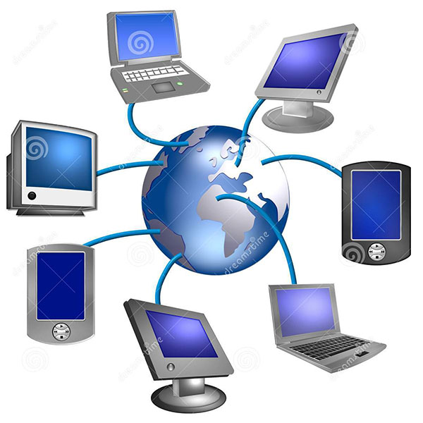
Question
How many internet-capable devices do you own?
Vote at http://PollEv.com/justinh
0
1
2-5
6-9
10+
How many people are there in the world?
How many IPv4 addresses are there (32 bits)?
Image: dreamstime.com
Notes:
2017: The current world population is 7.5 billion as of April 2017 according to the most recent United Nations estimates elaborated by Worldometers
2^32 = 4294967296 ~ 4.3 billion

Slide 28
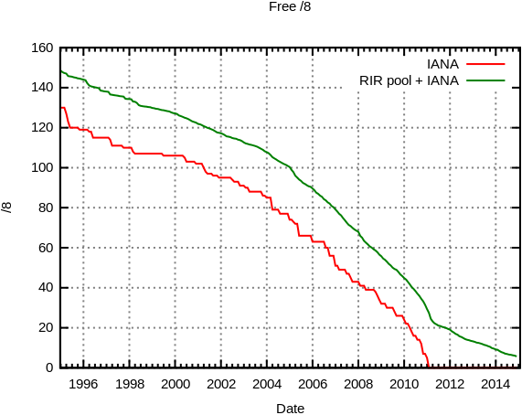
IPv4 Address Exhaustion
Neat video of allocation through the years:
https://www.youtube.com/watch?v=y8WqJum_Gfg
Source: Wikimedia Commons

Slide 29
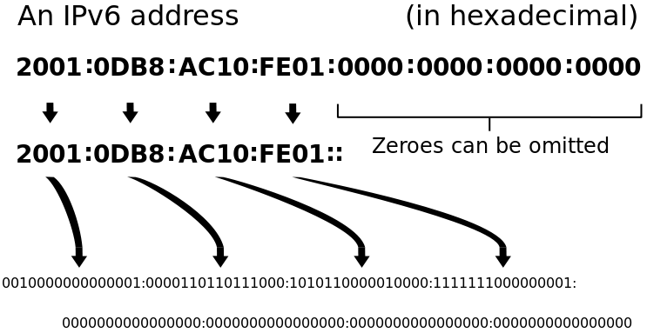
IPv6
2¹²⁸ unique addresses
Issue: adoption still in progress
Which are you? https://www.whatismyip.com
Source: Wikimedia Commons

Slide 30
Domain Name System
Remembering IP addresses would be brutal for humans
Instead we use domain names, which are human-readable and more flexible
e.g. cs.washington.edu instead of 128.208.3.88
Computers find IP address for a domain name from the domain name system (DNS)
Another computer that acts as an IP address book
Your computer does need to know the IP address of the DNS server
DNS is an automatic directory search – it’s huge!

Slide 31
Logical vs. Physical
Humans see the Internet as a logical network: an hierarchy of domains
Computers see the Internet as a physical network: IP addresses that map to computers
The DNS relates the logical network to the physical network by translating domain names to IP addresses
Requesting a web page from the same domain name may get “served” to you from a different IP address each time!
For improved performance, most web content is stored in multiple locations

Slide 32
Discussion (If Time)
The Internet was supposed to bring the world “closer together”
Do you think it has? Why or why not?

Slide 33
Summary
A network is a group of computing devices connected together, either by wire or wirelessly
From very small to very big
The Internet is the largest network of networks
The Internet grew rapidly and has become increasingly omnipresent
Highly fault-tolerant due to decentralization
Growth aided by open standards
Data is passed between computing devices in small pieces called packets
The domain name system translates from domain names to IP addresses in order to reach a specific device

