Slide 1
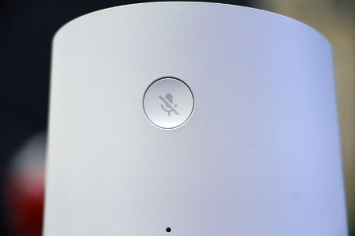
Algorithms CSE 120 Spring 2017
Instructor: Teaching Assistants:
Justin Hsia Anupam Gupta, Braydon Hall, Eugene Oh, Savanna Yee
Don’t run commercials designed to trigger smart assistants
A well-known fast food chain – let’s call them Kurger Bing – is debuting a new 15 second ad today set to start running nationally. [Some dude] explains that he doesn’t have the time to fully explain an iconic hamburger to you.
He’s going to use your smart home assistant. Google Home, in this case. “OK Google,” he addresses the camera, asking a question designed to trigger devices across the country, reading the first few sentences of the foodstuff’s Wikipedia entry.
The ad is an inevitability. Someone was bound to get there, and the folks at Kurger Bing beat everyone to the punch. For the company, it’s a way to extend advertising beyond the screen.
https://techcrunch.com/2017/04/12/no-thank-you/

Slide 2
Administrivia
Assignments:
Jumping Monster due Saturday (4/15)
Mice and Predator due Sunday (4/16)
Creativity Planning due Tuesday (4/18)
Find a partner, come up with two proposed programs

Slide 3
Outline
Algorithms
Examples of Algorithms
Specifying Algorithms

Slide 4
Definition
An algorithm is “any well-defined computational procedure that takes some value, or set of values, as input and produces some value, or set of values, as output.” “An algorithm is thus a sequence of computational steps that transform the input into the output.”
From textbook Introduction to Algorithms (link)
Algorithm
(well-defined computational procedure)
Inputs
Outputs

Slide 5
Computational Problems
Can think of an algorithm as a tool for solving a computational problem
The problem statement specifies desired input/output (I/O) relationship
The algorithm describes a specific computational procedure that gives you the desired input/output (I/O) relationship
Example: Sorting is a computational problem
Problem statement: Given a sequence of numbers, put them in order
Example I/O: [1, 9, 3, 6, 2] $→$ [1, 2, 3, 6, 9]

Slide 6
Early Algorithms
The concept of algorithms pre-dates computers
Dances, ceremonies, recipes, and building instructions are all conceptually similar to algorithms
Mathematical algorithms go way back:
Babylonians defined many fundamental procedures ~3600 years ago, more formal algorithms in Ancient Greece
Al-Khwarizmi laid out many algorithms for computation using decimal numbers
You implicitly use hundreds of numerical algorithms!
Nature runs algorithms (e.g. genes and development)

Slide 7
Properties of Algorithms
Algorithms can be combined to make new algorithms
It helps to know standard algorithms
Building from correct algorithms helps ensure correctness
There are many algorithms to solve the same computational problem
Developing a new algorithm to solve a problem can lead to insight about the problem
Example: 3SUM – Given a list of $n$ real numbers, are there three numbers in the list that sum to zero? New algorithm in 2014 broke supposed speed barrier

Slide 8
Outline
Algorithms
Examples of Algorithms
Specifying Algorithms

Slide 9
Algorithms You’ve Seen
Draw a square using lines
Make a character move into place on the screen
Make a multi-colored grid of animals
… and many more!

Slide 10
An Algorithm You’ve Seen Before
Multiplying two numbers:
Another multiplication algorithm?
Common core “box” method:
2
23
x 7
161
20 + 3_
7
140
21
140+21=161

Slide 11
Algorithm Demo Time
I need 10 brave(?) volunteers to join me at the front of the class!
7 of you are numbers (grab a sheet of paper)
3 of you will represent algorithms

Slide 12
1) Find the Smallest Number in a List
Input: 6 numbers in a given order
Output: The index of the smallest number
Example: {6, 3, 5, 1, 2, 4} would output 4, since the smallest number is in the 4th position
Algorithm:
Write the index 1 on the board (smallest so far)
Check each person 1-by-1; if number is smaller, then write the number on the board and update the index

Slide 13
2) Search an Unordered List
Input: 6 numbers in a given order, desired number
Output: Yes/True if desired number is in the list, No/False otherwise
Algorithm:
Check each index starting from 1 for desired number
If equal, report True
If not equal, move on (don’t report)
If done with numbers, then report False

Slide 14
3) Sort an Unordered List
Input: 6 numbers in a given order
Output: The same list, but now in numerical order
Example: {6, 3, 5, 1, 2, 4} would output {1, 2, 3, 4, 5, 6}
Algorithm:
Find the smallest number (algorithm 1) and move to the front of the list
Repeat this entire procedure, but for the rest of the list (recursion!)
This algorithm is called Selection Sort

Slide 15
4) Find Median of a List
Note: This is an actual job interview question!
Problem: Given a list of numbers (odd length, no repeats), return the median
Example: {9, 2, 1, 6, 3, 4, 7} would output 4
Algorithm:
Sort the list (algorithm 3)
Take the number in the middle index (N+1)/2

Slide 16
End of Demo
Round of applause for our volunteers!

Slide 17
More Famous Algorithms
PageRank algorithm
Google’s measure of the “reputation” of web pages
EdgeRank algorithm
Facebook’s method for determining what to show on your News Feed
Luhn algorithm
Credit card number validation
Deflate
Lossless data compression
RSA Encryption
Encrypt (secure) data for transmission

Slide 18
Outline
Algorithms
Examples of Algorithms
Specifying Algorithms

Slide 19
Be Specific!
A programmer’s spouse says, “Run to the store and pick up a loaf of break. If there have eggs, get a dozen.”
What happens?
The programmer comes home with 12 loaves of bread!
Algorithms need to be expressed in an unambiguous way for all participants

Slide 20
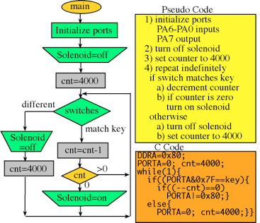
Ways to Express Algorithms
Many ways to specify an algorithm:
Natural Language (e.g. English, 中國) or Pseudocode
Easy for humans to understand, but can be ambiguous or vague
Visual and text-based programming languages (e.g. Scratch, Processing)
Have an exact meaning with no ambiguity
Can be run on a computer
Other information-conveying ways
e.g. flowcharts or pictures

Slide 21
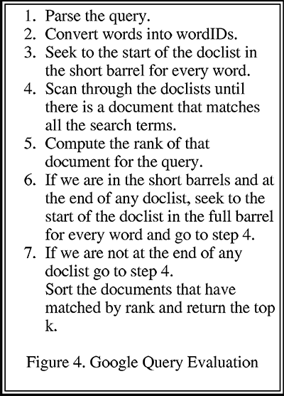
Google Query
From Larry Page and Sergey Brin’s research paper The Anatomy of a Large-Scale Hypertextual Web Search Engine

Slide 22
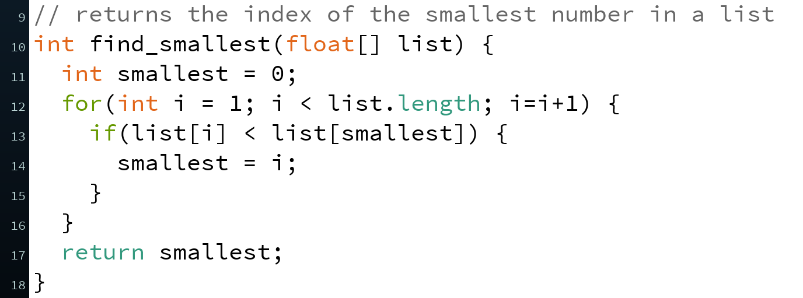
Implementations
If we specify an algorithm using code in a programming language, we say that the code implements the algorithm
A function or program that can be run on a computer
Example: Find index of smallest in list
Algorithm 1 of demo
Pseudocode/natural language
Function in Processing
Implementation

Slide 23
Which Language to Use?
Different languages are better suited for expressing different algorithms
Some languages are designed for specific domains, and are better for expressing algorithms in those domains
e.g. Unix shell scripts, SQL, HTML
Language choice can affect things like efficiency, portability, clarity, or readability
Clarity and readability are VERY important considerations
Doesn’t affect existence of algorithmic solution

Slide 24
Programming Languages
Programming language sweet spots:
C/C++ Code that is close to the hardware
Java/C# Portable code
Python Fast to write
Javascript Great for running in web browsers
Processing Great with visuals and interaction
Most programming languages can implement (almost) ANY algorithm
Equally “powerful”

Slide 25
Peer Instruction Question
I hand you a cooking recipe with no name – is this equivalent to a computational problem, algorithm, or implementation?
What can and can’t I do with just the recipe?
Vote at http://PollEv.com/justinh
Computational Problem
Algorithm
Implementation

Slide 26
Summary
A computational problem is a problem statement with desired I/O relationship
An algorithm describes a computational procedure that satisfies/solves a computational problem
An implementation is an algorithm written out in a programming language (unambiguous, executable)
Properties of algorithms:
Can be combined to make new algorithms
Knowledge of existing algorithms & correctness help
There are many algorithms to solve the same computational problem

Slide 27
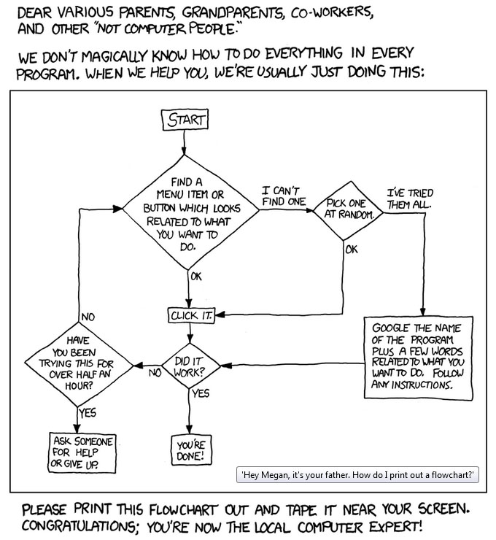
Summary
https://xkcd.com/627/
“alt” text

