Slide 1
The Most Useful Lecture In The History Of The Universe
Rick Chen

Slide 2
Not for credit seekers
Will not show up on test/exams
1 or 2 questions maybe
If you are here for “points” sorry!

Slide 3
Then who is it for ?
For people that want to learn useful tips and tricks that will will make your work faster, easier to do!
Mostly PC stuff, some cross-platform. I tried !
You may actually have some fun with it… (OMG)
Tried to make this lecture fun and learning filled.

Slide 4
About me
Human Computer Interaction student
Interested in web design/coding/graphics
Also Manchester United and Fifa 09 Xbox Live
CLUE Tutor for this particular class.
WED night at 6:30 – 8:00 Bring your friends.
It’s really really really really fun
Sorry for the Ugly slides…they are really ugly.
Really.

Slide 5
1. MICROSOFT WORD IMAGES
Perhaps the most difficult thing to do in the entire Universe.
Most Phd’s cannot do this.
No sources on that.

Slide 6
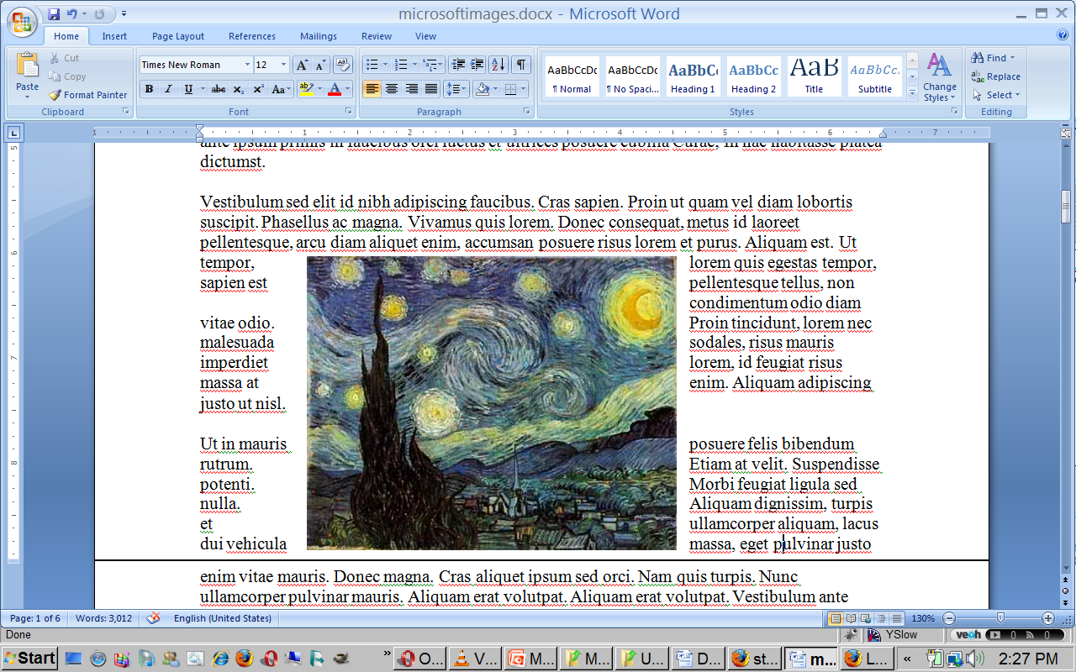
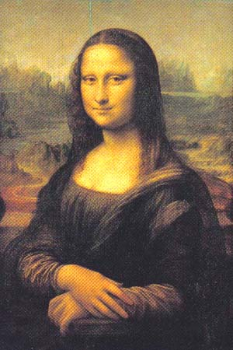
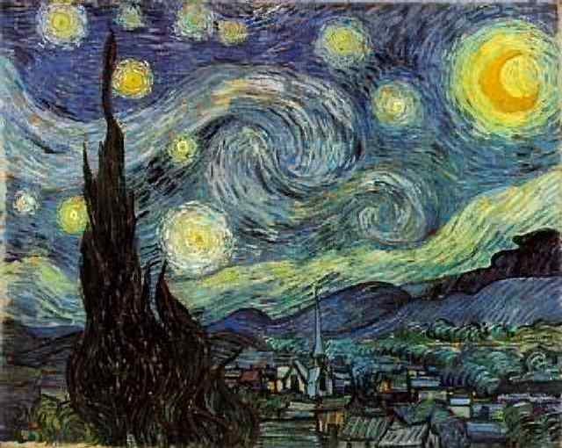
The ART of MICROSOFT WORD IMAGE PLACEMENT

Slide 7
2. MYUW LOGIN
Three words: WTF.

Slide 8
The super frustrating myuw login
MyUW is one of the most confusing/difficult to use UI’s in the History of the Universe.
One problem I have gotten 2384328559832789327583298327532 times.
The myuw screen is logged in as someone else and I can’t change the uw netID and log into my own account no matter what I do!!!!!!!!

Slide 9
Two Solutions
Clear cache…
or do better….
?user=youruwnetid

Slide 10
What do you mean Rick?
Log out of previous user
Close browser, restart
STILL THE SAME NAME!!!
Could clear cache(ctrlshiftdelete in firefox)… but what if you want to keep everything else.
?user=chenr
Myuw->login->voila!

Slide 11
3. BECOME A GOOGLE Gangsta

Slide 12
Google?
Who here knows how to use Google?
No,no,no.. ACTUALLY knows how to use Google…

Slide 13
Google Calculator
+ – * / basic arithmetic
12 + 34 - 56 * 7 / 8
convert units 300 Euros in USD, 130 lbs in kg, or 31 in hex

Slide 14
Google == Own the world
More powerful than most people think
Advanced Search Queries:
Intitle:
Inurl:
Site:
filetype:
Link:
Related:
Cache:
Intext:
phonebook:
What do all these silly things mean?

Slide 15
DEFINE:
Ever google a word for definition?
Not what your looking for?
USE DEFINE, SUCKAS : )
Let’s use the term “ubiquity”!

Slide 16
FILETYPE:
Doing research on a topic?
Need papers, or maybe you want to go over someone else’s slides.
Let’s try “cancer research” pdf’s, doc’s and powerpoints… Shall we!

Slide 17
PHONEBOOK:
Love/Hate Google
LESSON TO BE LEARNED: GOOGLE IS CREEPY!!!
Unlist yourself, do something, make a move!
Let’s play with phonebook: name + city
Phonebook: phonenum

Slide 18
For all those overachievers
http://www.googleguide.com/advanced_operators_reference.html
FUN, Exciting, GOOD FOR DATES!!!!
OMG, You are so good at google!
I know baby!

Slide 19
Wealth of “stuff”
Google is simply a huge resource too much to cover. They have super CSE computer dudes working on their stuff FULL-TIME. PRODUCTS MUST BE GOOD, SHOULD USE THEM!!!!
Or.. Yahoo..or msn.. Or become a genius make your own.
Google:Google groups, iGoogle,

Slide 20
4. Become a Firefox SUPERSTAR

Slide 21
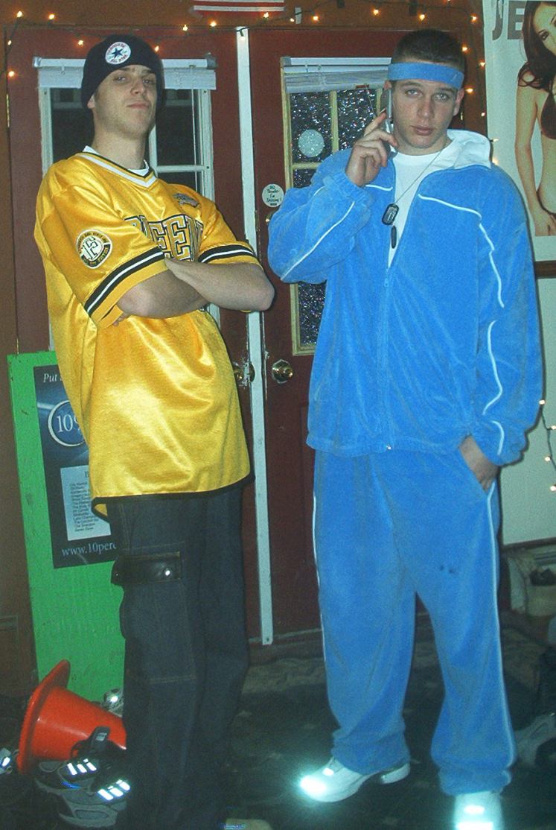
If you don’t have firefox… get it!
More secure
Renders correctly
User friendly
Renders Documents well!

Slide 22
Super faster fox!
Ever use the same resources over and over again?
Personally, youtube, dictionary.com, thesaurus.com, wikipedia, google etc….
Let’s keep it real with firefox.

Slide 23
Add Keyword for this search…
Right-click the box!
Add Keyword to this search!
Name= “whatever”
Keyword= The keyword you want to use for this input box!
Let’s try it out for thesaurus.com!

Slide 24
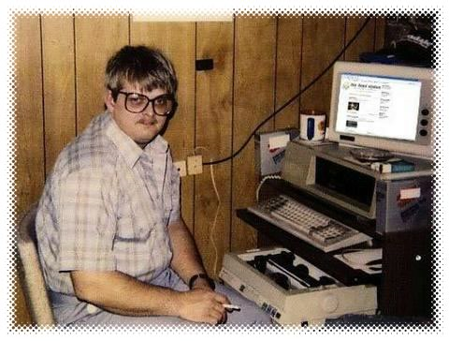
Well, Rick that was cool but…
Why don’t I just go to thesaurus.com, You suck!
Let’s think for a minute or two ..how do we make this faster and better for the user?
Think like a computer!

Slide 25
Sorry, Rick you were right, you rock!
Let’s try it again, but let’s be more computer like.
Right-click the box!
Add Keyword to this search!
Name= “whatever”
Keyword= a one letter representation of the input
Let’s try it with dictionary.com

Slide 26
Interesting applications/resources to help you get more awesome.
These following applications and tools have helped me out throughout my college career and hopefully will also help you guys now and in the future!!!!!
1 ………….. 2………………3………………… GO

Slide 27
Flashcarddb.com
Coolest thing ever?
Can make online sharable flash cards.
Useful for memorizing lots and lots of information…
BEST FEATURE == saved card sets? What’s that?

Slide 28
http://rocketdock.com/
Get RocketDock and be like me! I mean mac…
Customizable. Recognition Rather then recall.
Quick access to your applications
It also looks really cool!

Slide 29
OPEN SOURCE…
Is your best friend. Open source = “free”
Microsoft, Mac, adobe are all absolutely fantastic. Brilliant minds and ideas…
ANY computer product that you can think of there is a open source version, works “just as well”
Buggy, non-compatible sometimes.

Slide 30
Couple of examples
Ever wanna create cool pictures?
“Photoshop”- try gimpshop or paint.net first.
http://www.gimpshop.com/
http://www.paint.net/
Before you drop $$$ on adobe.
Open Office
http://www.openoffice.org/
Office suite, but free : )
If you have an old computer I would recommend this!

Slide 31
YOU CAN DO ANYTHING YOU WANT WHEN YOU GROW UP!
http://www.fas.harvard.edu/~cscie1/
Watch Lectures: YOU WILL LEARN A LOT.
http://webcast.berkeley.edu/courses.php
Let’s check out what other universities are doing... Let’s also check out a class that isn’t in our major…

Slide 32
OMG RICK!! That was the most useful lecture in the history of the universe!
The end of the most useful lecture in the history of the universe, good luck with the rest of your quarter and have fun playing around with some of the tips and tricks you have learned today. ANY QUESTIONS??????????
rickchendesign@gmail.com
Facebook == rick chen

